Slide 1
R Short Course Part 2 Topic1: Regression models including linear regression and nonlinear model
Chao Xu, PhD
Department of Biostatistics and Epidemiology
Hudson College of Public Health, OUHSC
February 26, 2021

Slide 2
Outline
Prerequisites
Basic R programming
Regression model
Linear regression
Nonlinear regression

Slide 3
Linear Regression
Continuous outcome
$Y=β_{0}+Xβ+ε$
$ε\sim N(0,σ^{2})$
$Y|X\sim N(β_{0}+Xβ,σ^{2})$
Variable of interest
${\hat{β}}_{0}$, $\hat{β}$, confidence intervals (CI), and p-value
Fit statistics: $R^{2}$

Slide 4
Linear Regression
Mostly used command
lm()
$$lm(outcome\sim predictors, […])$$
[…]: optional arguments
data = your.data
subset = gender==“Female”
Other advanced functions

Slide 5
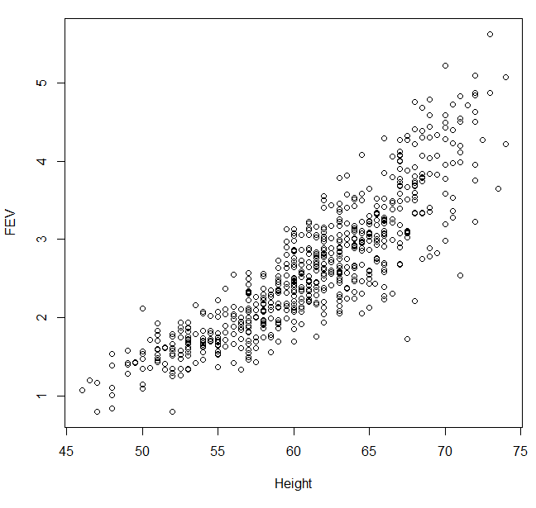
Linear Regression
Example – FEV and Height
Forced expiratory volume (FEV): an index of pulmonary function that measures the volume of air expelled after 1 second of constant effort

Slide 6
Linear Regression
Data

Slide 7
Linear Regression
Data

Slide 8
Linear Regression
lm()
> fit.lm=lm(dr$FEV~dr$Height)
> fit.lm
Call:
lm(formula = FEV ~ Height, data = dr)
Coefficients:
(Intercept) Height
-5.3432 0.1304

Slide 9
Linear Regression
lm()
> fit.lm=lm(FEV~Height,data=dr)
> fit.lm
Call:
lm(formula = FEV ~ Height, data = dr)
Coefficients:
(Intercept) Height
-5.3432 0.1304

Slide 10
Linear Regression
Extract estimates

Slide 11
Linear Regression
Extract CI: confint()

Slide 12

Linear Regression
P-values and $R^{2}$

Slide 13
Linear Regression
P-values and $R^{2}$

Slide 14
Linear Regression
P-values and $R^{2}$

Slide 15
Linear Regression
Subset: male subjects

Slide 16
Linear Regression
Subset: age<7

Slide 17
Linear Regression
Model diagnostic: plot(fit.lm)
$ε\sim N\left(0,σ^{2}\right), Y|X\sim N(β_{0}+Xβ,σ^{2})$

Slide 18
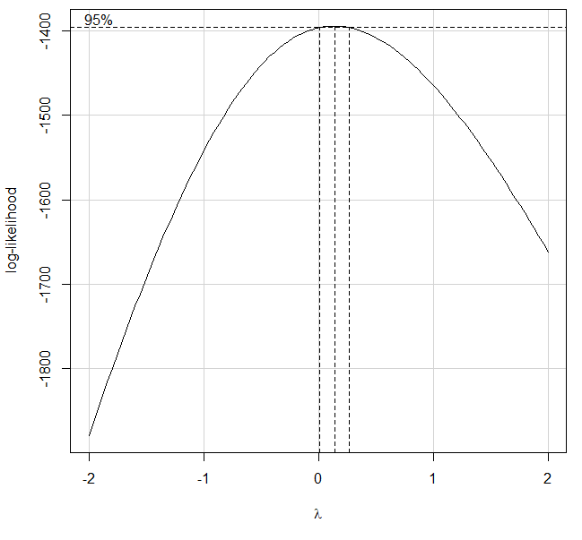
Linear Regression
Model diagnostic
Box-Cox Transformations For Linear Models
library(car)

Slide 19
Linear Regression
Model diagnostic
Box-Cox Transformations For Linear Models
$Y^{∗}=\frac{Y^{λ}−1}{λ}$

Slide 20
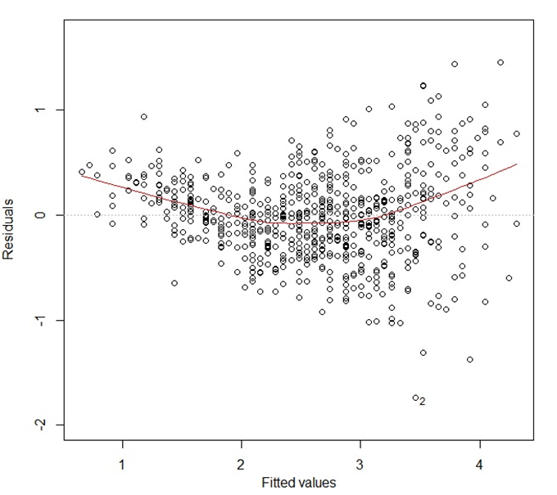
Linear Regression
Model diagnostic: plot(fit.lm)
homogeneity of variance: the variance of the dependent variable are the same for different subpopulation

Slide 21
Linear Regression
Model diagnostic
homogeneity of variance: the variance of the dependent variable are the same for different subpopulation
Score Test For Non-Constant Error Variance

Slide 22
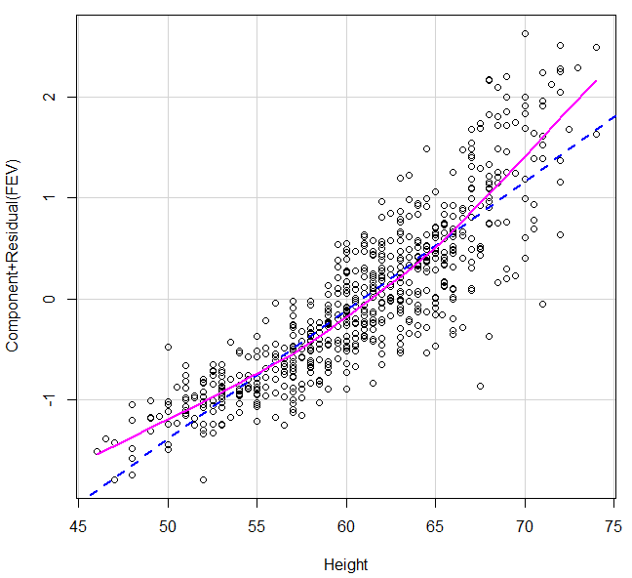
Linear Regression
Model diagnostic:
the means of the subpopulation of dependent values lies on a straight line
library(car)
crPlots(fit.lm)

Slide 23
Linear Regression
Model diagnostic:
the dependent values are independent of each other
Durbin-Watson Test computes residual autocorrelations and generalized Durbin-Watson statistics and their bootstrapped p-values

Slide 24
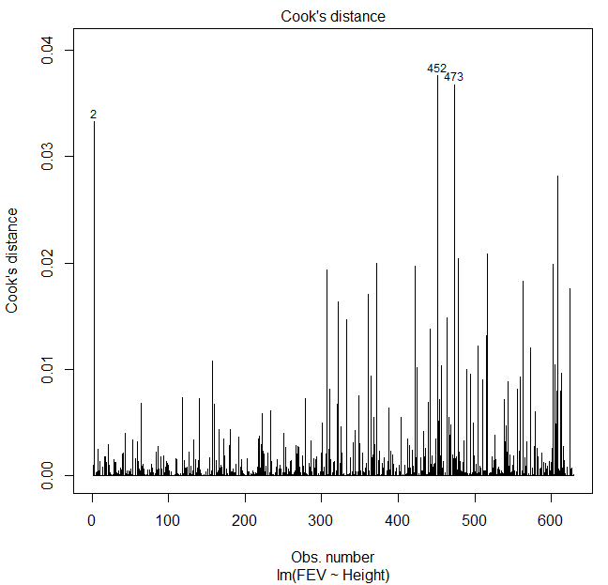
Linear Regression
Influential points
Cook’s distance

Slide 25
Linear Regression
Multivariate model
Univariate analysis
 | p-value | Adjusted R-squared
Height | <2.2e-16 | 0.7602
Age | <2.2e-16 | 0.5676
Gender | 1.96E-07 | 0.03935
Smoke | 4.61E-11 | 0.06311

Slide 26
Linear Regression
Multivariate model

Slide 27
Linear Regression
Multivariate model

Slide 28
Linear Regression
Variable/feature selection
Forward/Backward/Stepwise regression analysis
step(): AIC or BIC

Slide 29
Linear Regression
Variable/feature selection
Forward/Backward/Stepwise regression analysis
step(): AIC or BIC

Slide 30
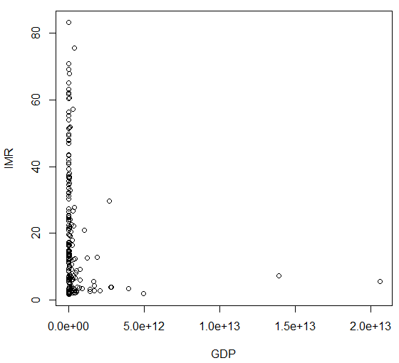
Nonlinear regression
Infant Mortality Rate vs Gross Domestic Product
Quadratic model
LOESS: LOcal regrESSion
https://databank.worldbank.org/reports.aspx?source=2&series=SP.DYN.IMRT.IN&country=

Slide 31
Nonlinear regression
IMR vs GDP
World Bank data of 2018, n = 187 countries

Slide 32
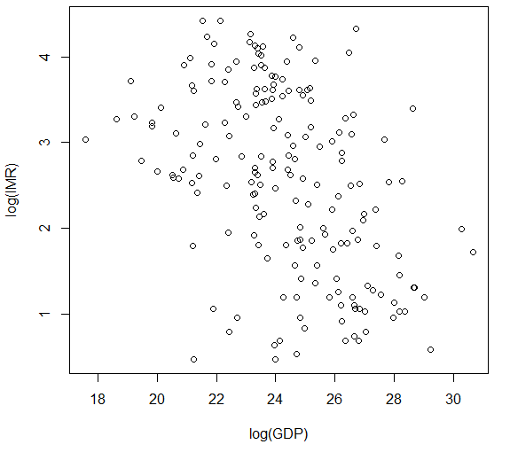
Nonlinear regression
IMR vs GDP

Slide 33
Nonlinear regression
Quadratic model

Slide 34
Nonlinear regression
Quadratic model

Slide 35
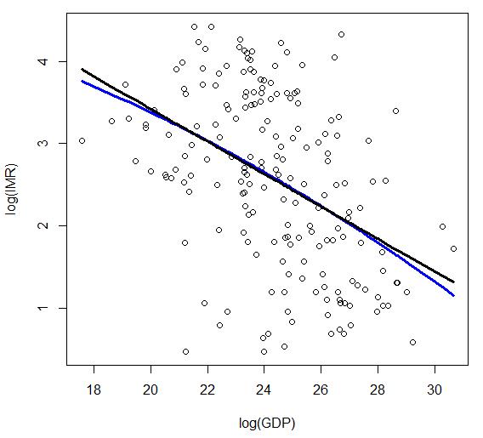
Nonlinear regression
Quadratic model

Slide 36
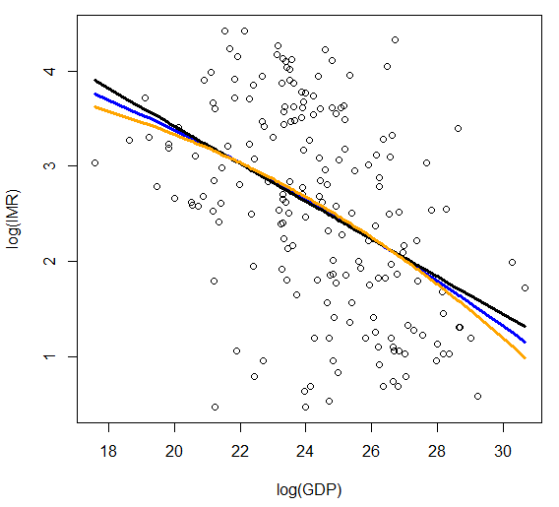
Nonlinear regression
Quadratic model

Slide 37
Nonlinear regression
loess()

Slide 38
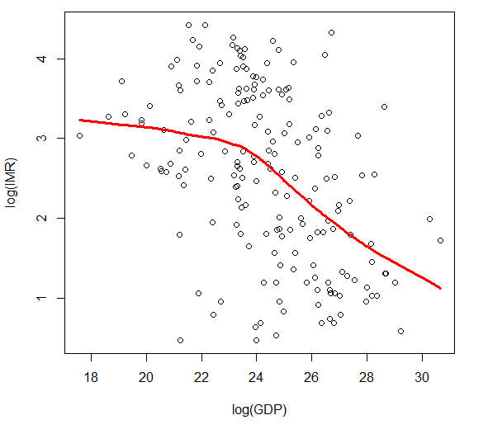
Nonlinear regression
loess()

Slide 39
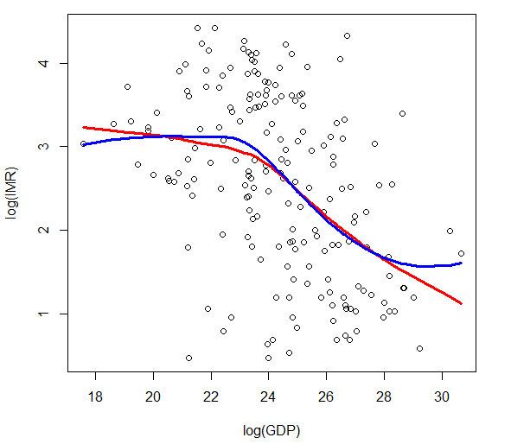
Nonlinear regression
loess()

