Slide 1

R Short Course Part 2
Topic2: Generalized linear model
Chao Xu, PhD
Department of Biostatistics and Epidemiology
Hudson College of Public Health, OUHSC
March 3, 2021

Slide 2
Outline
Prerequisites
  Frequency data analysis
Logistic regression
Poisson regression
Negative binomial regression

Slide 3
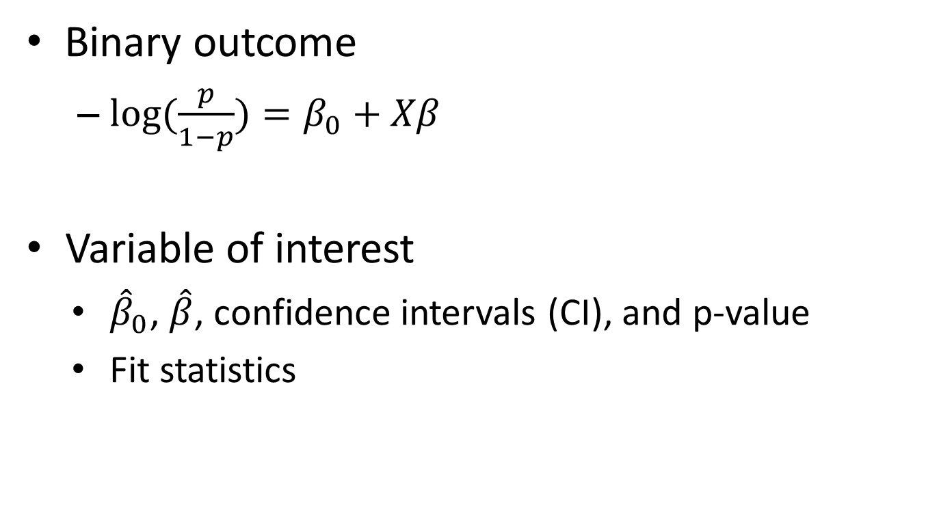
Logistic Regression
Binary outcome
  $log⁡(\frac{p}{1−p})=β_{0}+Xβ$
  Variable of interest
    ${\hat{β}}_{0}$, $\hat{β}$, confidence intervals (CI), and p-value
    Fit statistics

Slide 4
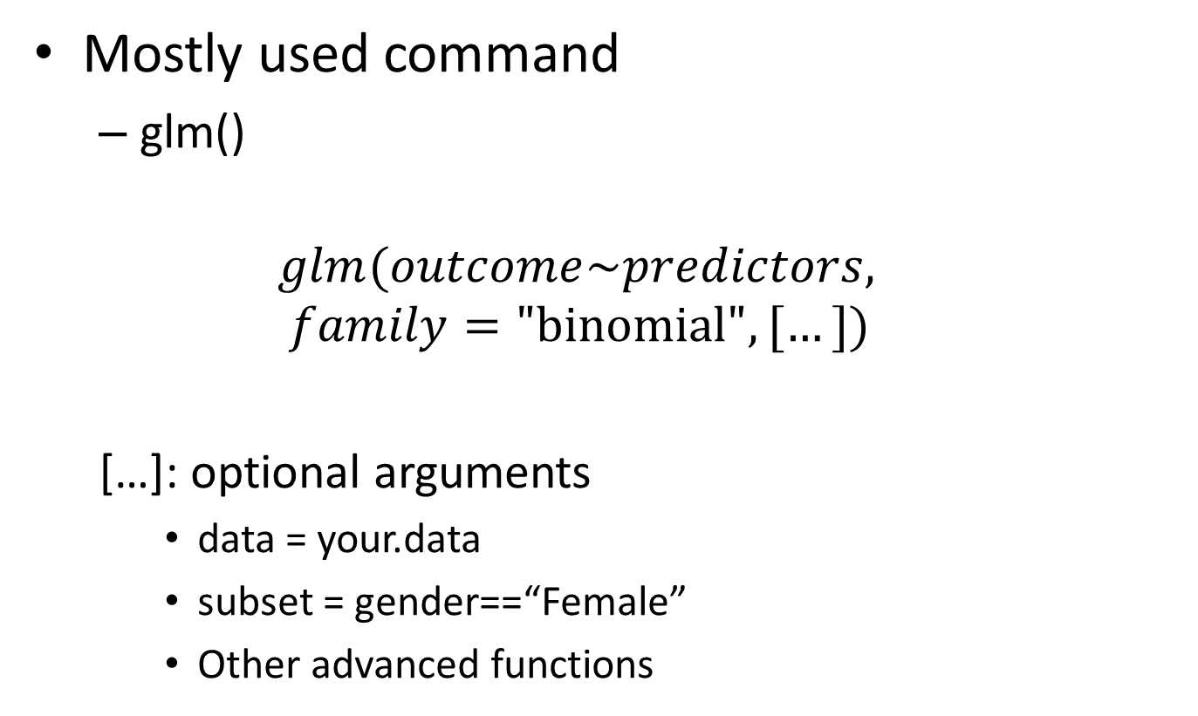
Logistic Regression
Mostly used command
  glm()
  $$glm(outcome\sim predictors, family=\text{"}\text{binomial}\text{"}, […])$$
  […]: optional arguments
    data = your.data
    subset = gender==“Female”
    Other advanced functions

Slide 5
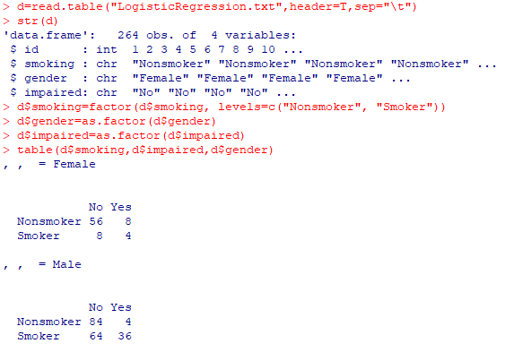
Logistic Regression
Example – Impairment due to asthma
  Risk factors: gender and smoking status

Slide 6
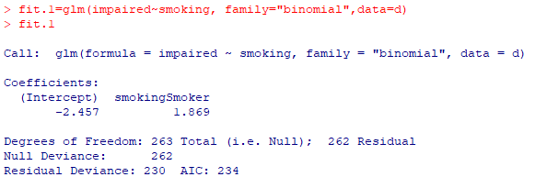
Logistic Regression
glm()

Slide 7
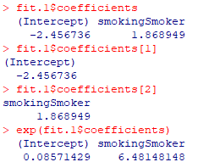

Logistic Regression
Extract estimates, odds, and odds ratio (OR)
Odds of impaired in nonsmokers: 12/140=0.0857
Odds of impaired in smokers: 42/72=0.5556
OR smokers vs nonsmokers= 0.5556/0.0857=6.48

Slide 8
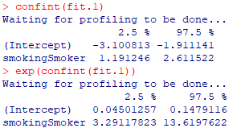
Logistic Regression
Extract CI of estimate and Odds: confint()

Slide 9

Logistic Regression
Extract OR
or_glm(data, model, incr = list(continuous_variable = increase_unit), ci = 0.95)

Slide 10
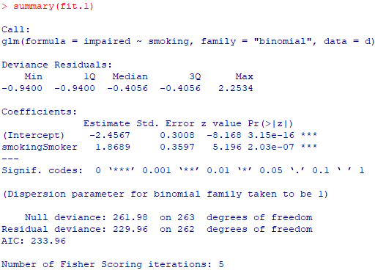
Logistic Regression
P-values

Slide 11

Logistic Regression
P-values

Slide 12
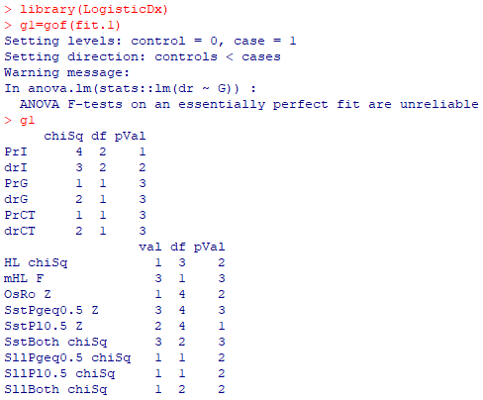
Logistic Regression
Model fit diagnostic

Slide 13
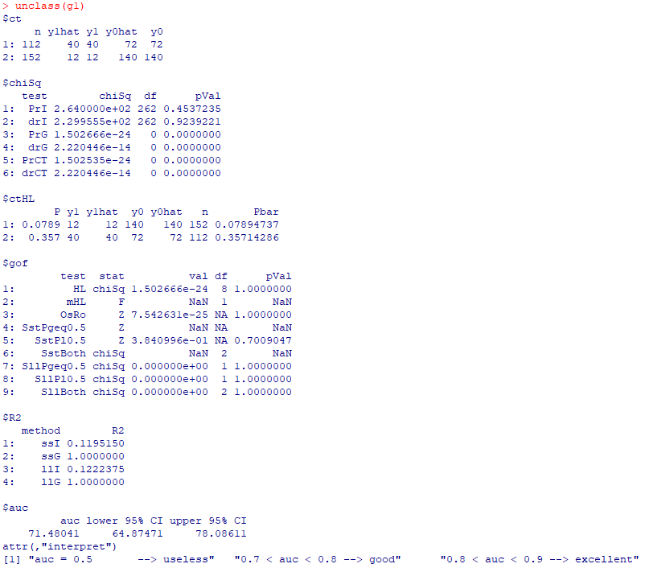
Logistic Regression
Model fit diagnostic

Slide 14
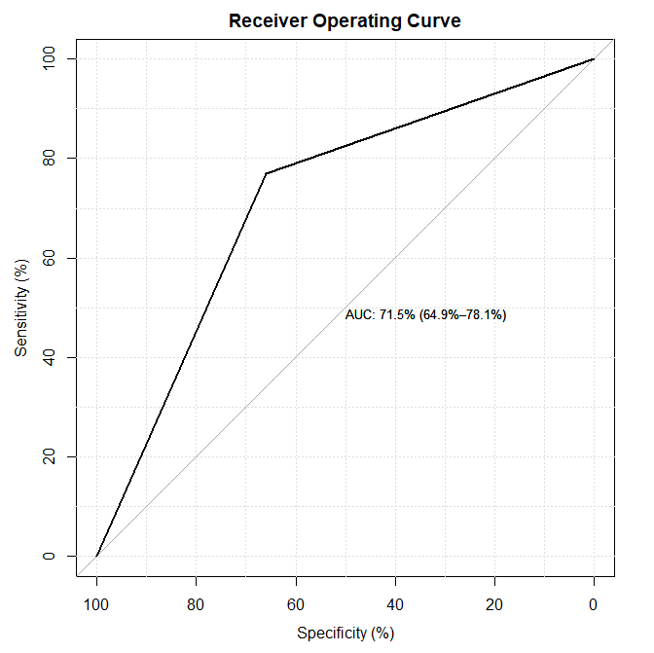
Logistic Regression
Model fit diagnostic

Slide 15
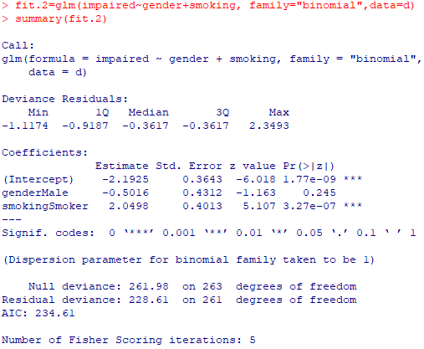
Logistic Regression
Multivariate model

Slide 16

Logistic Regression
Multivariate model

Slide 17
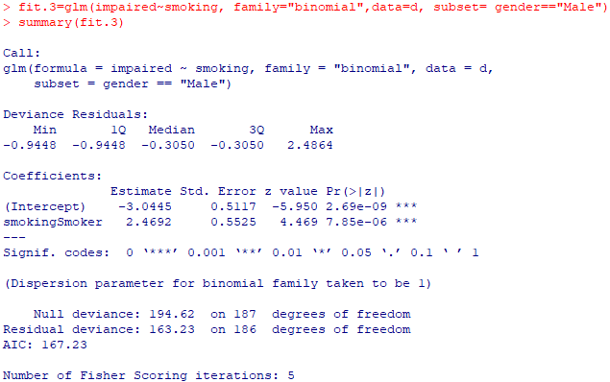
Logistic Regression
Subset: male subjects

Slide 18
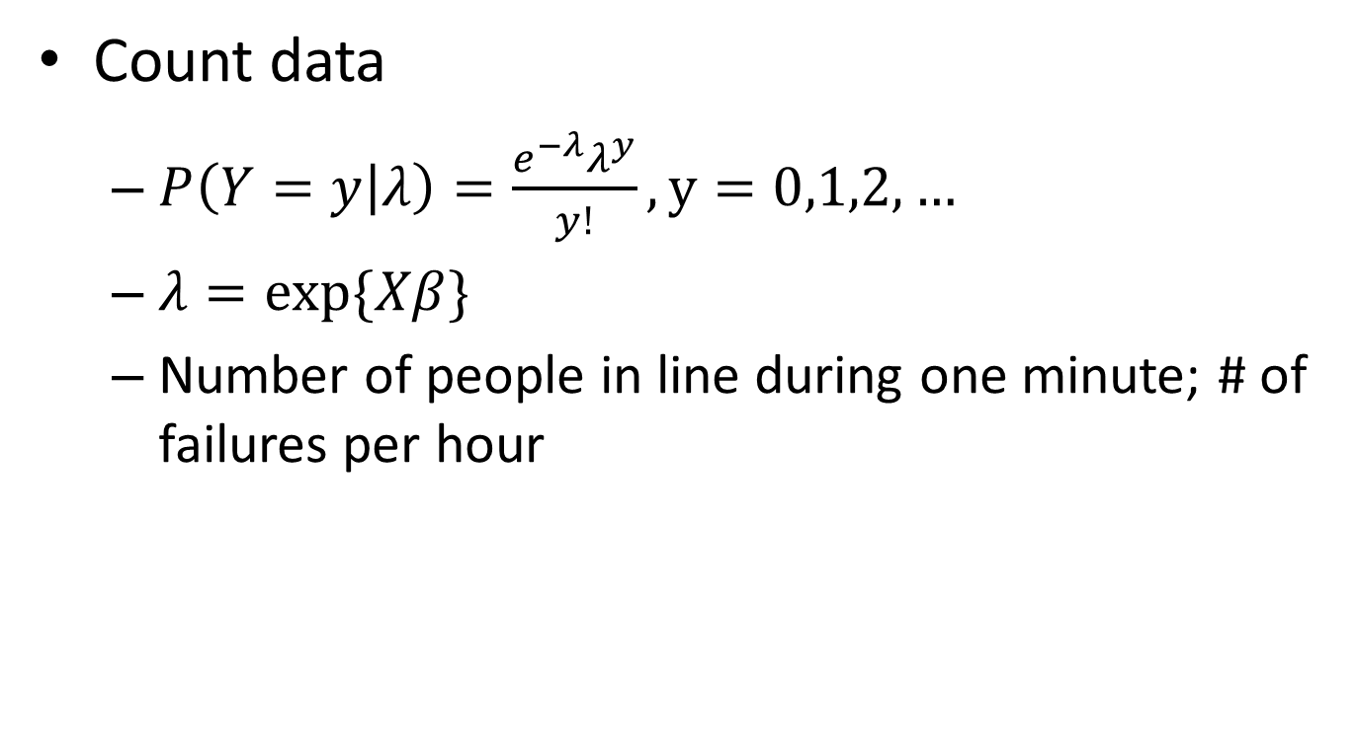
Poisson Regression
Count data
  $P\left(Y=y | λ\right)=\frac{e^{−λ}λ^{y}}{y!}, y=0,1,2,…$
  $λ=exp⁡\{Xβ\}$
  Number of people in line during one minute; # of failures per hour

Slide 19
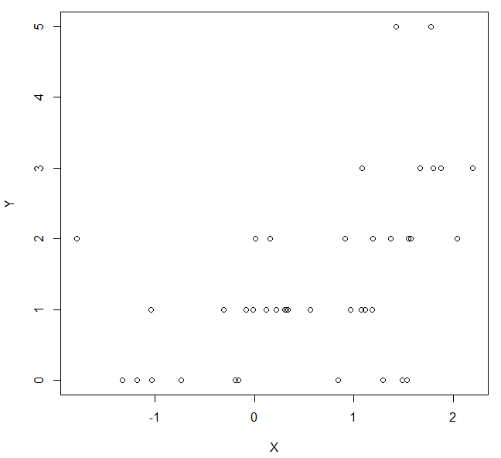

Poisson Regression
Count data
  $λ=\exp\left\{Xβ\right\}=exp⁡(0.2+0.5X)$

Slide 20
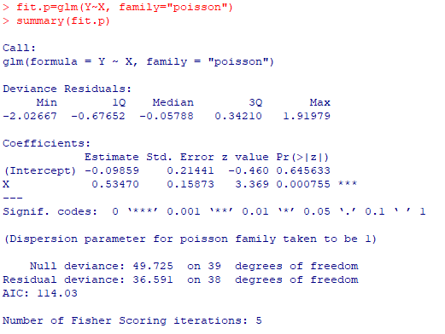
Poisson Regression
glm()

Slide 21

Poisson Regression
Deviance goodness of fit

Slide 22
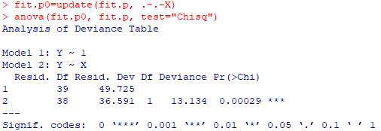
Poisson Regression
Improvement test

Slide 23

Negative Binomial Regression
Overdispersion in Poisson regression
  Variance > mean
  $Y\sim NB\left(μ,k\right)$
  $var\left(Y\right)=r\frac{1−p}{p^{2}}=$ $μ\frac{1}{p}=μ+\frac{μ^{2}}{k}$

Slide 24
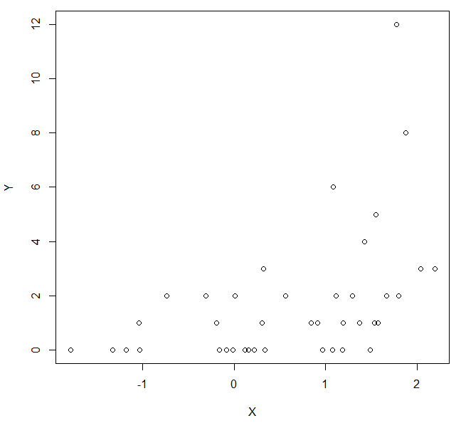
Negative Binomial Regression
Overdispersion in Poisson regression
  K=2

Slide 25
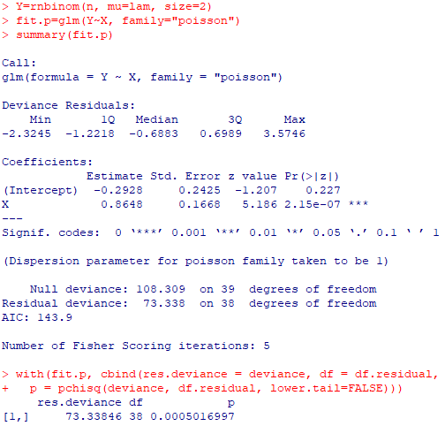
Negative Binomial Regression
Overdispersion in Poisson regression
  K=2

Slide 26
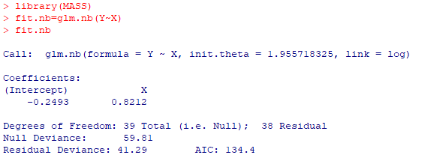
Negative Binomial Regression
glm.nb()

Slide 27
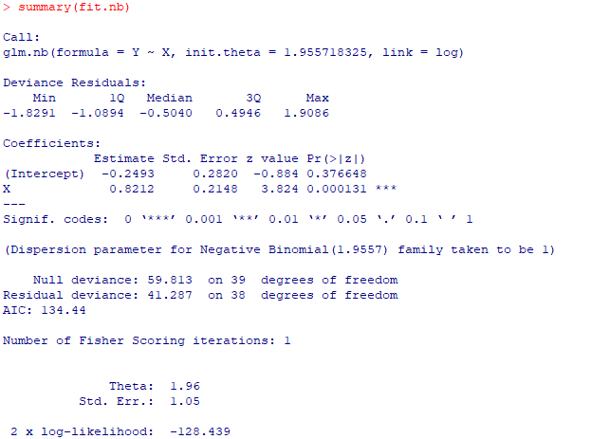
Negative Binomial Regression
glm.nb()

Slide 28
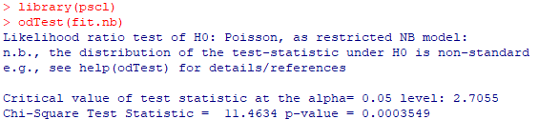
Negative Binomial Regression
odTest
  Compares the log-likelihoods of a negative binomial regression model and a Poisson regression model

Slide 29
Stepwise selection
step()
  same syntax/language as in linear regression
> fit.null=glm(sat~1, data=d, family=poisson)
> fit.full=glm(sat~weight+width+color+spine, data=d, family=poisson)
##stepwise BIC, k=log(n)
res=step(fit.null, scope=list(lower=fit.null, upper=fit.full), direction="both", k=log(173))
##stepwise AIC, k=2
> res=step(fit.null, scope=list(lower=fit.null, upper=fit.full), direction="both", k=2)

