Slide 1

R Short Course Part 2
Topic 4: Nonparametric statistics
Kai Ding, PhD
Department of Biostatistics and Epidemiology
Hudson College of Public Health, OUHSC
March 10, 2021

Slide 2
Outline
Inference for a binomial proportion
Inference for a median
Wilcoxon signed-rank test for paired data
Wilcoxon rank-sum test for two independent samples
Kruskal-Wallis test for k (k > 2) independent samples
  Dwass, Steel, Critchlow, and Fligner multiple comparison procedure
Spearman correlation coefficient
Kaplan-Meier curve and log-rank test for right-censored data

Slide 3
Inference for a binomial proportion (p)
Suppose we observe the outcomes of n independent Bernoulli trials (success/failure). Probability of success in each trial is p
X: number of successes out of the n trials
Hypothesis testing: H₀: p = p₀ vs. H_{a}: p ≠ p₀
  Pre-specified value p₀
Confidence interval: Wilson CI, Laplace Wald CI (labeled as “asymptotic” in R), Agresti-Coull CI, Clopper-Pearson CI (labeled as “exact” in R) etc.

Slide 4
Example
Drug developers wish to study the response rate p of a new drug.
This drug was tested on 7 patients and 6 patients responded.
Suppose there is a standard drug currently being used with a response rate of 15%. Is the new drug different in terms of response rate?

Slide 5
Inference for a binomial proportion (p)

Slide 6
Inference for a median
Hypothesis testing for population median ϴ_{0.5}
  H₀: ϴ_{0.5}= ϴ₀ vs. H_{a}: ϴ_{0.5} ≠ ϴ₀
  ϴ₀ is a specified value
Analogous to one-sample t-test
Translate to the problem of testing for a binomial proportion
  Let p be the probability of each X_{i} > ϴ₀
  Equivalently, the hypothesis can be written as: H₀: p=0.5 vs. H_{a}: p ≠ 0.5

Slide 7
Example
Suppose a certain food product is advertised to contain 75 mg of sodium per serving, but preliminary studies indicate that servings may contain more than that amount.
Suppose one wish to test hypothesis about median as follows:
  H₀: ϴ_{0.5}= 75 vs. H_{a}: ϴ_{0.5}> 75
  Equivalently, H₀: p=0.5 vs. H_{a}: p > 0.5

Slide 8
Inference for a median

Slide 9
Wilcoxon signed-rank test for paired data
Paired data arise from pre- and post-treatment measures, cross-over design with 2 treatments, twin studies, matched pair designs, etc.
Inference is based on the difference (D) between the observations within the pair
  rank |D_{i}|, i=1, 2, …, n
  attach the signs of differences to ranks → signed ranks
Analogous to paired t-test

Slide 10
Example
Twin study: One of the twins received drug 1 and the other received drug 2.
Treatment assignment was random.
Outcome is the reduction in cholesterol from baseline.
Is there a difference in the mean outcome between drug 1 and drug2?

Slide 11
Wilcoxon signed-rank test for paired data

Slide 12
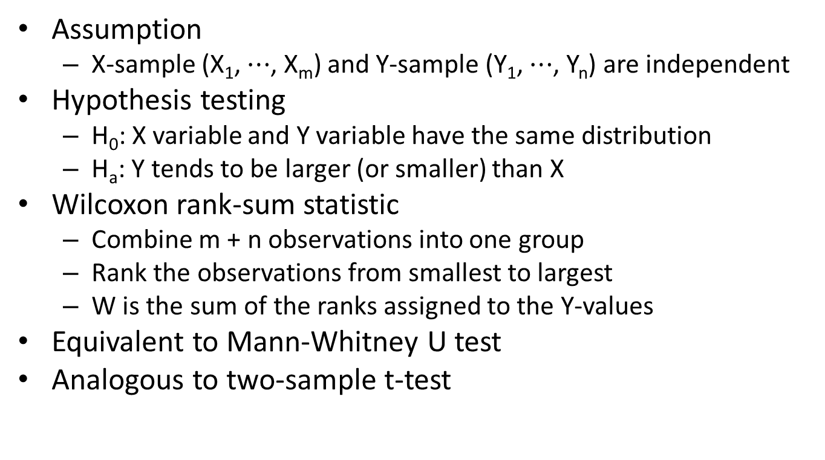
Wilcoxon rank-sum test for two independent samples
Assumption
  X-sample (X₁, $⋯$, X_{m}) and Y-sample (Y₁, $⋯$, Y_{n}) are independent
Hypothesis testing
  H₀: X variable and Y variable have the same distribution
  H_{a}: Y tends to be larger (or smaller) than X
Wilcoxon rank-sum statistic
  Combine m + n observations into one group
  Rank the observations from smallest to largest
  W is the sum of the ranks assigned to the Y-values
Equivalent to Mann-Whitney U test
Analogous to two-sample t-test

Slide 13
Example
Compare the effects of two soporific drugs
Each subject receives a placebo and then is randomly assigned to receive Drug 1 (X) or Drug 2 (Y)
Outcome: Number of hours of increased sleep over placebo
Study question: which drug is more effective at increasing sleep?

Slide 14
Wilcoxon rank-sum test for two independent samples

Slide 15
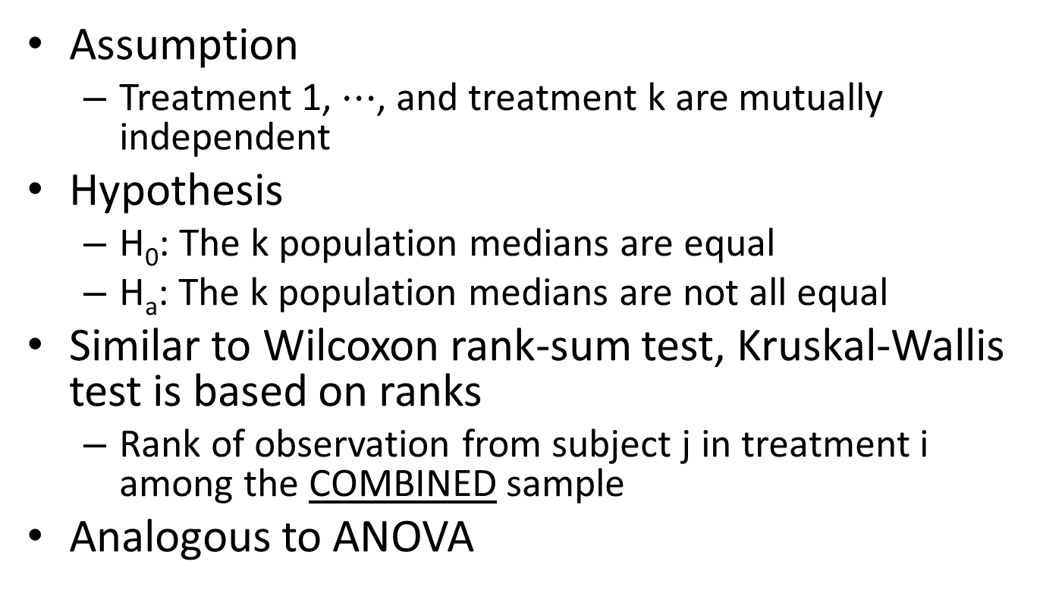
Kruskal-Wallis test for k (k > 2) independent samples
Assumption
  Treatment 1, $⋯$, and treatment k are mutually independent
Hypothesis
  H₀: The k population medians are equal
  H_{a}: The k population medians are not all equal
Similar to Wilcoxon rank-sum test, Kruskal-Wallis test is based on ranks
  Rank of observation from subject j in treatment i among the COMBINED sample
Analogous to ANOVA

Slide 16
Example
Data on length (mm) of YOY Gizzard Shad were collected at four different sites in Kokosing lake (Ohio)
Question: Is there any difference between the median YOY lengths at the four sites? If so, which particular sites differ in median YOY length?

Slide 17
Kruskal-Wallis test for k (k > 2) independent samples

Slide 18
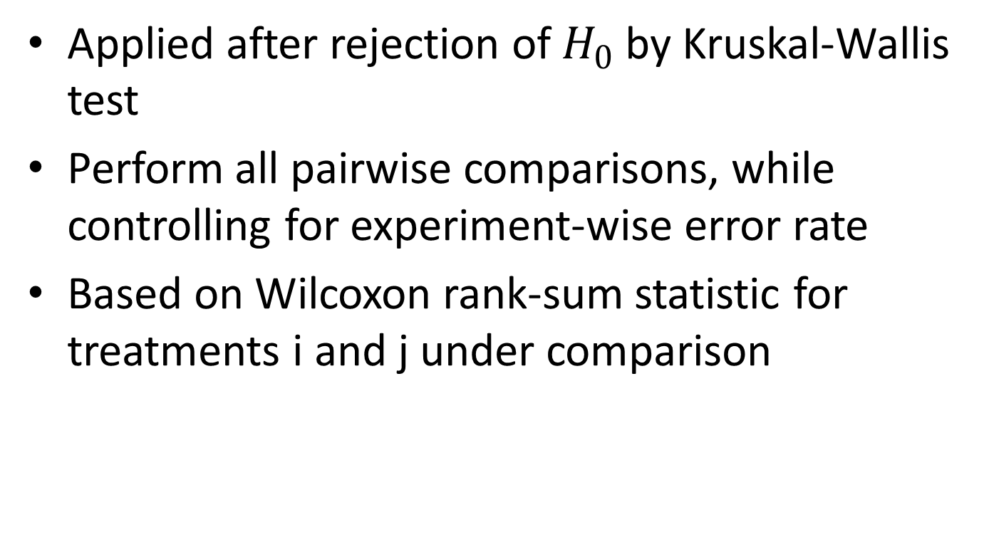
Dwass, Steel, Critchlow, and Fligner multiple comparison procedure
Applied after rejection of $H_{0}$ by Kruskal-Wallis test
Perform all pairwise comparisons, while controlling for experiment-wise error rate
Based on Wilcoxon rank-sum statistic for treatments i and j under comparison

Slide 19
Dwass, Steel, Critchlow, and Fligner multiple comparison procedure

Slide 20
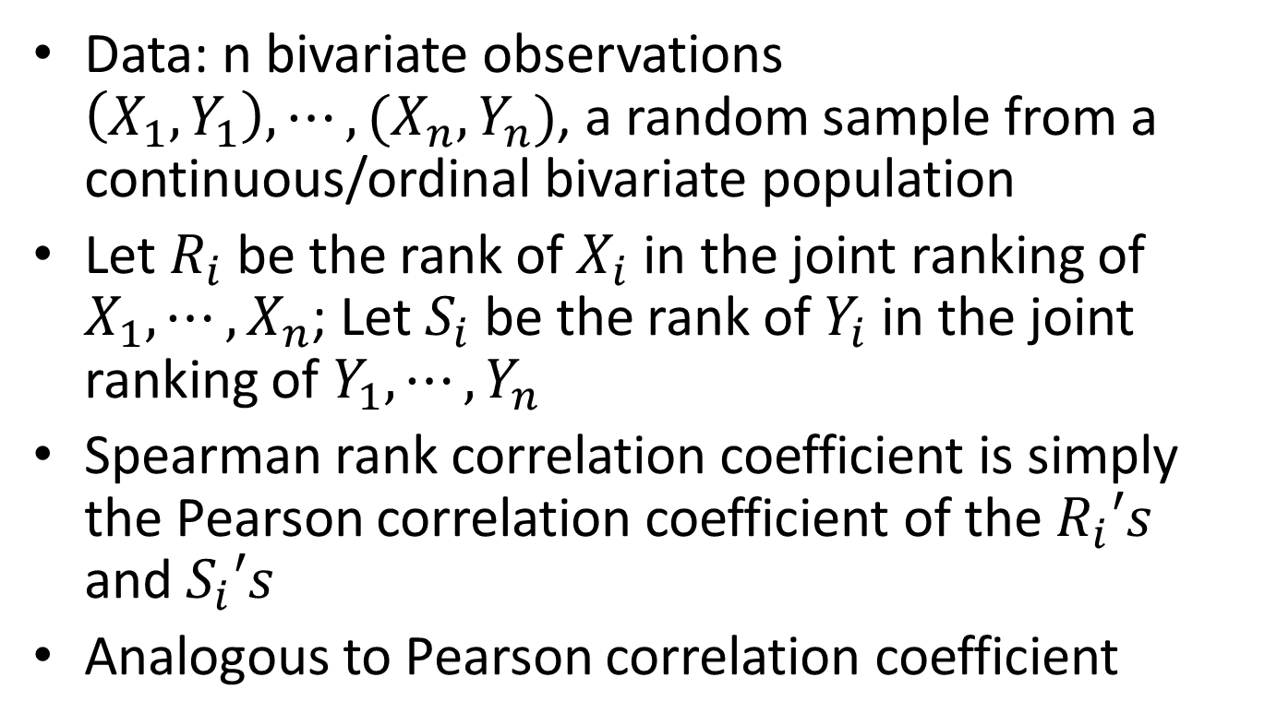
Spearman correlation coefficient
Data: n bivariate observations $\left(X_{1},Y_{1}\right),⋯,(X_{n},Y_{n})$, a random sample from a continuous/ordinal bivariate population
Let $R_{i}$ be the rank of $X_{i}$ in the joint ranking of $X_{1}, {⋯,X}_{n}$; Let $S_{i}$ be the rank of $Y_{i}$ in the joint ranking of $Y_{1}, {⋯,Y}_{n}$
Spearman rank correlation coefficient is simply the Pearson correlation coefficient of the $R_{i}′s$ and $S_{i}′s$
Analogous to Pearson correlation coefficient

Slide 21
Example
Researchers studied the relation between the free pool of proline and collagen content in human liver cirrhosis.
Data were collected from seven patients with a histological diagnosis of portal cirrhosis.
Conduct a test of whether total collagen and free proline levels are positively related, based on Spearman correlation coefficient.

Slide 22
Spearman correlation coefficient

Slide 23
Kaplan-Meier curve and log-rank test for right-censored data
Time to the occurrence of a given event (e.g. death) measured from a well-defined starting point (time origin)
  e.g. Time from study enrollment to death in a cancer clinical trial
The full time to death is not observed for some subjects
  Withdrawal, lost to follow-up, alive at the end of study
  All we know is the survival time is larger than the censoring time (e.g. time from study enrollment to drop out)

Slide 24
Example
Question: do leukemia patients treated with 6-mercaptopruine (6-MP) have a longer remission time than those in the control group?
Sample: 42 leukemia patients, 1:1 randomized
Survival outcome: remission time (weeks)
Event: relapse

Slide 25
Dataset
Group: 0=control 1=drug
Time: Remission time (wks)
Delta: 0=censored 1=replace event observed

Slide 26
Kaplan-Meier estimate

Slide 27
Kaplan-Meier curves

Slide 28
Median survival time estimate and confidence interval

Slide 29
Log-rank test

Slide 30
Other nonparametric methods
Contingency tables (e.g. Chi-square test, Fisher’s exact test, Cochran–Mantel–Haenszel test, McNemar’s Test)
Bootstrap
Smoothing (e.g. kernel, spline)

Slide 31
Reference
Hollander M, Wolfe DA and Chicken E (2014). Nonparametric Statistical Methods. Wiley; 3rd edition. ISBN-13: 9780470387375.
Higgins JJ (2003). Introduction to Modern Nonparametric Statistics. Duxbury Press; 1 edition. ISBN-13: 9780534387754
Collett D (2015) Modelling Survival Data in Medical Research. Third Edition. ISBN-13: 9781439856789.

