Slide 1
Tree-Based Methods
University of Oklahoma Health Sciences Center
R Short Course, Spring 2021
March 9th, 2021
Lecturer: Lance Ford, MS, PhD Candidate
Lance-Ford@ouhsc.edu
Slides adapted from Introduction to Statistical Learning, 6th Edition and Dr. Daniel Zhao
Notes:
Name, degree
Statistical consulting for 6 years on a WIDE range of research projects
Really enjoy biostatistics, hope I can share some of that passion with you
Today we will discuss…
This is a VERY COMMONLY used statistical test….
Important to understand when it’s appropriate to use…

Slide 2
Outline
The Basics of Classification and Regression Trees (CART)
Regression Trees
Classification Trees
Pruning Trees
Trees vs. Linear Models
Advantages and Disadvantages of Trees

Slide 3
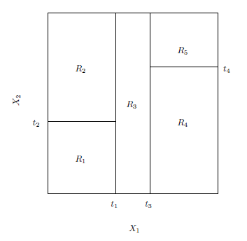
Intro to CART
One way to make predictions in a regression or classification problem is to divide the predictor space (i.e. all the possible values for for $X1,X2,…,Xp$) into distinct regions, say $R1, R2,…,Rk$
Then for every $X$ that falls in a particular region (say $Rj$) we make the same prediction

Slide 4
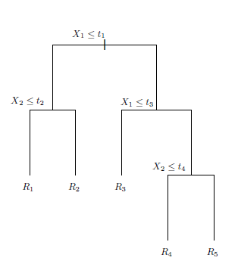
Intro to CART
These splitting rules used to segment the predictor space can be summarized in a tree and are known as the decision tree method.
Tree-based methods are simple and useful, but may have lesser prediction accuracy than logistic regression or KNN method
Bagging, random forests, and boosting that combining multiple trees can improve prediction but lose interpretation.

Slide 5
Motivating Example: Lung Cancer Screening
Population: Individuals in Oklahoma that met United States Preventative Services Task Force lung cancer screening recommendation (2017-2018)
Outcome: Screened for lung cancer (Yes/No)
Predictors: Sex, Education, Health Status, COPD, Asthma, Income, Smoking Status, BMI, other Comorbidities
Challenges: Lots of interactions!

Slide 6
Motivating Example: Lung Cancer Screening
Used classification trees
Easier to interpret than regression model with lots of interaction terms
Helped us identify subgroups with low screening proportions

Slide 7
Regression Trees

Slide 8
Regression Trees Example
$$R_{1}$$
$$R_{2}$$
Suppose for example we have two regions $R1$ and $R2$ with ${\hat{Y}}_{1}=10, {\hat{Y}}_{2}=20$
Then for any value of $X$ such that $X∈R_{1}$ we would predict 10, otherwise if $X∈R_{2}$ we would predict 20.
$$10$$
$$20$$

Slide 9
The General View
Here we have two predictors and five distinct regions
Depending on which region our new X comes from we would make one of five possible predictions for Y.
We predict 34 for X₁=5 and X₂=18
22
12
20
9
34
23
10
20

Slide 10
Splitting the X Variables
Generally we create the partitions by iteratively splitting one of the X variables into two regions

Slide 11
Splitting the X Variable
First split on X₁=t₁

Slide 12
Splitting the X Variable
First split on X₁=t₁
If X₁<t₁, split on X₂=t₂

Slide 13
Splitting the X Variable
First split on X₁=t₁
If X₁<t₁, split on X₂=t₂
If X₁>t₁, split on X₁=t₃

Slide 14
Splitting the X Variable
First split on X₁=t₁
If X₁<t₁, split on X₂=t₂
If X₁>t₁, split on X₁=t₃
If X₁>t₃, split on X₂=t₄

Slide 15
Splitting the X Variable
When we create partitions this way we can always represent them using a tree structure.
This provides a very simple way to explain the model to a non-expert.

Slide 16
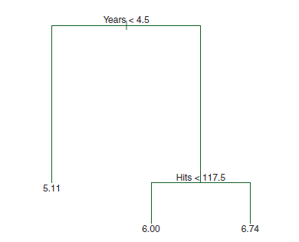
Example: Baseball Players’ Salaries
Hitters data, predict log salary measured in 1000s
The predicted Salary is the number in each leaf node. It is the mean of the response for the observations that fall there
Tree is upside down
There are 2 large branches
There are 2 internal nodes and 3 terminal nodes (leaves)
The predicted salary for a player who played in the league for more than 4.5 years and had less than 117.5 hits last year is $\$1000×e^{6.00}=\$402,834$

Slide 17
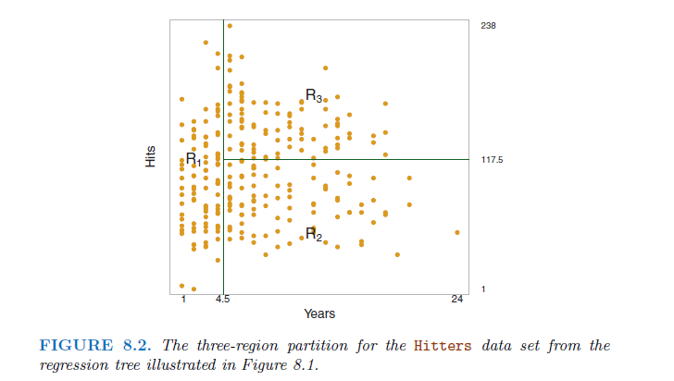
Another way of visualizing the decision tree…

Slide 18
Some Natural Questions
Where to split? i.e. how do we decide on what regions to use i.e. R₁, R₂,…,R_{k} or equivalently what tree structure should we use?
What values should we use for ${\hat{Y}}_{1},{\hat{Y}}_{2},…,{\hat{Y}}_{k}$?

Slide 19
1. What values should we use for ${\hat{Y}}_{1},{\hat{Y}}_{2},…,{\hat{Y}}_{k}$?
For region R_{j}, the best prediction is simply the average of all the responses from our training data that fell in region R_{j}.

Slide 20
2. Where to Split?
Top-down greedy approach: recursive binary splitting
We consider splitting into two regions, X_{j}>s and X_{j}<s for all possible values of s and j.
We then choose the s and j that results in the lowest MSE on the training data.

Slide 21
Where to Split?
Here the optimal split was on X₁ at point t₁.
Now we repeat the process looking for the next best split except that we must also consider whether to split the first region or the second region up.
Again the criteria is smallest MSE.

Slide 22
Where to Split?
Here the optimal split was the left region on X₂ at point t₂.
This process continues until our regions have too few observations to continue e.g. all regions have 5 or fewer points.

Slide 23
Tree Pruning

Slide 24
Why pruning?
A large tree (i.e. one with many terminal nodes) may tend to overfit the training data.
Generally, we can improve accuracy by pruning the tree i.e. cutting off some of the terminal nodes.
The idea is to grow a very large tree and then prune it back to obtain a subtree.
One alternative to the above is to build a tree only if the reduction in RSS due to each split exceeds some threshold
However, the downside is that it is possible that a seemingly worthless split early on in the tree could followed by a very good split

Slide 25
Algorithm to build and prune a tree with cost complexity pruning
Use recursive binary splitting to grow a large tree ($T_{0}$) on the training data, stopping only when each terminal node has fewer than some minimum number of observations.
Apply cost complexity pruning to the large tree $T_{0}$ in order to obtain a sequence of best subtrees, as a function of α.
Find a subtree $T⊂T_{0}$ such that $\sum_{m=1}^{|T|}{\sum_{x_{i}∈R_{m}}{{\left(y_{i}−{{\hat{y}}_{R}}_{m}\right)}^{2}+α|T|}}$ is smallest

Slide 26
Algorithm to build and prune a tree with cost complexity pruning
Use K-fold cross-validation to choose α. That is, divide the training observations into K folds. For each k = 1, . . .,K:
Repeat Steps 1 and 2 on all but the kth fold of the training data.
Evaluate the mean squared prediction error on the data in the left-out kth fold, as a function of α.
Average the results for each value of α, and pick α to minimize the average error.
Return the subtree from Step 2 that corresponds to the chosen value of α.

Slide 27
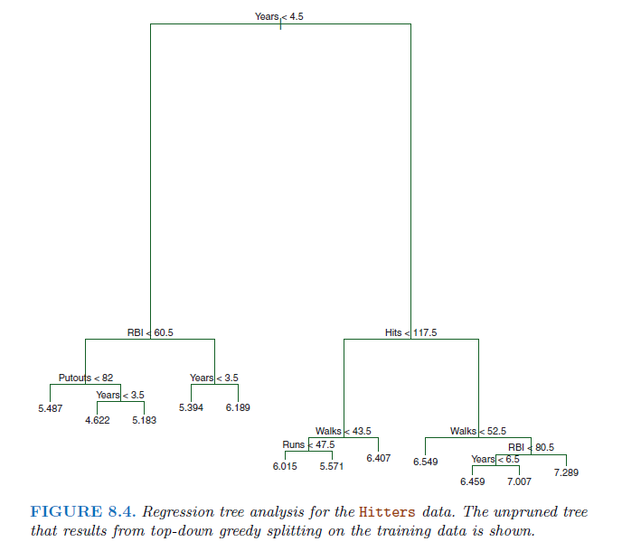
Hitter Data: Unpruned tree
Outcome: log salary in $1000
9 predictors
Randomly divide data
Training data (132)
Test Data (131)
Built a large tree using the training data
6-fold cross validation

Slide 28
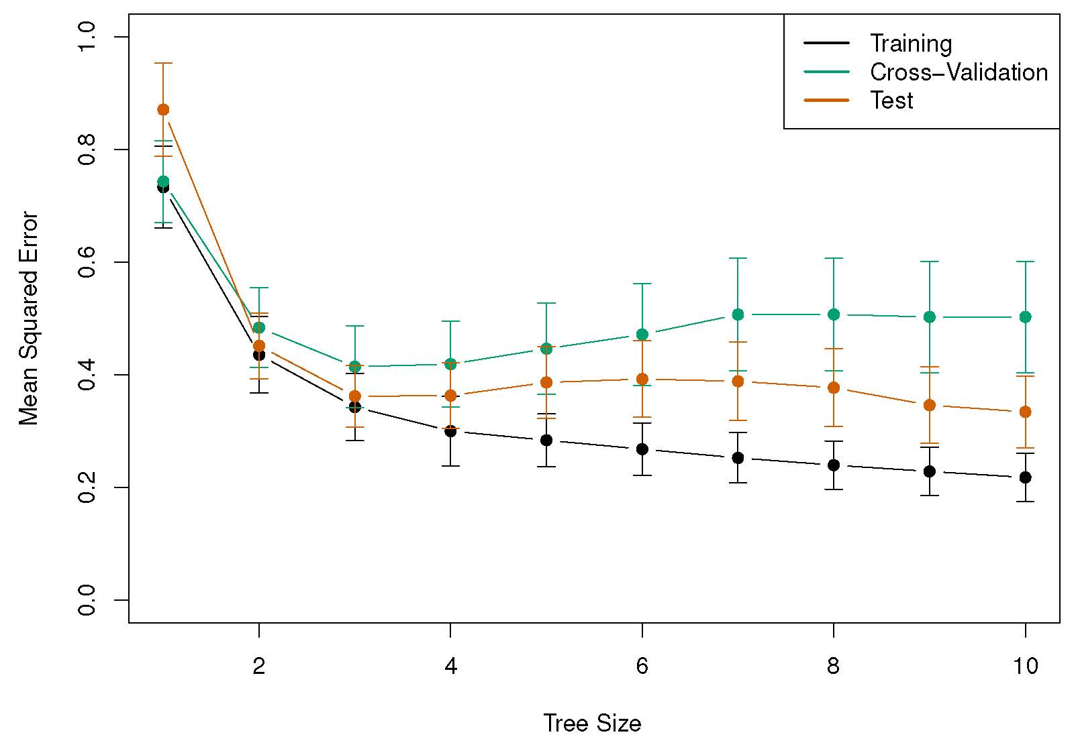
Hitter Data: Unpruned tree
The training, cross-validation, and test MSE are shown as a function of the number of terminal nodes in the pruned tree.
The minimum cross-validation error occurs at a tree size of three

Slide 29
Hitter Data: Pruned tree
We might interpret the regression tree displayed as follows:
Years is the most important factor in determining Salary, and players with less experience earn lower salaries than more experienced players.
Given that a player is less experienced, the number of hits that he made in the previous year seems to play little role in his salary.
But among players who have been in the major leagues for five or more years, the number of hits made in the previous year does affect salary.

Slide 30
Classification Trees

Slide 31
Growing a Classification Tree
A classification tree is very similar to a regression tree except that we try to make a prediction for a categorical rather than continuous Y.
For each region (or node) we predict the most common category among the training data within that region.
The tree is grown (i.e. the splits are chosen) in exactly the same way as with a regression tree except that minimizing MSE no longer makes sense.
There are several possible different criteria to use such as the “gini index” and “cross-entropy” but the easiest one to think about is to minimize the error rate.

Slide 32
Growing a Classification Tree
Let ${\hat{p}}_{mk}$ be the proportion of training obs in the $m$th region that are from the $k$th class
Error rate $E=1−\max_{k}{{\hat{p}}_{mk}}$
Gini index $G=\sum_{k=1}^{K}{{\hat{p}}_{mk}(1−{\hat{p}}_{mk}})$, a measure of total variance across the $K$ classes
Gini index takes on a small value if all of the ${\hat{p}}_{mk}$’s are close to 0 or 1
So Gini index is a measure of node purity, ie, a node with small Gini index contains predominantly obs from a single class

Slide 33
Growing a Classification Tree
Cross-entropy $D=−\sum_{k=1}^{K}{{\hat{p}}_{mk}}log{\hat{p}}_{mk}$, similar to Gini index
Gini index and cross-entropy are typically used to build a tree
All 3 approaches are used to prune a tree, but the error rate is preferable if prediction accuracy is the goal

Slide 34
Example: Heart Data
Sample size 303 patients
Binary outcome of Heart Disease
Yes: presence of heart disease based on an anigographic test
No: otherwise
There were 13 predictors (continuous or categorical)
Age, Sex, chol (cholesterol)
Thal (Thalium stress test): normal, fixed, reversible
ChestPain: typical angina, atypical angina, non-angina, asymptomatic
Other heart and lung function measurements
Cross-validation results in a tree with six terminal nodes

Slide 35
Example: Heart Data
Unpruned Tree

Slide 36
Example: Heart Data
Error Rate
Pruned Tree

Slide 37
Trees vs. Linear models

Slide 38
Trees vs. Linear Models
Linear regression assumes a model of the form: $f\left(X\right)=β_{0}+\sum_{j=1}^{p}{β_{j}X_{j}}$
Regression trees assume a model of the form: $f\left(X\right)=\sum_{m=1}^{M}{c_{m}1_{(X∈R_{m})}}$
Which model is better?
If the relationship between the predictors and response is linear, then classical linear models such as linear regression would outperform regression trees
On the other hand, if the relationship between the predictors is non-linear, then decision trees would outperform classical approaches

Slide 39
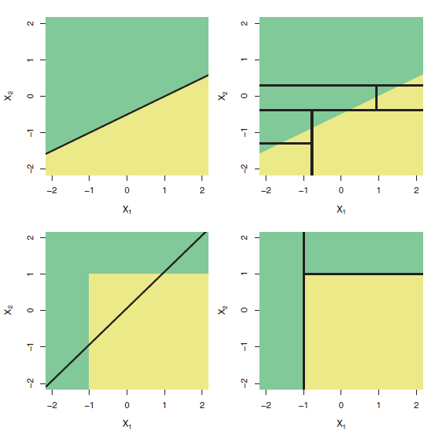
Trees vs. Linear Model: Classification Example
Top row: the true decision boundary is linear
Left: linear model (good)
Right: decision tree
Bottom row: the true decision boundary is non-linear
Left: linear model
Right: decision tree (good)

Slide 40
Advantages and Disadvantages of Trees

Slide 41
Pros and Cons of Decision Trees
Pros:
Trees are very easy to explain to people (probably even easier than linear regression)
Trees can be plotted graphically, and are easily interpreted even by non-expert
They work fine on both classification and regression problems
Cons:
Trees don’t have the same prediction accuracy as some of the more complicated approaches that we examine in this course

Slide 42
Tree-Based Methods
University of Oklahoma Health Sciences Center
R Short Course, Spring 2021
March 9th, 2021
Lecturer: Lance Ford, MS, PhD Candidate
Lance-Ford@ouhsc.edu
Slides adapted from Introduction to Statistical Learning, 6th Edition and Dr. Daniel Zhao
Notes:
Name, degree
Statistical consulting for 6 years on a WIDE range of research projects
Really enjoy biostatistics, hope I can share some of that passion with you
Today we will discuss…
This is a VERY COMMONLY used statistical test….
Important to understand when it’s appropriate to use…

