Slide 1

R Short Course Part 2
Topic 6: Missing Data Analysis
Sixia Chen, PhD
Department of Biostatistics and Epidemiology
Hudson College of Public Health, OUHSC
April 30, 2021

Slide 2
Introduction
Motivation: reduce nonresponse error
Examples: refusals, non-contact in the survey
Approaches:
  Item nonresponse: imputation
  Unit nonresponse: propensity score weighting

Slide 3
Input data file
Unique identifier: id
Predictors (No missing values): x1-x5
Study variables (With missing values): y1-y3
Response indicators: r1-r3 (1 for respondent and 0 for nonrespondent)

Slide 4
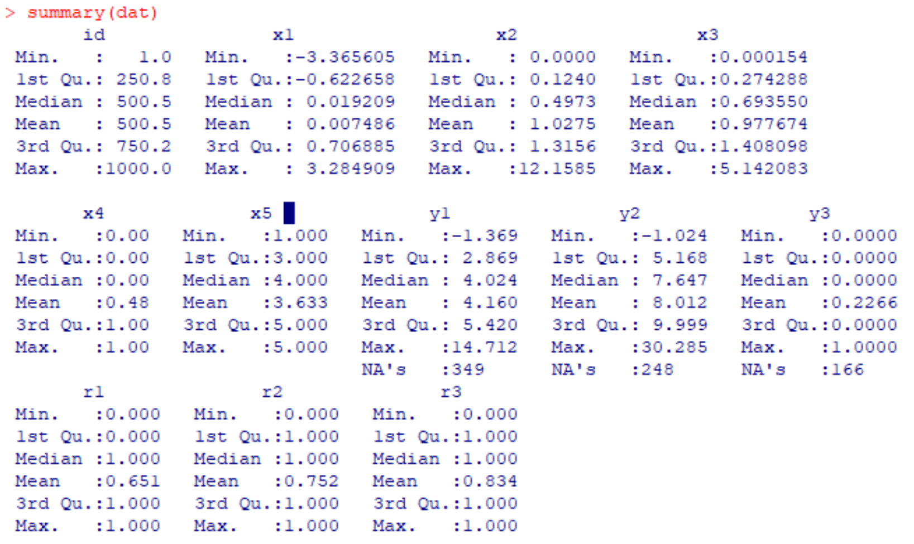
Data check

Slide 5
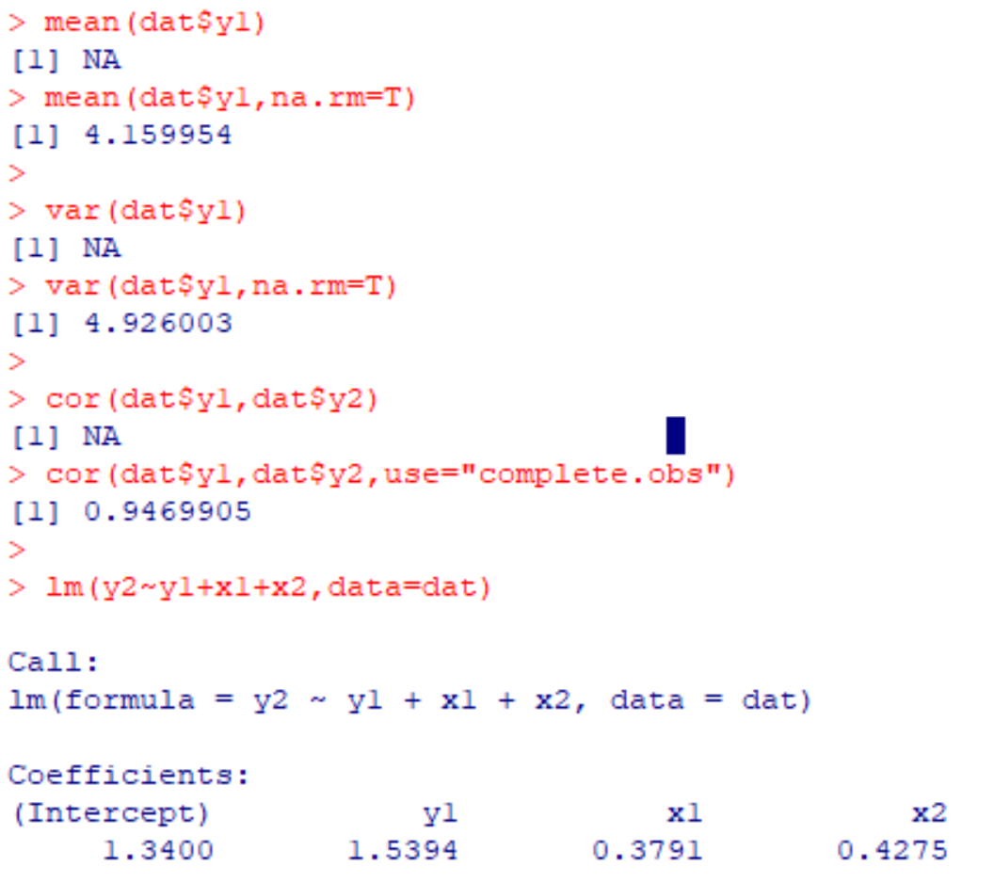
Analysis by removing missing values

Slide 6
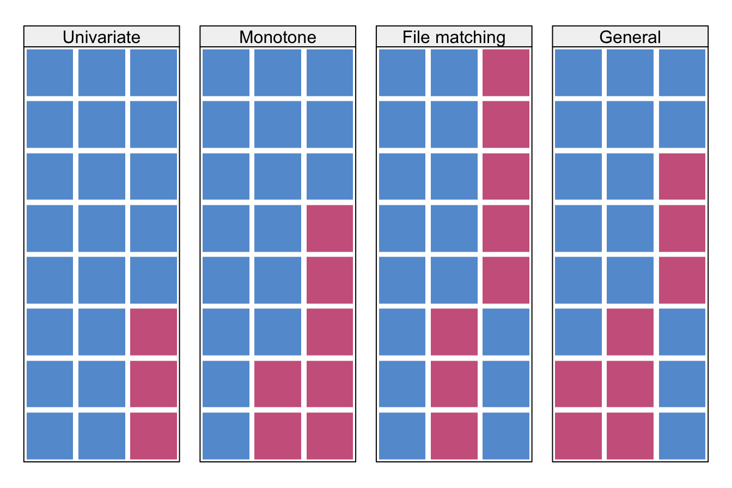
Missing Pattern

Slide 7
Missing Pattern R code
library(naniar)
gg_miss_var(dat)
vis_miss(dat)
gg_miss_upset(dat)

Slide 8
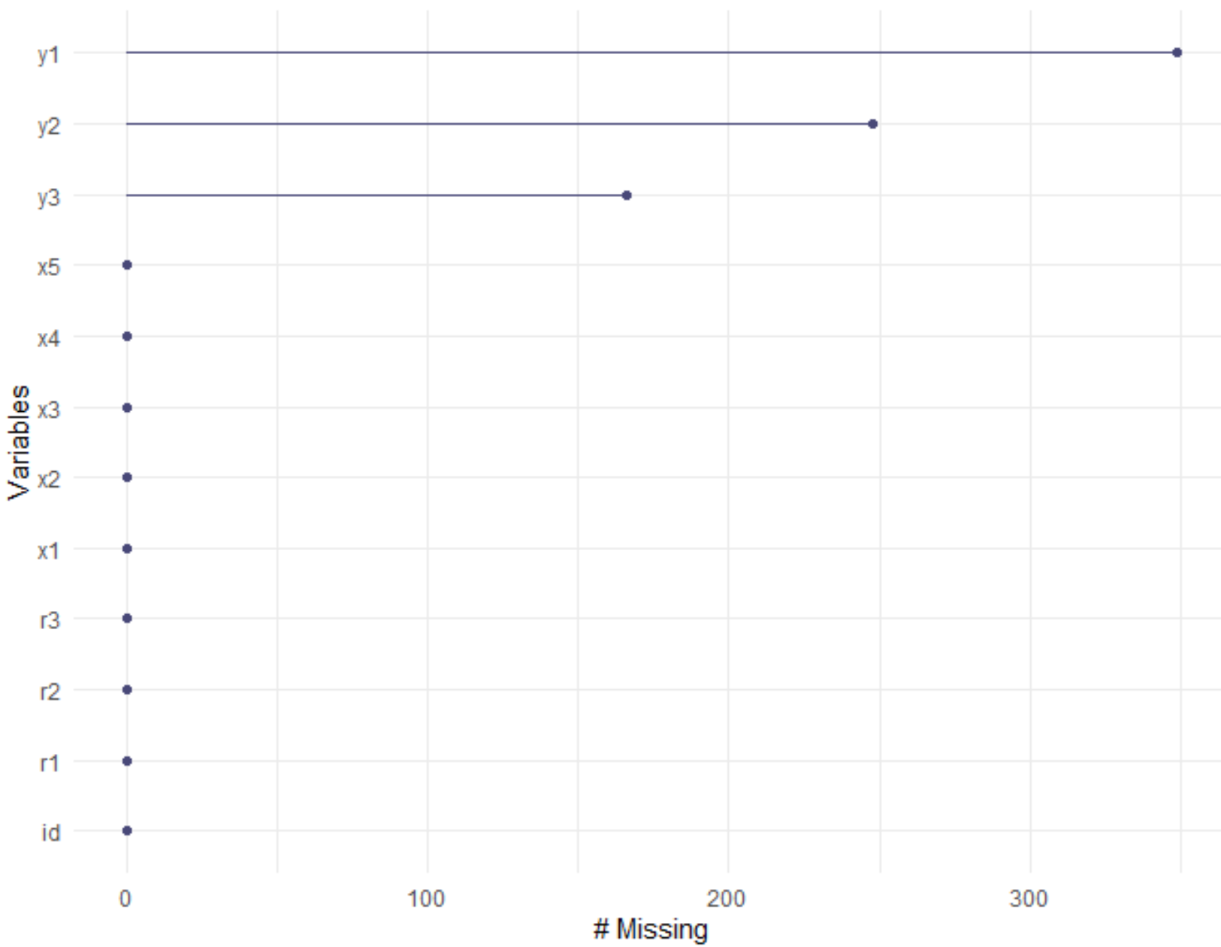
Univariate Missingness

Slide 9
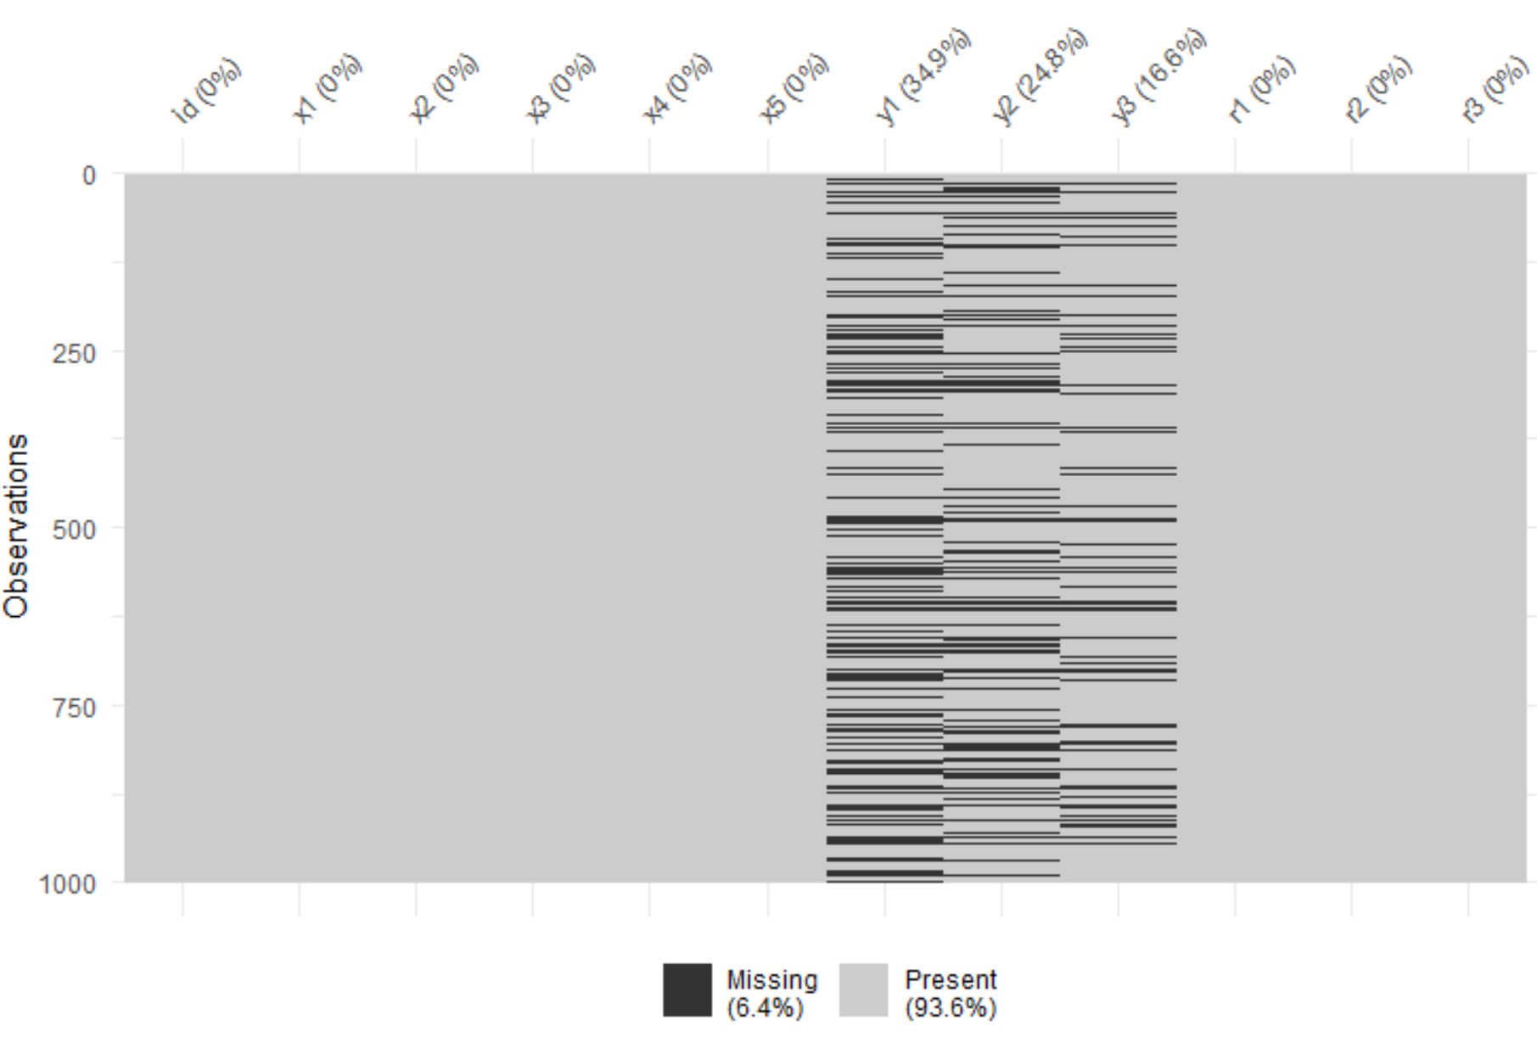
Missing Pattern Check

Slide 10
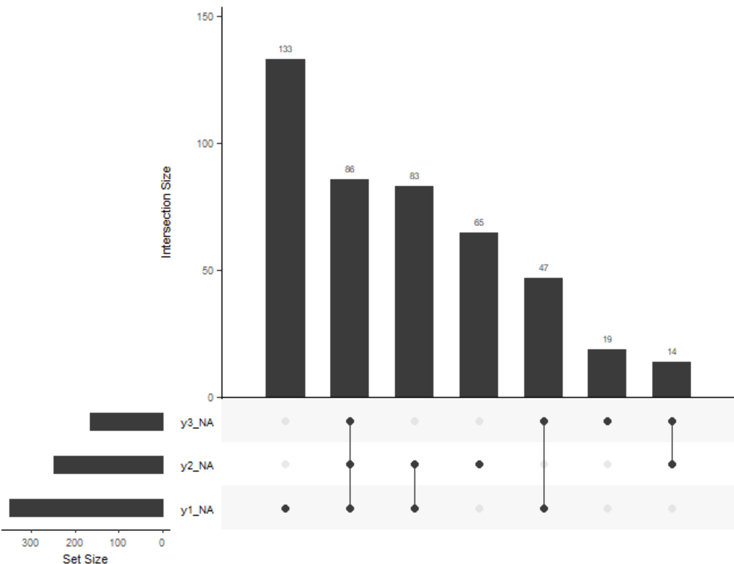
Missing Pattern Scenarios

Slide 11
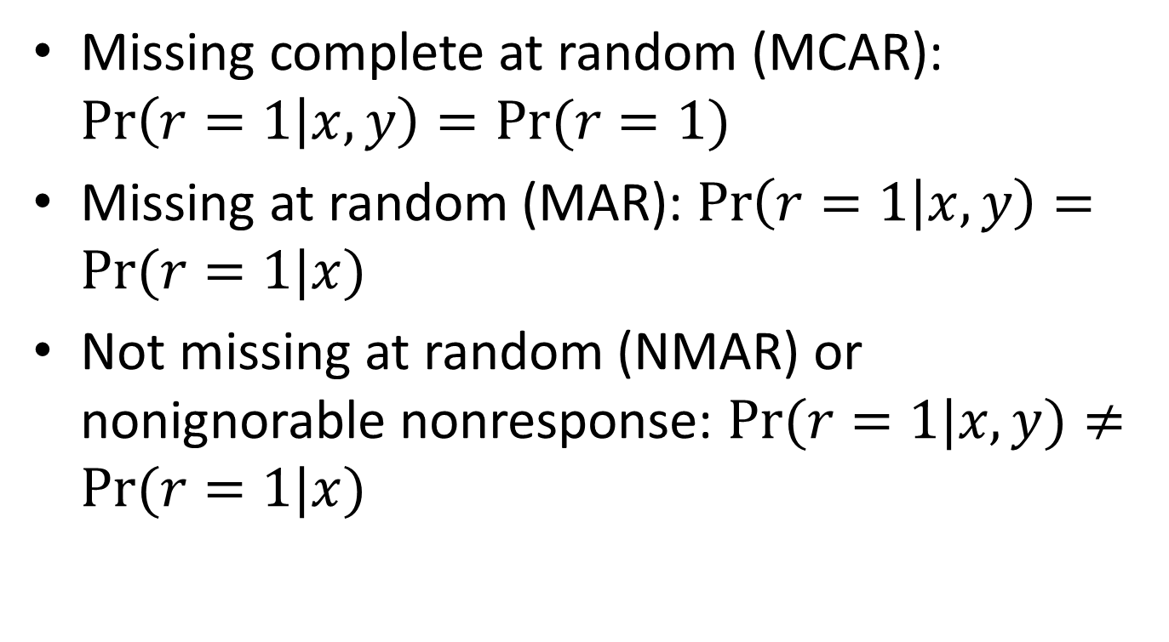
Missing Mechanism
Missing complete at random (MCAR): $\operatorname{Pr}\left(r=1 | x,y\right)=Pr⁡(r=1)$
Missing at random (MAR): $\operatorname{Pr}\left(r=1 | x,y\right)=Pr⁡(r=1|x)$
Not missing at random (NMAR) or nonignorable nonresponse: $Pr⁡(r=1|x,y)≠Pr⁡(r=1|x)$

Slide 12
Compare distribution of continuous covariate
par(mfrow=c(3,3))
boxplot(dat$x1 ~ dat$r1, col="orange", main="Distribution of x1", ylab="x1", xlab="r1")
boxplot(dat$x1 ~ dat$r2, col="red", main="Distribution of x1", ylab="x1", xlab="r2")
boxplot(dat$x1 ~ dat$r3, col="blue", main="Distribution of x1", ylab="x1", xlab="r3")
boxplot(dat$x2 ~ dat$r1, col="orange", main="Distribution of x2", ylab="x2", xlab="r1")
boxplot(dat$x2 ~ dat$r2, col="red", main="Distribution of x2", ylab="x2", xlab="r2")
boxplot(dat$x2 ~ dat$r3, col="blue", main="Distribution of x2", ylab="x2", xlab="r3")
boxplot(dat$x3 ~ dat$r1, col="orange", main="Distribution of x3", ylab="x3", xlab="r1")
boxplot(dat$x3 ~ dat$r2, col="red", main="Distribution of x3", ylab="x3", xlab="r2")
boxplot(dat$x3 ~ dat$r3, col="blue", main="Distribution of x3", ylab="x3", xlab="r3")

Slide 13
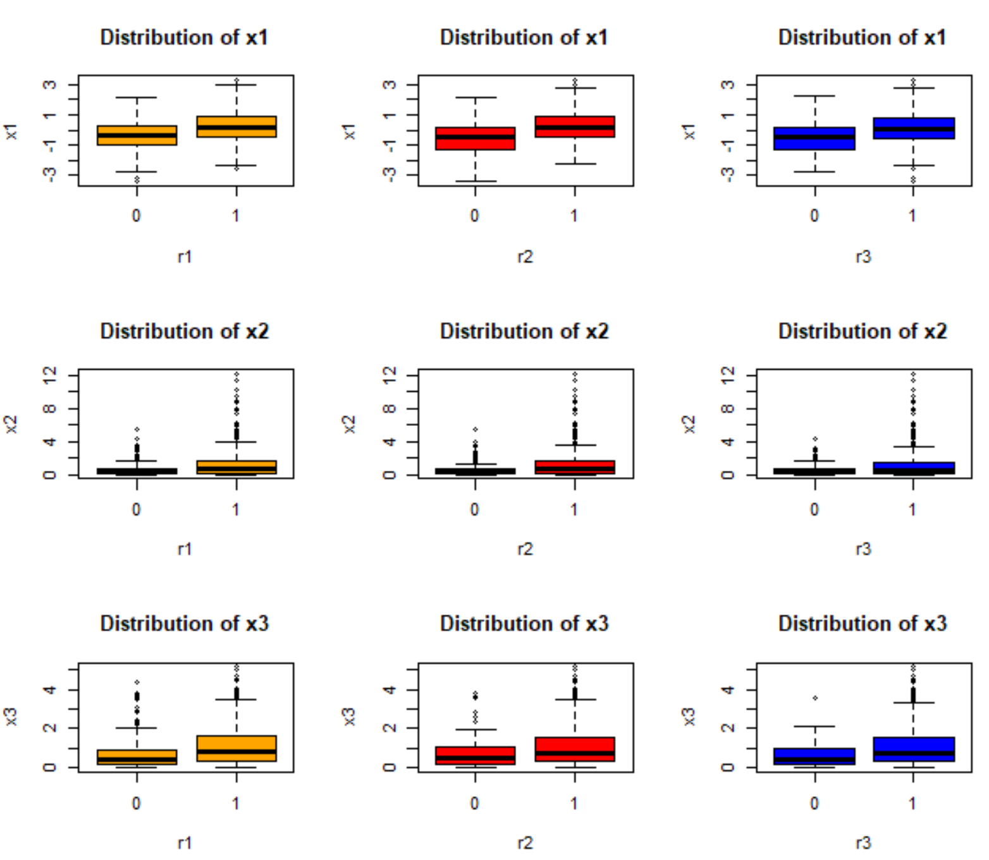
Compare distribution of continuous covariate

Slide 14
Compare distribution of categorical covariate
ggplot(dat, aes(x= x4, group=r1)) +
geom_bar(aes(y = ..prop.., fill = factor(..x..)), stat="count") +
geom_text(aes( label = scales::percent(..prop..),
y= ..prop.. ), stat= "count", vjust = -.5) +
labs(y = "Percent", fill="x4") +
facet_grid(~r1) +
scale_y_continuous(labels = scales::percent)

Slide 15
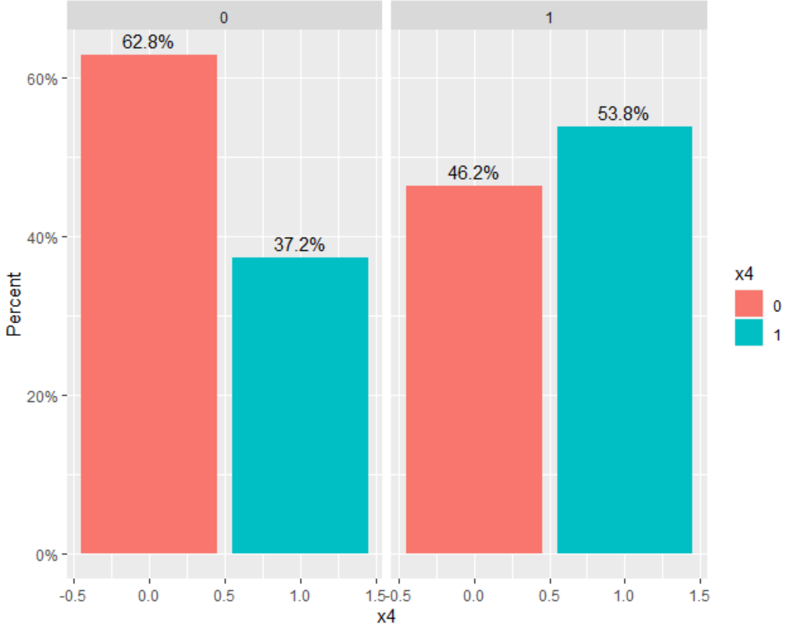
Compare distribution of categorical covariate

Slide 16
Compare distribution of categorical covariate
ggplot(dat, aes(x= x5, group=r1)) +
geom_bar(aes(y = ..prop.., fill = factor(..x..)), stat="count") +
geom_text(aes( label = scales::percent(..prop..),
y= ..prop.. ), stat= "count", vjust = -.5) +
labs(y = "Percent", fill="x5") +
facet_grid(~r1) +
scale_y_continuous(labels = scales::percent)

Slide 17
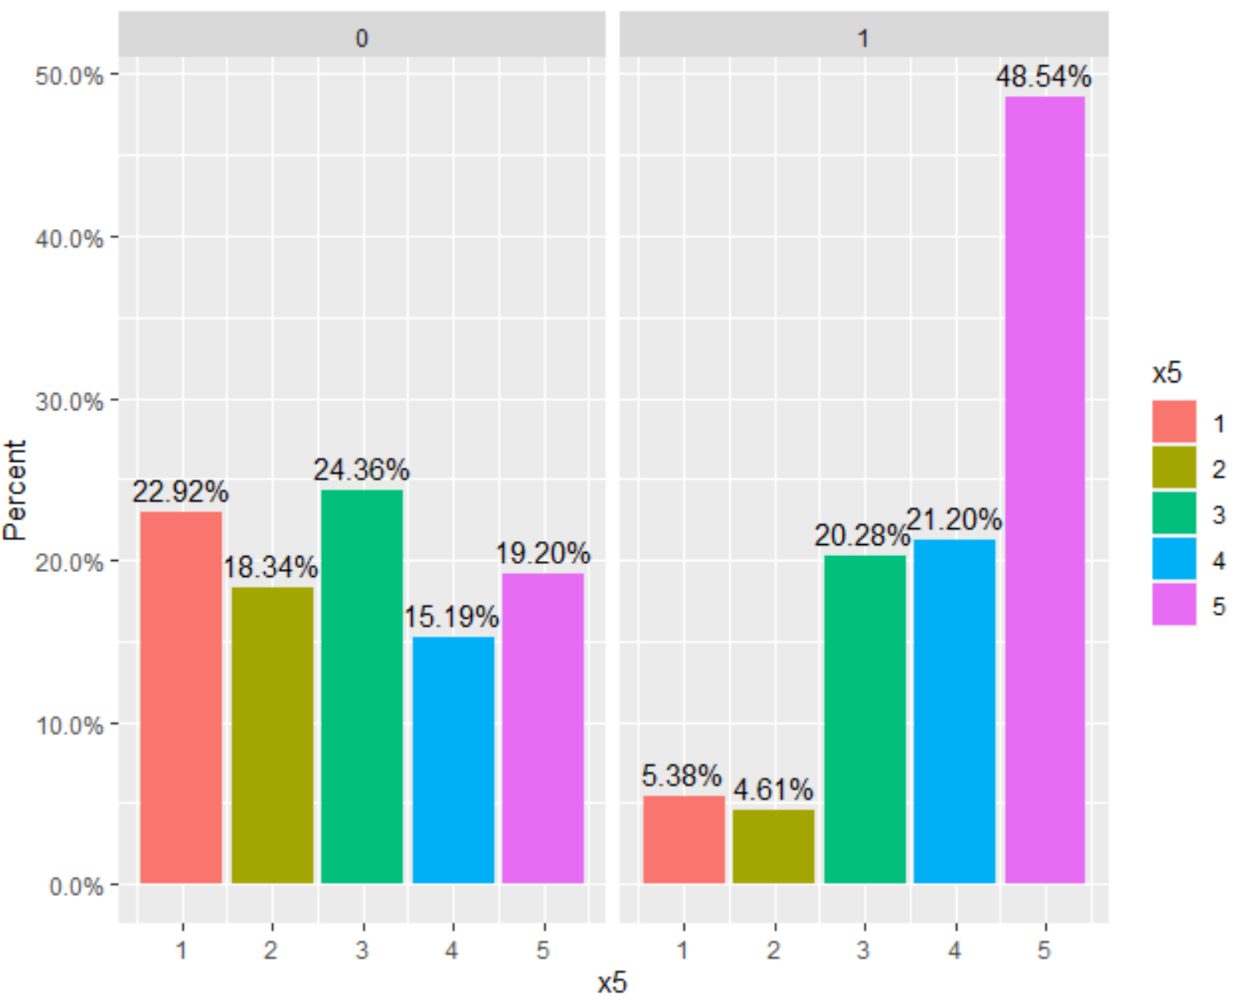
Compare distribution of categorical covariate

Slide 18
Missing Mechanism Check by Models
fit1<-glm(r1~x1+x2+x3+x4+as.character(x5),data=dat,family=binomial(link = "logit"))
summary(fit1)
fit2<-glm(r2~x1+x2+x3+x4+as.character(x5),data=dat,family=binomial(link = "logit"))
summary(fit2)
fit3<-glm(r3~x1+x2+x3+x4+as.character(x5),data=dat,family=binomial(link = "logit"))
summary(fit3)

Slide 19
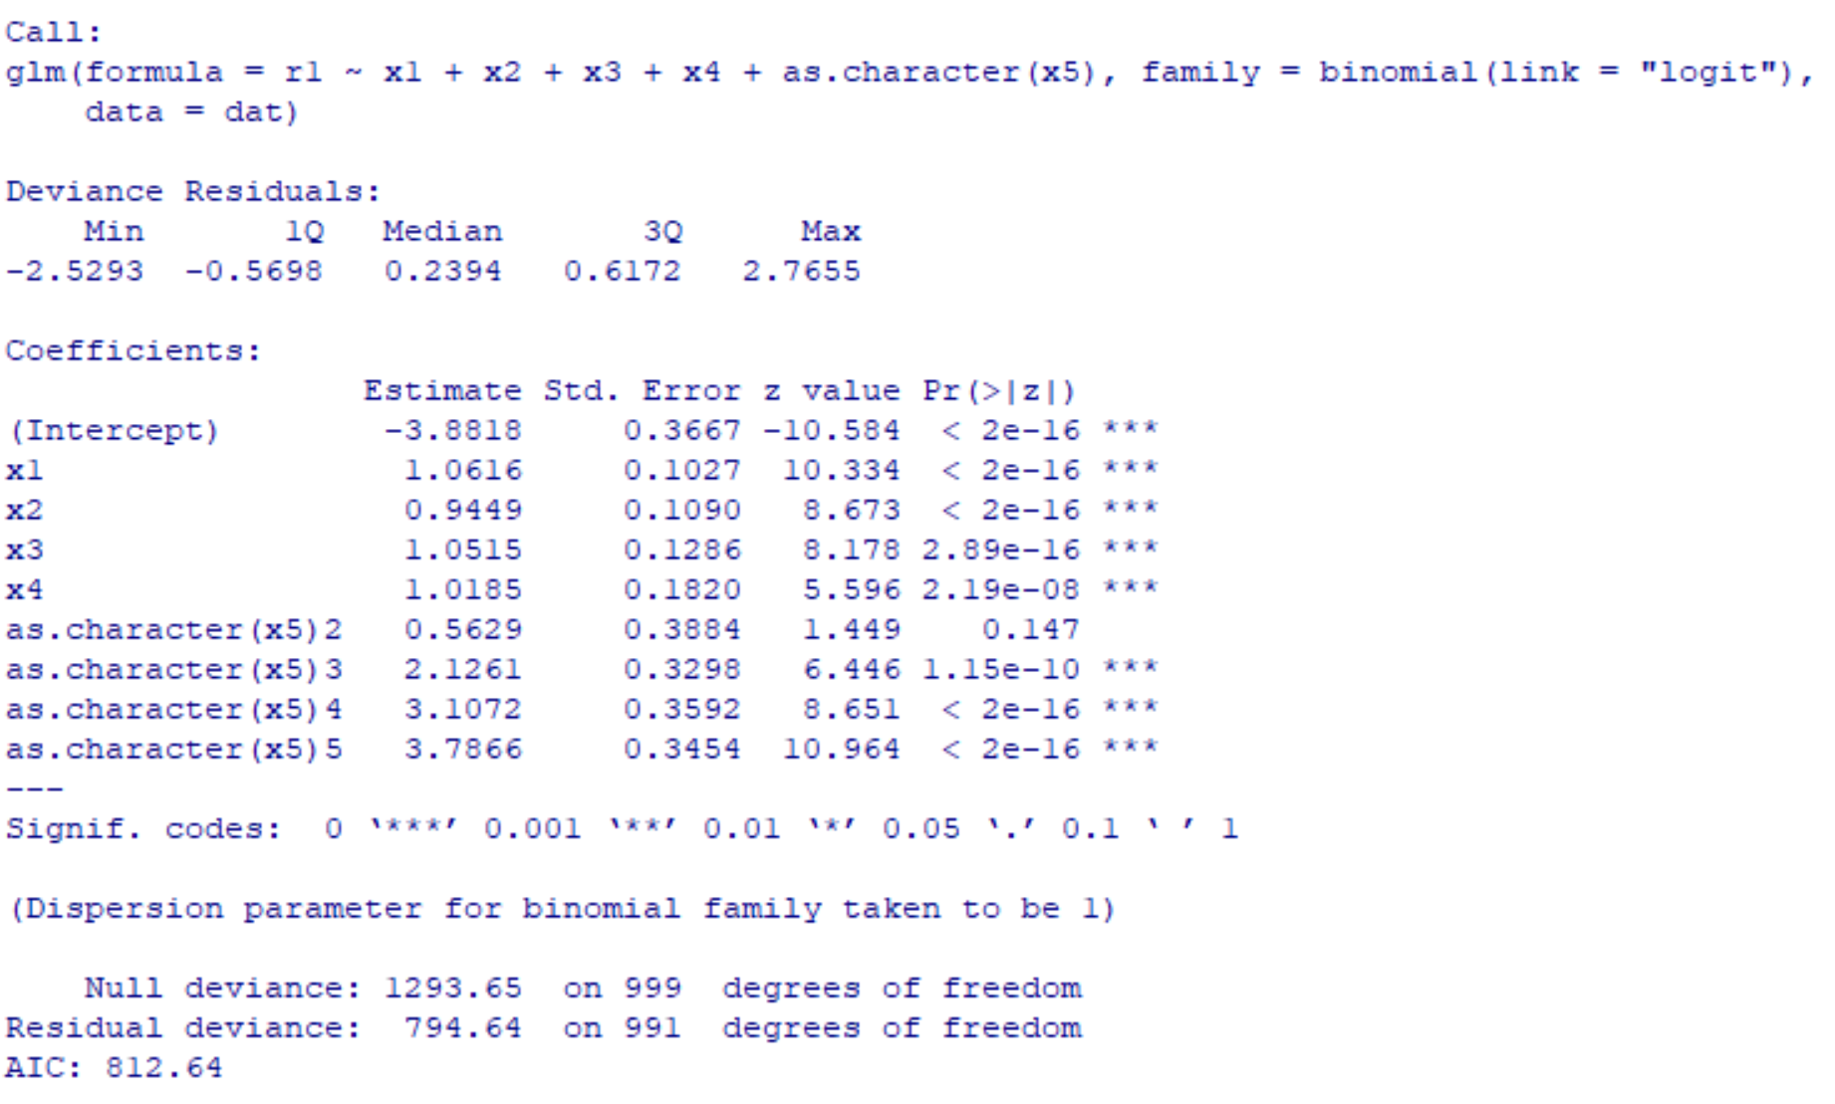
Output

Slide 20
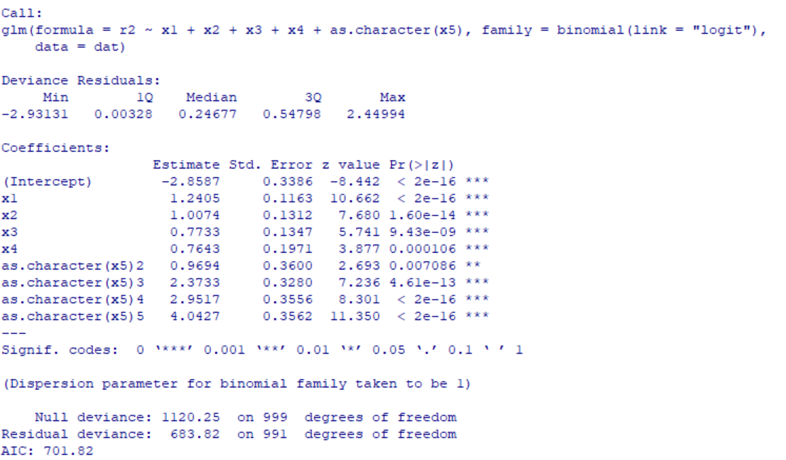
Output

Slide 21
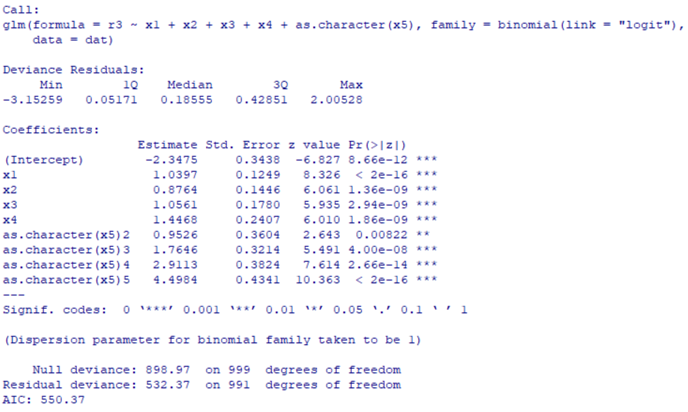
Output

Slide 22
Imputation
Simple imputation: Mean
Hot-deck imputation
Nearest Neighbor imputation
Predictive mean imputation
Regression imputation
Machine learning based (Random forest, Regression tree etc.)
Multiple imputation

Slide 23
Imputation model check
pairs(dat[,c(2,3,4,7,8)])
par(mfrow=c(2,3))
boxplot(dat$y1 ~ dat$x4, col="orange", main="Distribution of y1", ylab="y1", xlab="x4")
boxplot(dat$y1 ~ dat$x5, col="blue", main="Distribution of y1", ylab="y1", xlab="x5")
boxplot(dat$y1 ~ dat$y3, col="red", main="Distribution of y1", ylab="y1", xlab="y3")
boxplot(dat$y2 ~ dat$x4, col="orange", main="Distribution of y2", ylab="y2", xlab="x4")
boxplot(dat$y2 ~ dat$x5, col="blue", main="Distribution of y2", ylab="y2", xlab="x5")
boxplot(dat$y2 ~ dat$y3, col="red", main="Distribution of y2", ylab="y2", xlab="y3")

Slide 24
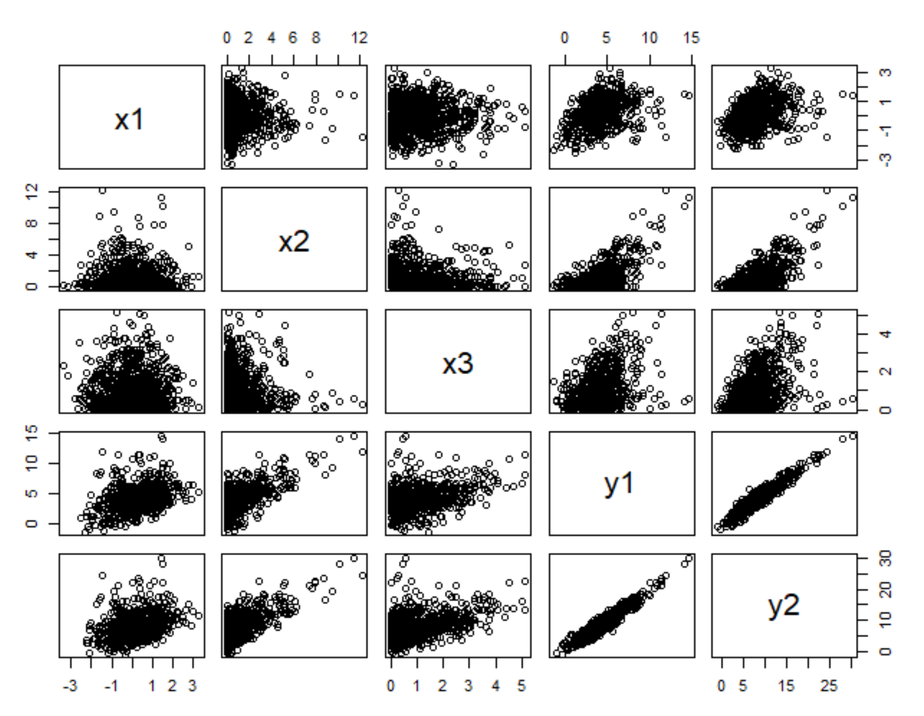
Continuous outcome variables and predictors

Slide 25
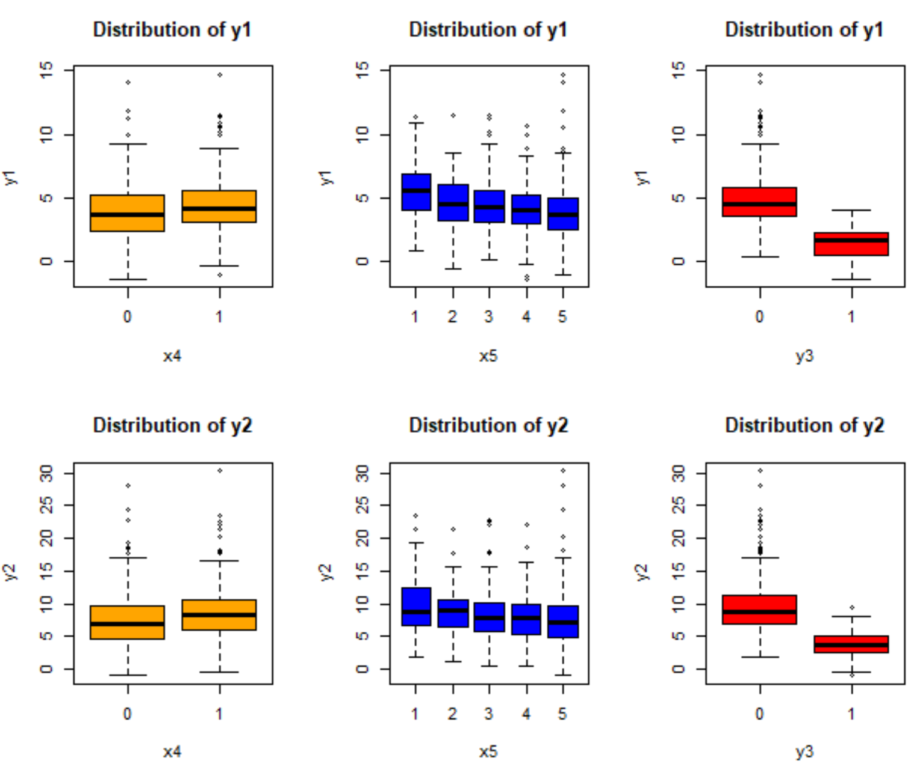
Continuous outcome variables and categorical predictors

Slide 26
Imputation model testing
fit1_m<-glm(y1~x1+x2+x3+x4+as.character(x5),data=dat)
summary(fit1_m)
fit2_m<-glm(y2~x1+x2+x3+x4+as.character(x5)+y1,data=dat)
summary(fit2_m)
fit3_m<-glm(y3~x1+x2+x3+x4+as.character(x5)+y1+y2,data=dat,family=binomial(link = "logit"))
summary(fit3_m)

Slide 27
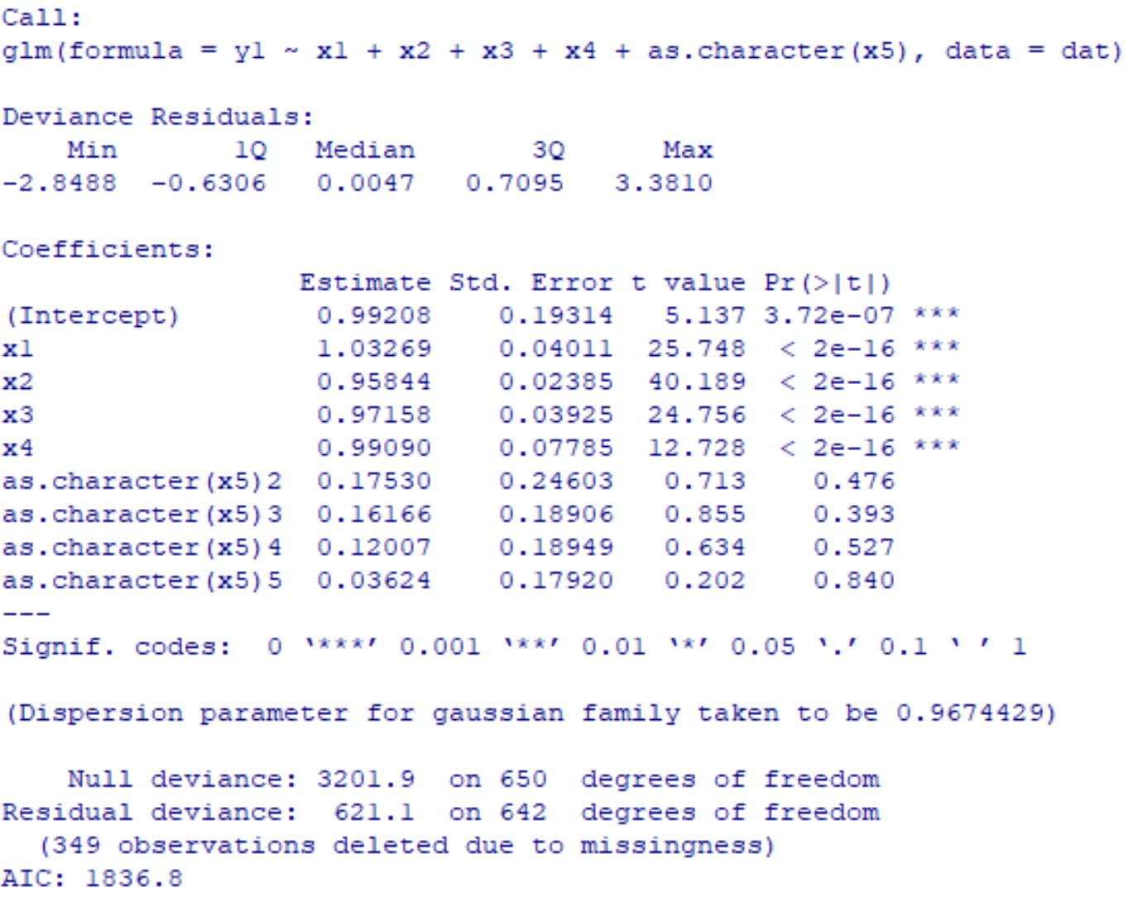
Imputation model testing

Slide 28
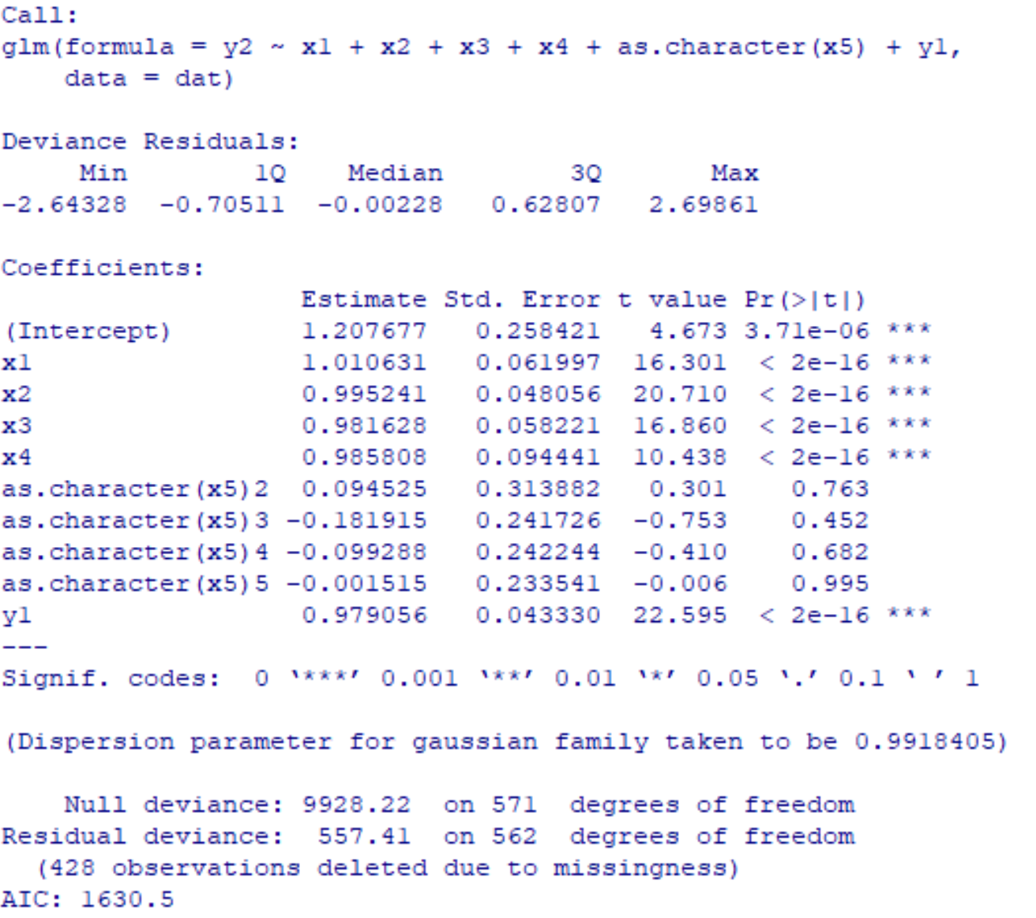
Imputation model testing

Slide 29
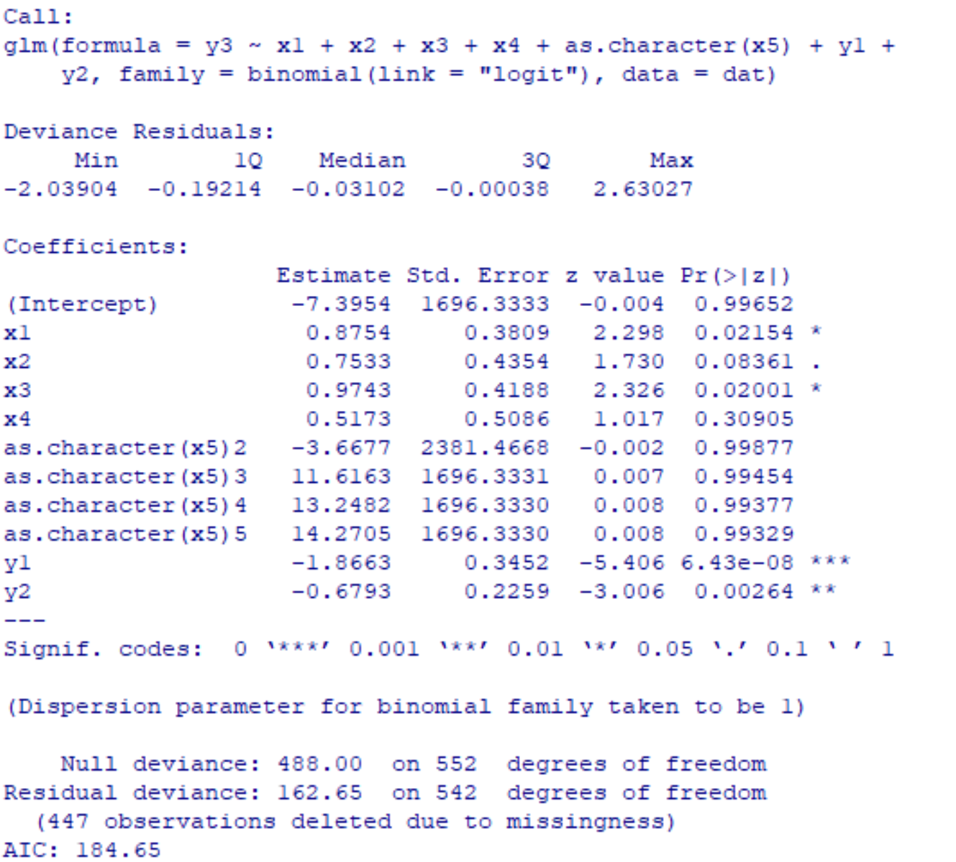
Imputation model testing

Slide 30
R package ‘MICE’
Multivariate Imputation by Chained Equations (MICE)
Multiple imputation using Fully Conditional Specification (FCS)implemented by the MICE algorithm as described in Van Buuren and Groothuis-Oudshoorn (2011) <doi:10.18637/jss.v045.i03>.

Slide 31
R package ‘MICE’
mice(data, m = 5, method = NULL, predictorMatrix, ignore = NULL, where = NULL, blocks, visitSequence = NULL, formulas, blots = NULL, post = NULL, defaultMethod = c("pmm", "logreg", "polyreg", "polr"), maxit = 5, printFlag = TRUE, seed = NA, data.init = NULL,...)

Slide 32
Built-in univariate imputation methods
Pmm (any): Predictive mean matching
Sample (any): Random sample from observed values
Mean (numeric): Unconditional mean imputation
norm.nob (numeric): Linear regression ignoring model error
Logreg (binary): Logistic regression
Polr (ordered): Proportional odds model
Polyreg (unordered): Polytomous logistic regression

Slide 33
Example runs (Imputation)
library(mice)
dat$x4<-as.factor(dat$x4)
dat$x5<-as.factor(dat$x5)
dat$y3<-as.factor(dat$y3)
dat2<-dat[,c(2:9)]
datm1<-mice(dat2)
datm2<-mice(dat2, meth = c("pmm","pmm","pmm","logreg","polyreg","pmm","pmm","logreg"))
PM<-rbind(c(0,rep(1,7)),c(1,0,rep(1,6)),c(1,1,0,rep(1,5)),c(rep(1,3),0,rep(1,4)),
c(rep(1,4),0,rep(1,3)),c(rep(1,4),rep(0,4)),c(rep(1,4),0,1,0,0),c(1,1,1,0,0,1,1,0))
datm3<-mice(dat2,meth=c("pmm","pmm","pmm","logreg","polyreg","pmm","pmm","logreg"), predictorMatrix=PM)

Slide 34
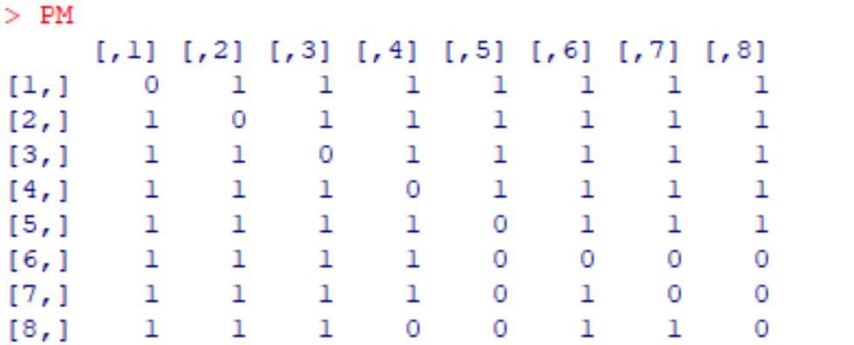
Predictor Matrix

Slide 35
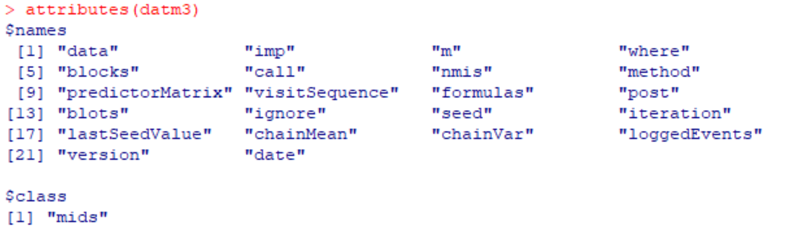
Output

Slide 36
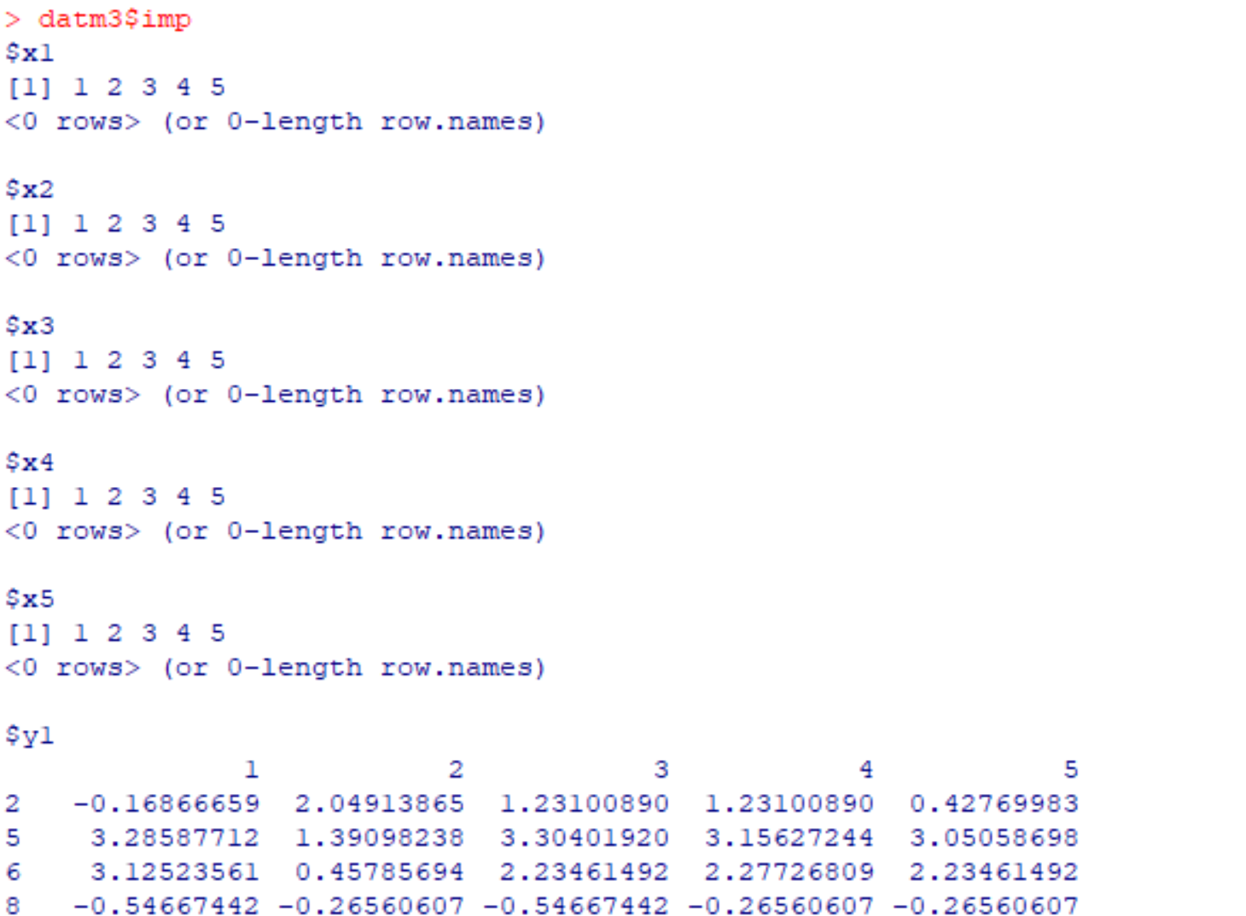
Output

Slide 37
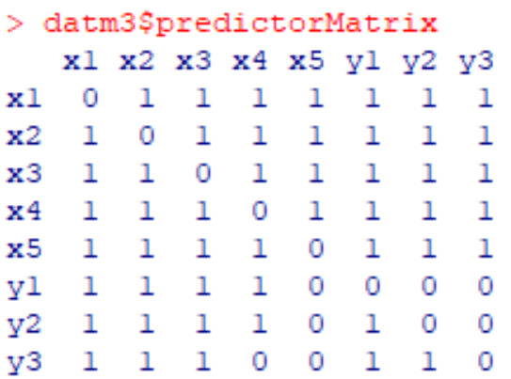
Output

Slide 38
Pooled analysis by using Rubin's rule
fit <- with(data = datm3, exp = lm(y1 ~ x1 + x2 + x3 + x4))
summary(pool(fit))
fit <- with(data = datm3, exp = glm(y3 ~ x1 + x2 + x3 + x4 + y1 + y2,family=binomial(link = "logit")))
summary(pool(fit))
fit <- with(data = datm3, exp = lm(y1~1))
summary(pool(fit))

Slide 39
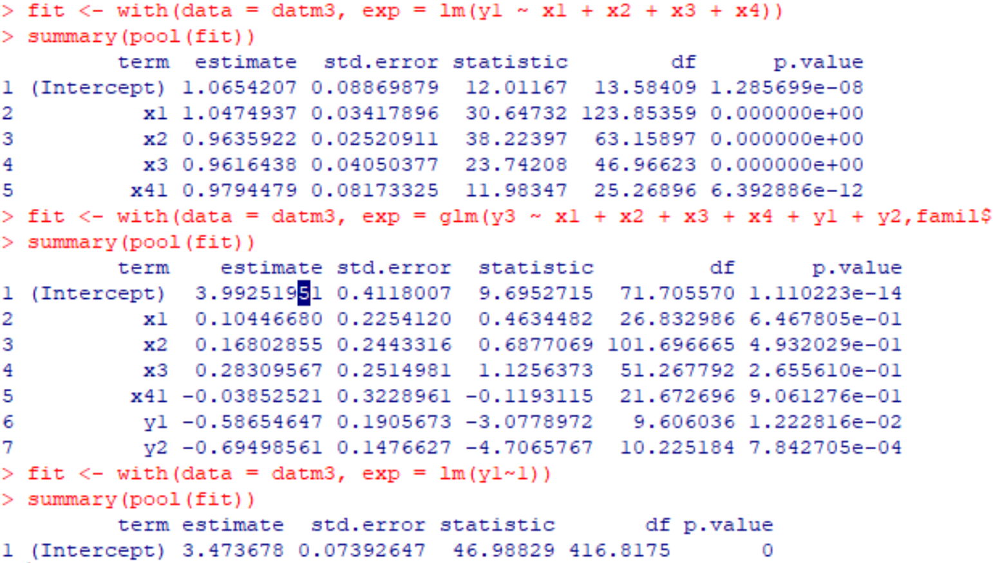
Output

Slide 40
Propensity score weighting
#estimate propensity scores for responding:
pfit1<-glm(r1~x1+x2+x3+x4+x5,data=dat,family=binomial(link = "logit"))
ep1<-pfit1$fitted.values
ew1<-1/ep1
pfit2<-glm(r2~x1+x2+x3+x4+x5,data=dat,family=binomial(link = "logit"))
ep2<-pfit2$fitted.values
ew2<-1/ep2
pfit3<-glm(r3~x1+x2+x3+x4+x5,data=dat,family=binomial(link = "logit"))
ep3<-pfit3$fitted.values
ew3<-1/ep3
dat3<-cbind(dat,ew1,ew2,ew3)

Slide 41
Propensity score weighting
##weighted analysis:
a1<-glm(y1~x1+x2+x3+x4,data=dat3,weights=ew1)
summary(a1)
a2<-glm(y2~x1+x2+x3+x4,data=dat3,weights=ew2)
summary(a2)
a3<-glm(y3~x1+x2+x3+x4,data=dat3,weights=ew3,family=binomial(link = "logit"))
summary(a3)

Slide 42
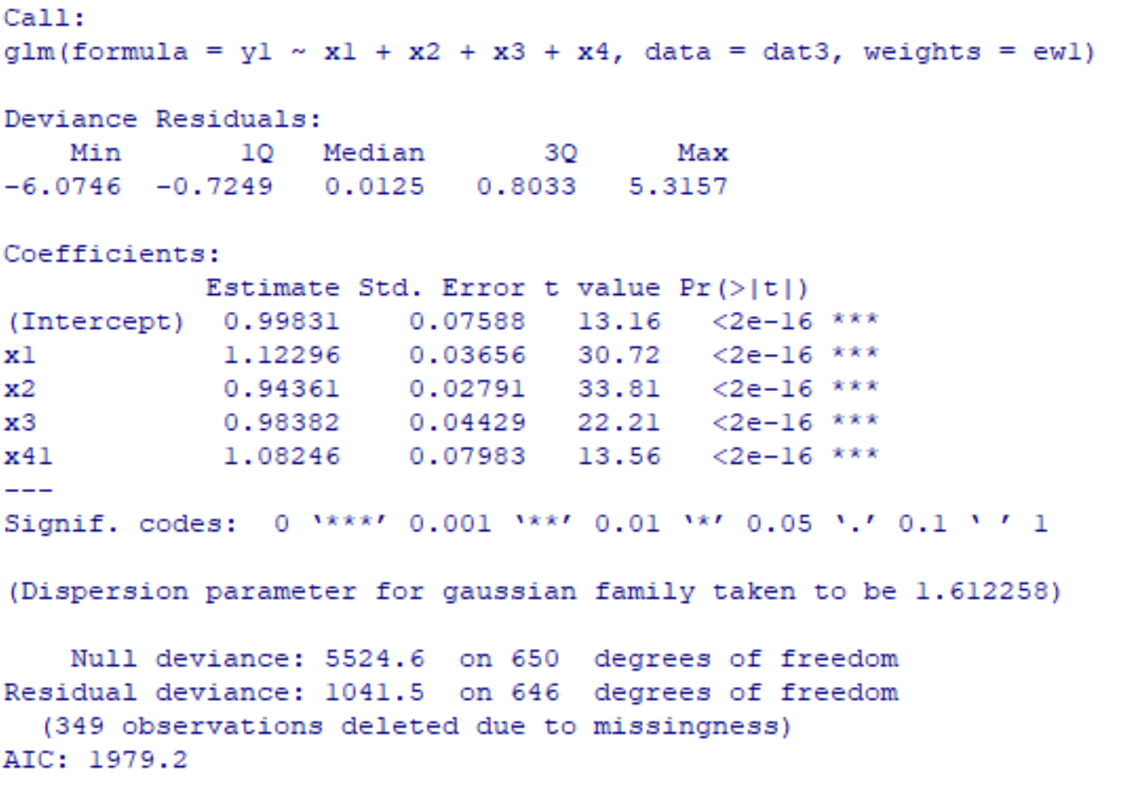
Output

Slide 43
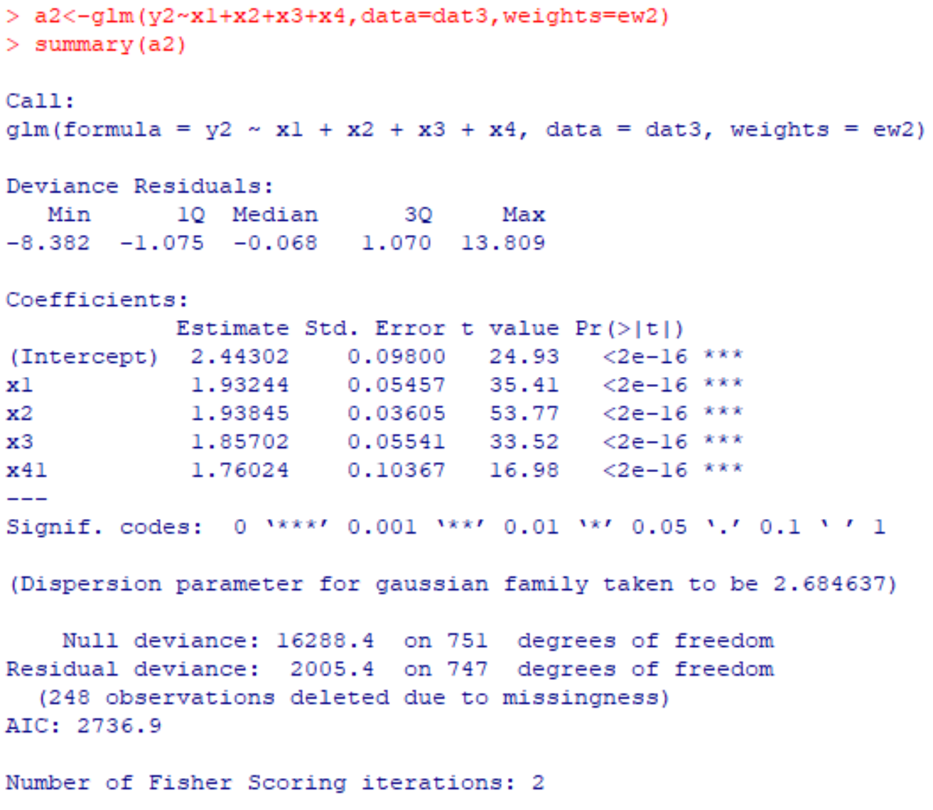
Output

Slide 44
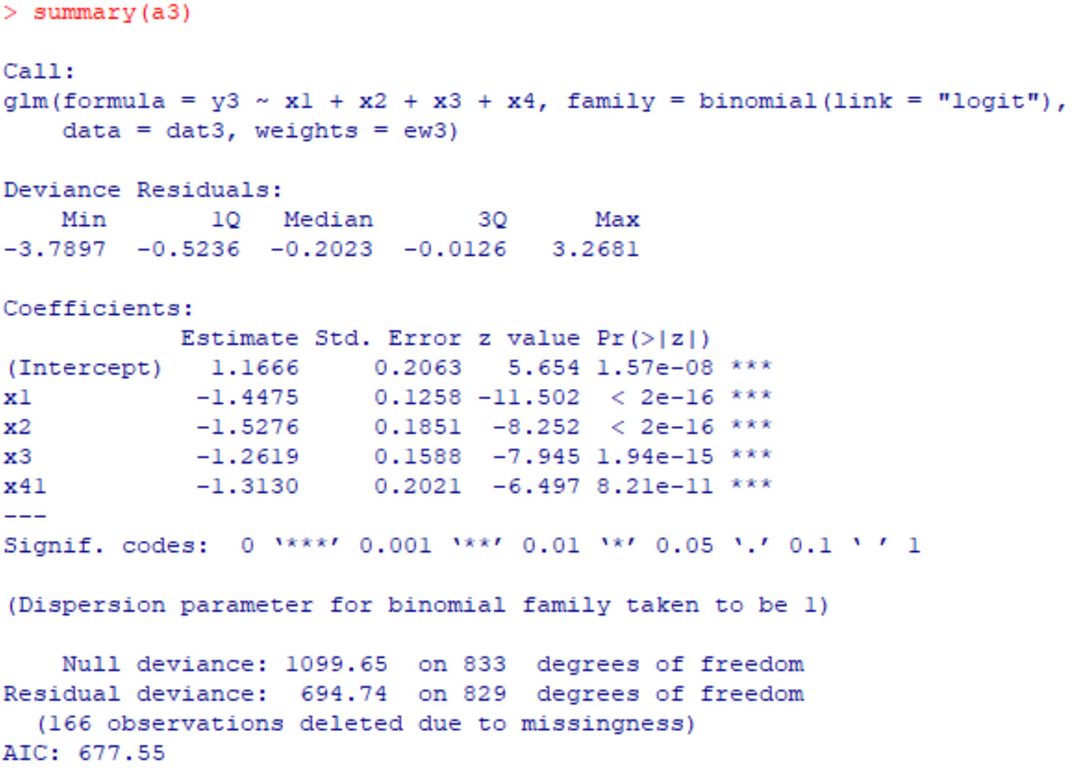
Output

Slide 45
Other methods (Not covered)
Observed likelihood methods
Doubly robust methods
Multiply robust methods
Not missing at random

