Slide 1

R Short Course Part 2
Topic 4: Survival analysis
Kai Ding, PhD
Department of Biostatistics and Epidemiology
Hudson College of Public Health, OUHSC
April 7, 2021

Slide 2
Outline
Right-censored data
Kaplan-Meier curve
Log-rank test and stratified log-rank test
Cox regression

Slide 3
Right-censored data
Time to the occurrence of a given event (e.g. death) measured from a well-defined starting point (time origin)
  e.g. Time from study enrollment to death in a cancer clinical trial
The full time to death is not observed for some subjects
  Withdrawal, lost to follow-up, alive at the end of study
  All we know is the survival time is larger than the censoring time (e.g. time from study enrollment to drop out)

Slide 4
Example
Question: do leukemia patients treated with 6-mercaptopruine (6-MP) have a longer remission time than those in the control group?
Sample: 42 leukemia patients, 1:1 randomized
Survival outcome: remission time (weeks)
Event: relapse

Slide 5
Dataset
Group: 0=control 1=drug
Time: Remission time (wks)
Delta: 0=censored 1=replace event observed

Slide 6
Kaplan-Meier estimate

Slide 7
Kaplan-Meier curves

Slide 8
Median survival time estimate and confidence interval

Slide 9
Log-rank test

Slide 10
Stratified log-rank test
What if we want to test for difference between two survival functions, adjusted for some confounding factor?
  One solution: stratify on the confounding factor (e.g. study site in multi-center RCT)

Slide 11
Example: Melanoma
Compare two immunotherapy treatments (BCG vs. C.parvum) among melanoma patients.
Tumor was surgically removed, then patient were assigned to either BCG or C. parvum.
Age (categorized into 3 groups) is a potential confounding factor.

Slide 12
Dataset
Age: 1=21-40 2=41-60 3=61-
Treatment: 1=BCG 2=C. parvum
Status: 0=censored 1=death

Slide 13
Stratified log-rank test

Slide 14
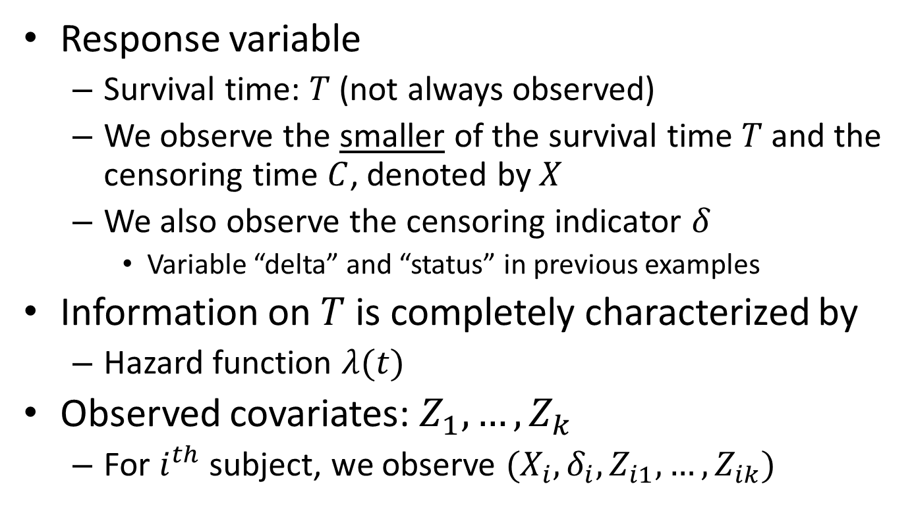
Cox regression
Response variable
  Survival time: $T$ (not always observed)
  We observe the smaller of the survival time $T$ and the censoring time $C$, denoted by $X$
  We also observe the censoring indicator $δ$
    Variable “delta” and “status” in previous examples
Information on $T$ is completely characterized by
  Hazard function $λ(t)$
Observed covariates: $Z_{1}, …, Z_{k}$
  For $i^{th}$ subject, we observe $(X_{i}, δ_{i}, Z_{i1}, …, Z_{ik})$

Slide 15
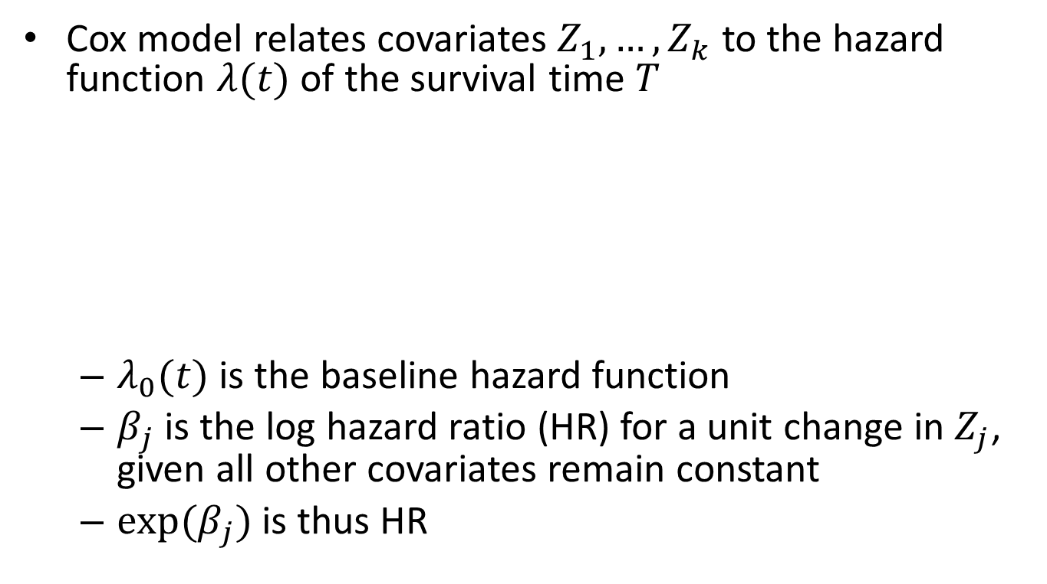
Cox regression
Cox model relates covariates $Z_{1}, …, Z_{k}$ to the hazard function $λ(t)$ of the survival time $T$
  $λ_{0}(t)$ is the baseline hazard function
  $β_{j}$ is the log hazard ratio (HR) for a unit change in $Z_{j}$, given all other covariates remain constant
  ${exp⁡(β}_{j})$ is thus HR

Slide 16
Example: Survival of multiple myeloma patients
The aim of this study carried out at the Medical Center of the University of West Virginia, was to examine the association between explanatory variables or covariates and the survival time of patients.
The primary response variable was the time, in months, from diagnosis until death from multiple myeloma.
Sample: 48 multiple myeloma patients of age 50 – 80 years

Slide 17
Example: Survival of multiple myeloma patients
Data on the following 7 covariates were collected:
We will fit a Cox regression model

Slide 18
Dataset

Slide 19
Fitting Cox model
Column “exp(coef)” can be interpreted as hazard ratios
  After adjusting for age, bun, ca, Hb, pcells and protein, the hazard of death from multiple myeloma among females is 22% lower than among males
  After adjusting for age, sex, ca, Hb, pcells and protein, one unit increase in bun is associated with a 2% increase in the hazard of death from multiple myeloma

Slide 20
Obtaining confidence intervals

Slide 21
Handling ties in Cox regression
Often, survival time is continuous
Ties are the result of imprecise measurement of time.
  There is a true time ordering among the ties.

Slide 22
Efron’s method (default)

Slide 23
Exact method (can be time consuming)

Slide 24
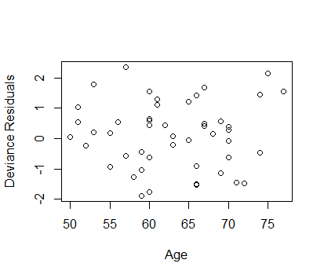
Deviance residual plot
To detect any outlier(s)

Slide 25
Schoenfeld residual plots
To check the proportional hazards (PH) assumption
Schoenfeld residuals should be randomly scattered about zero if the PH assumption is met

Slide 26
Schoenfeld residual plots

Slide 27
Statistical test of PH assumption

Slide 28
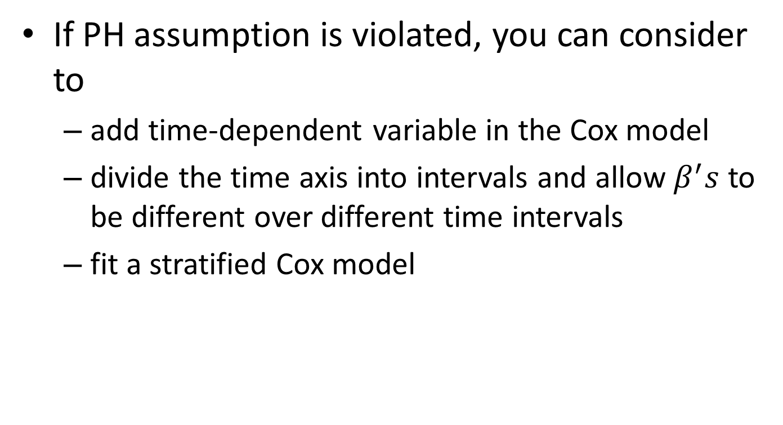
Methods to address PH assumption violation
If PH assumption is violated, you can consider to
  add time-dependent variable in the Cox model
  divide the time axis into intervals and allow $β^{′}s$ to be different over different time intervals
  fit a stratified Cox model

Slide 29
Reference
Collett D (2015) Modelling Survival Data in Medical Research. Third Edition. ISBN-13: 9781439856789.

