Slide 1
R Short Course Part 2 Topic 8: Graphics
Chao Xu, PhD
Department of Biostatistics and Epidemiology
Hudson College of Public Health, OUHSC
April 8, 2021

Slide 2
Outline
Mathematical annotation
ggplot
Graph export
Graph quality

Slide 3
Mathematical annotation
Using quote()/expression()
Mathematical expression/formula/symbol
help(plotmath)

Slide 4
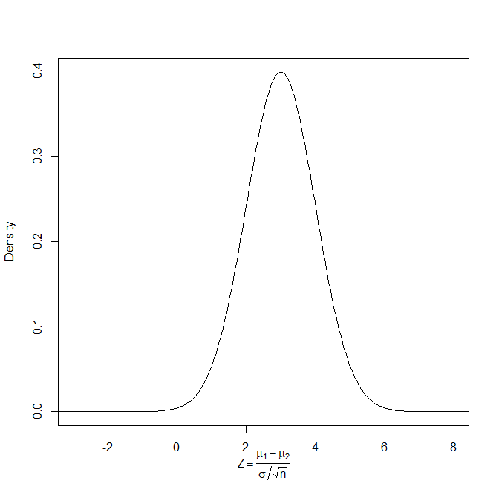
Mathematical annotation
Using quote()

Slide 5
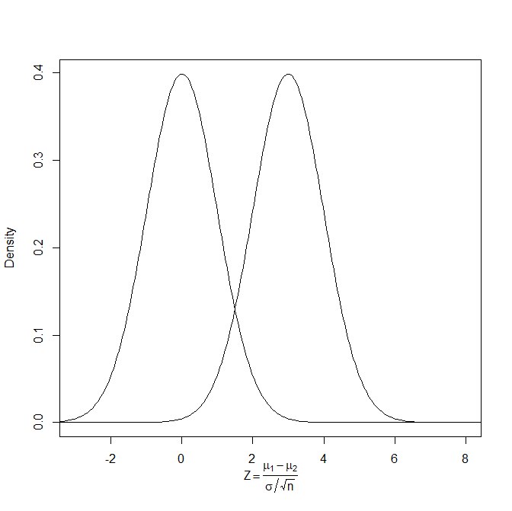
Mathematical annotation
Using expression()

Slide 6
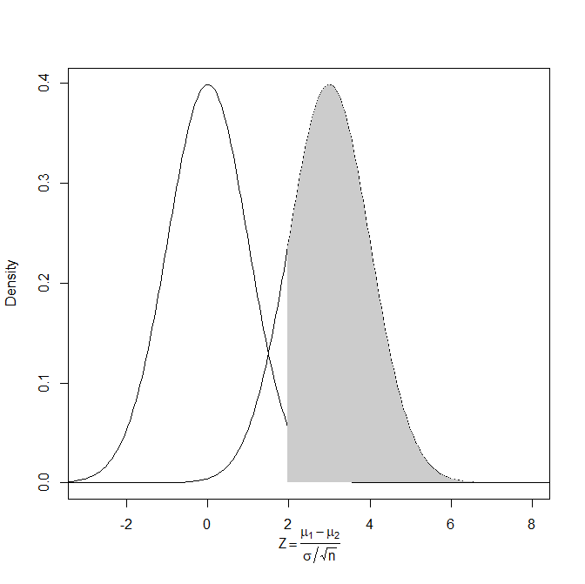
Mathematical annotation
Annotate plot area using polygon()

Slide 7
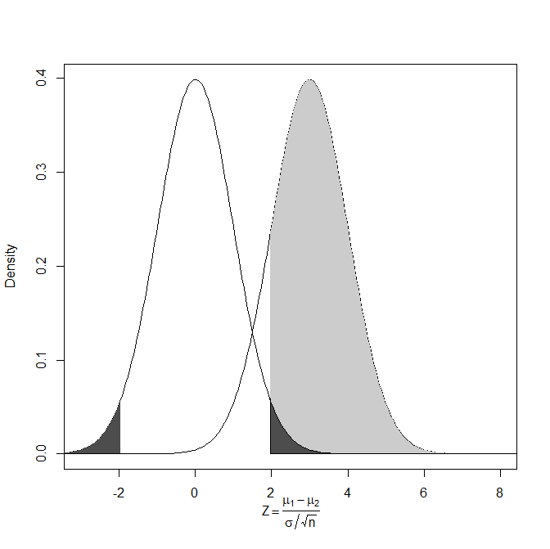
Mathematical annotation
Annotate plot area using polygon()

Slide 8
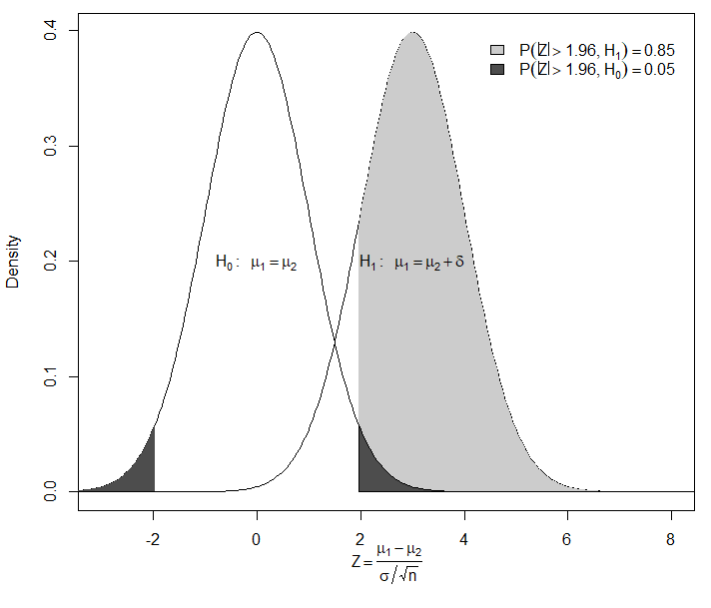
Mathematical annotation
Final product

Slide 9
ggplot
The Grammar of Graphics
https://ggplot2.tidyverse.org/

Slide 10
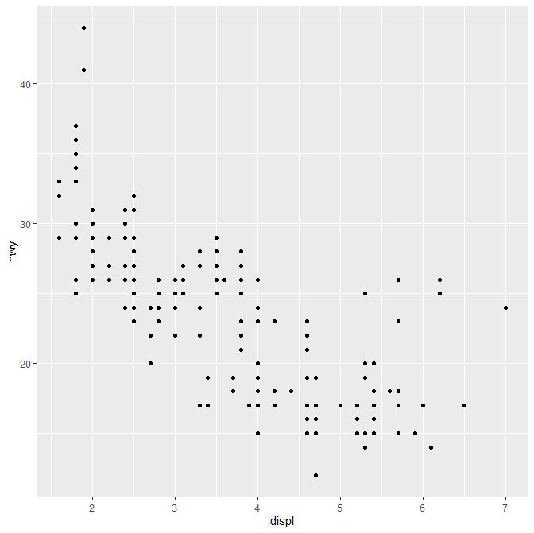
ggplot
Basic usage

Slide 11
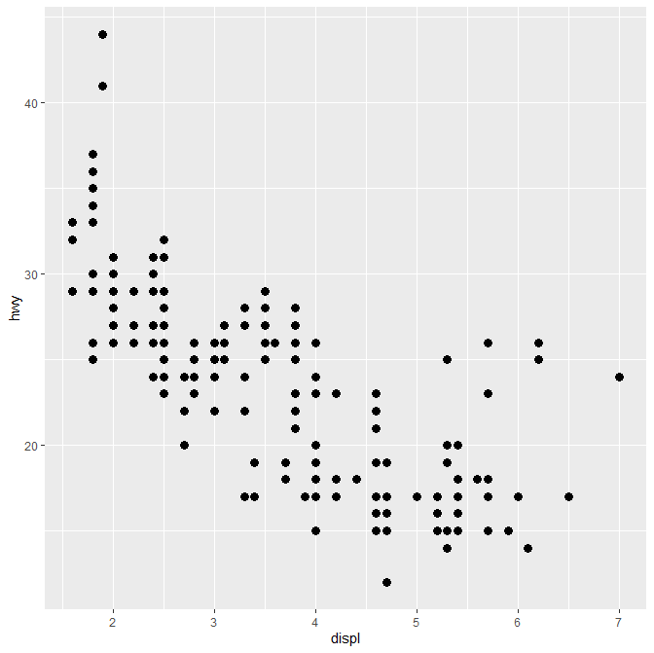
ggplot
Basic usage

Slide 12
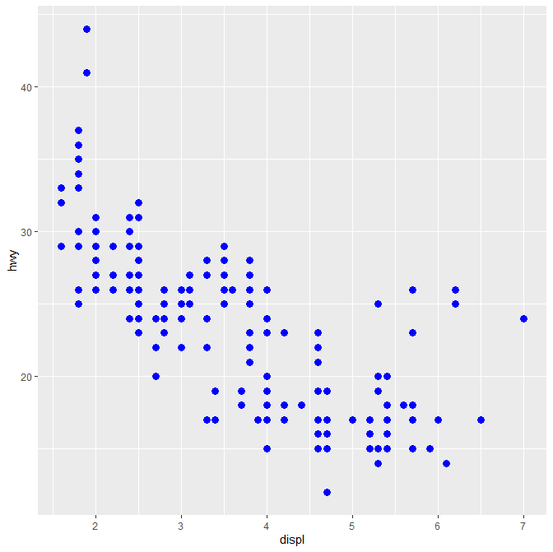
ggplot
Basic usage

Slide 13
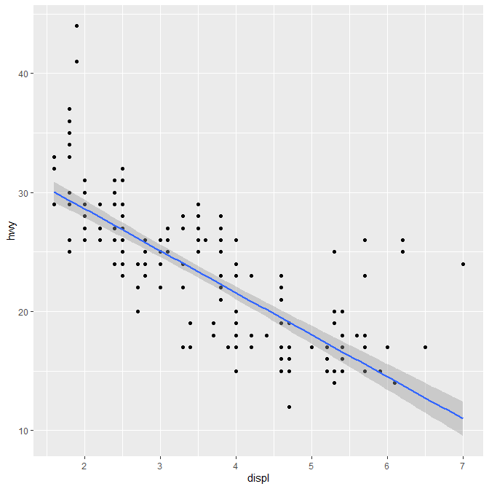
ggplot
Basic usage

Slide 14
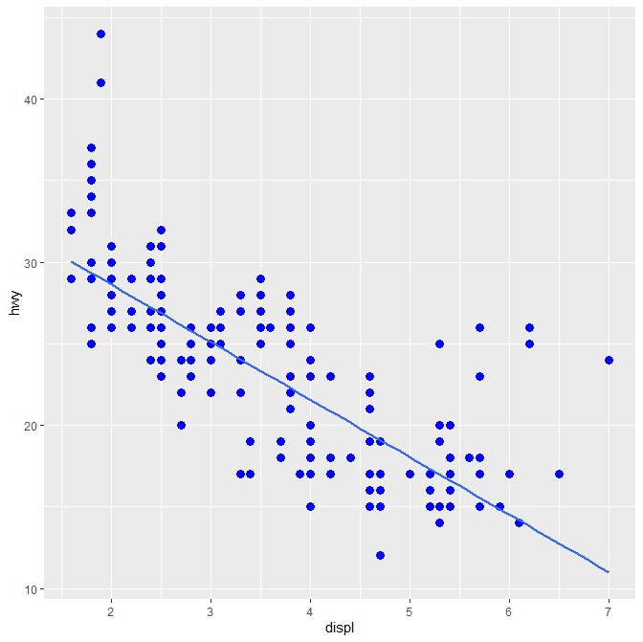
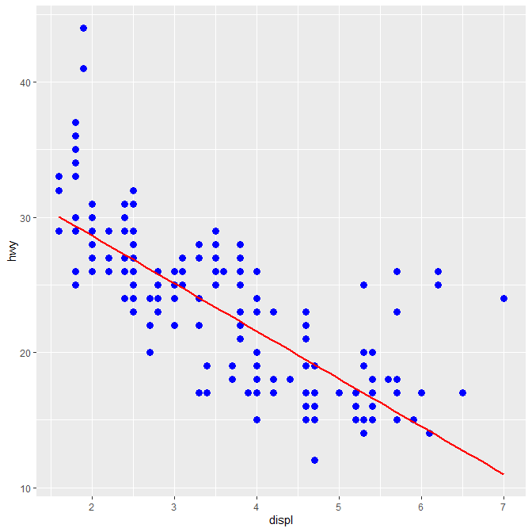
ggplot
Basic usage

Slide 15
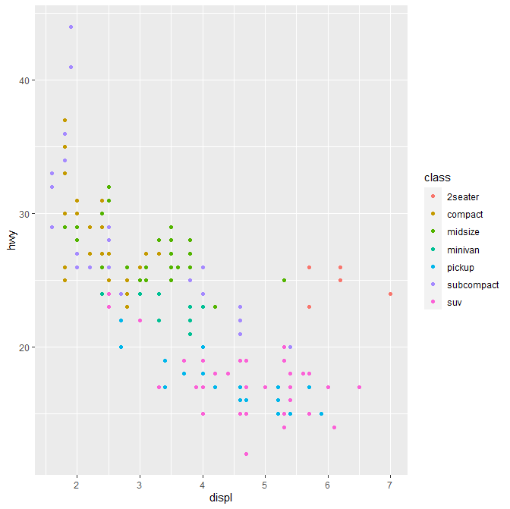
ggplot
Basic usage

Slide 16
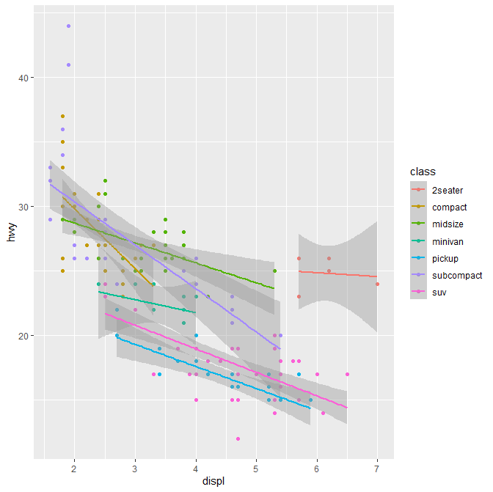
ggplot
Basic usage

Slide 17
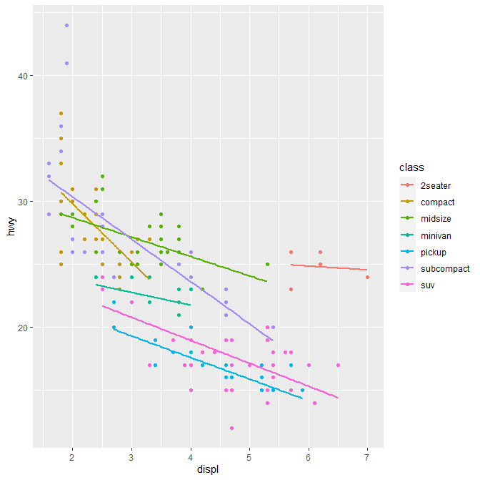
ggplot
Basic usage

Slide 18
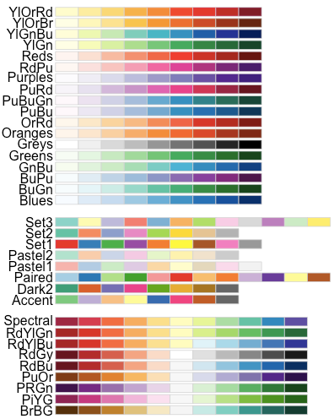
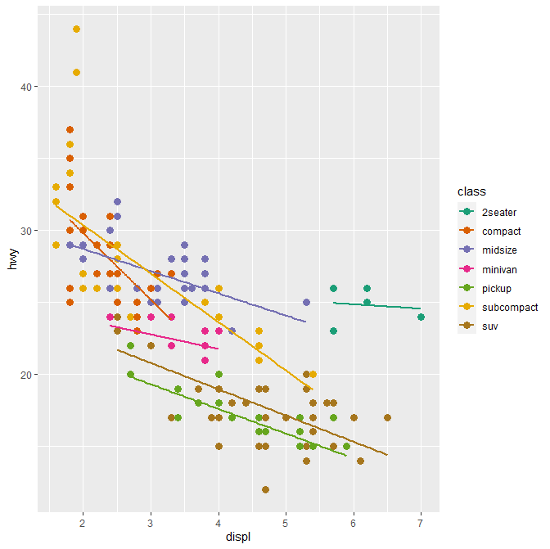
ggplot
Basic usage

Slide 19
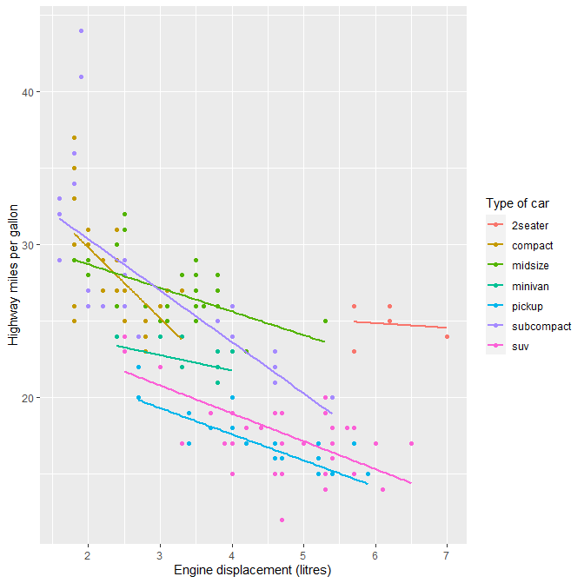
ggplot
Basic usage

Slide 20
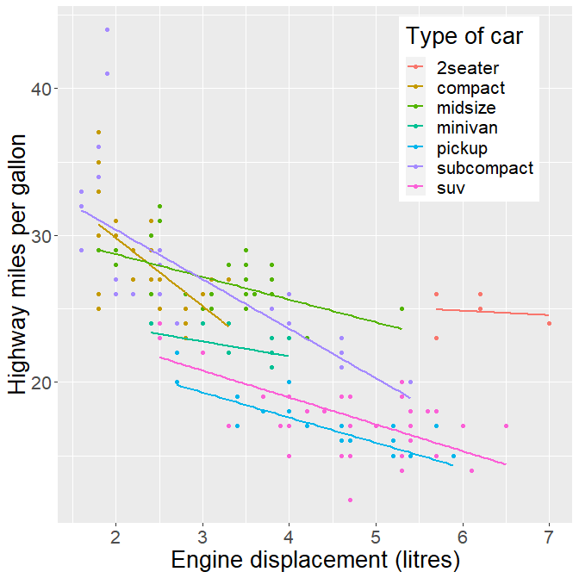
ggplot
Basic usage

Slide 21
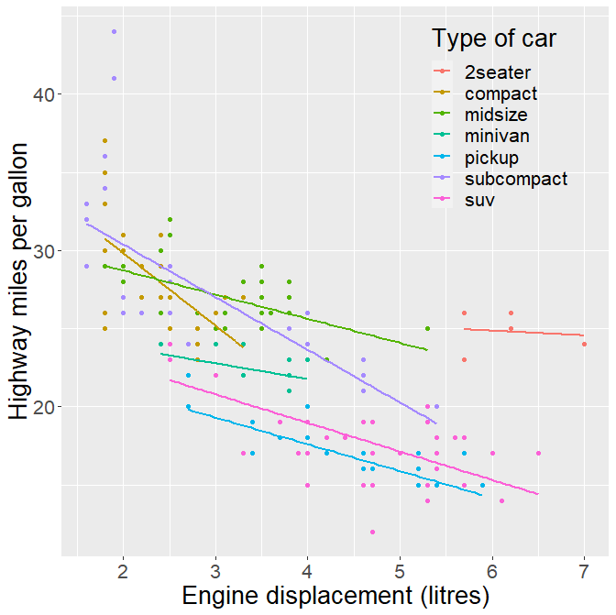
ggplot
Basic usage

Slide 22
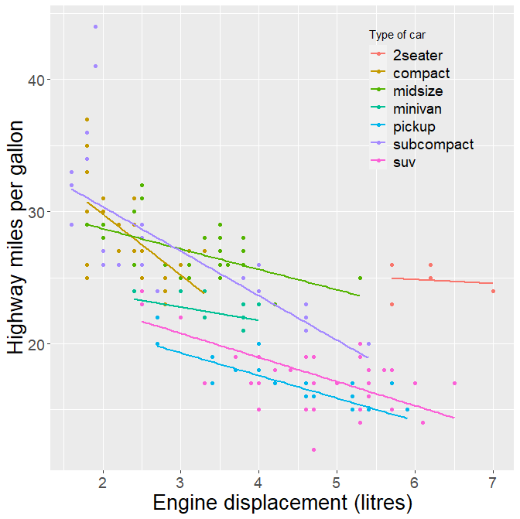
ggplot
Basic usage

Slide 23
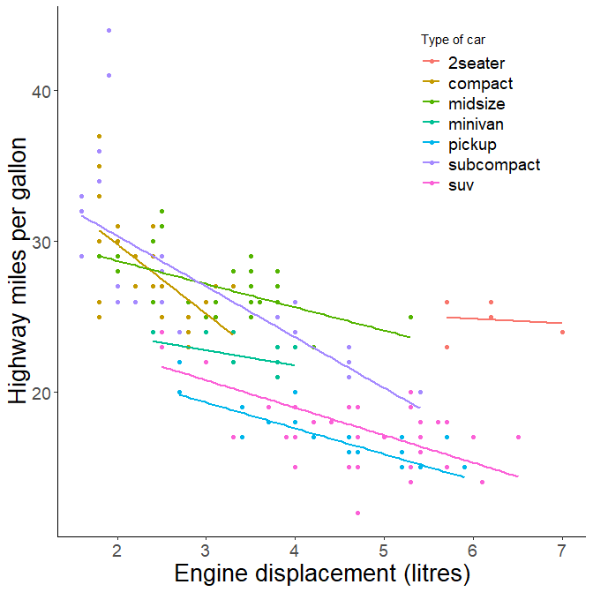
ggplot
Basic usage

Slide 24
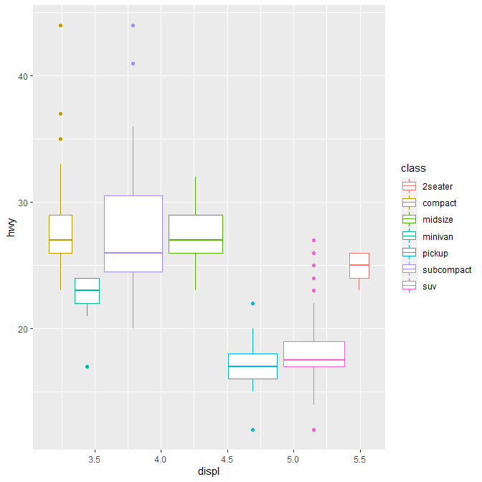
ggplot
Boxplot

Slide 25
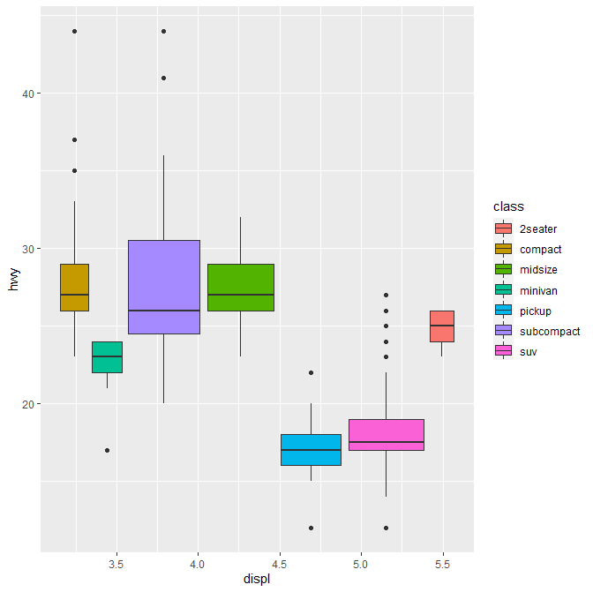
ggplot
Boxplot

Slide 26
ggplot
Boxplot

Slide 27
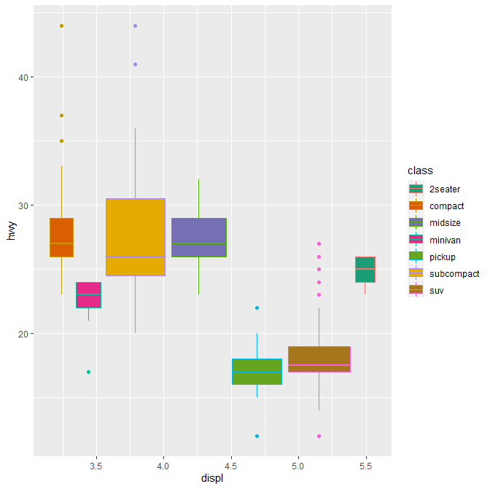
ggplot
Boxplot

Slide 28
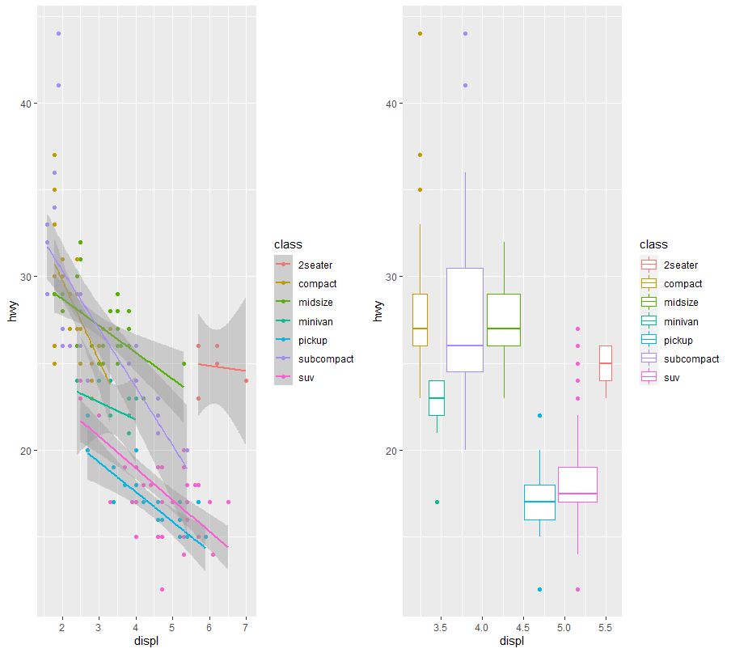
ggplot
Multiplot

Slide 29
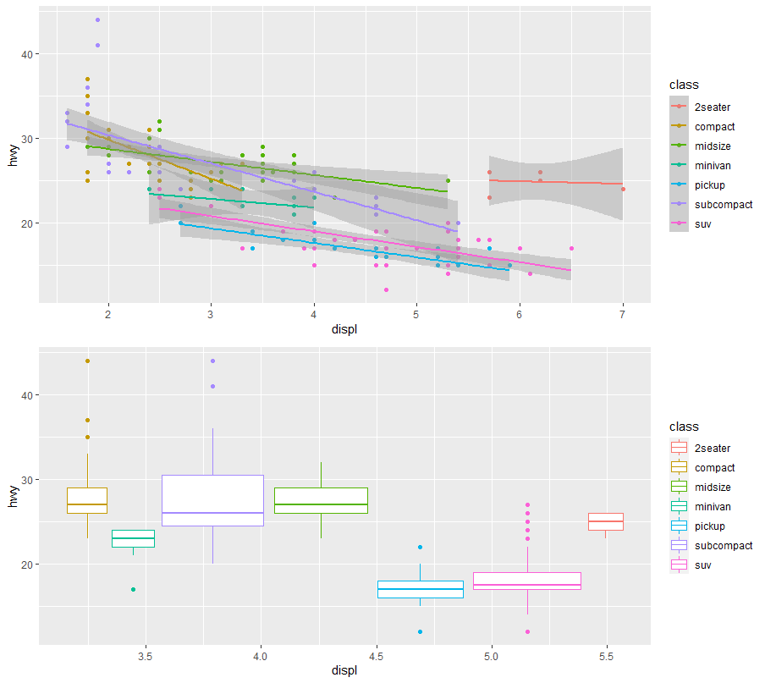
ggplot
Multiplot

Slide 30
Graph export
Screenshot
PDF files
PNG or jpeg formats
Using Copy/Save as function

Slide 31
Graph export
PDF files

Slide 32
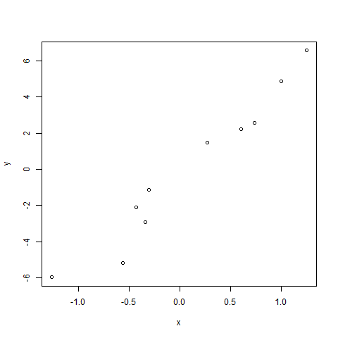
Graph export
PNG files

Slide 33
Graph quality
Figure size
Windows(height=4, width=6)
pdf(“figure.pdf”, height=4, width=6)
……

Slide 34
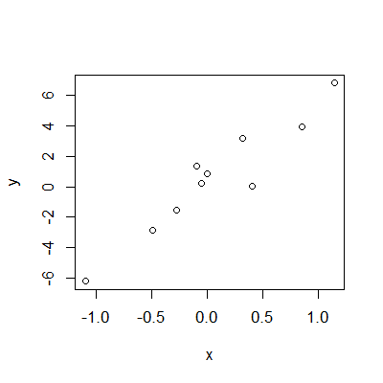
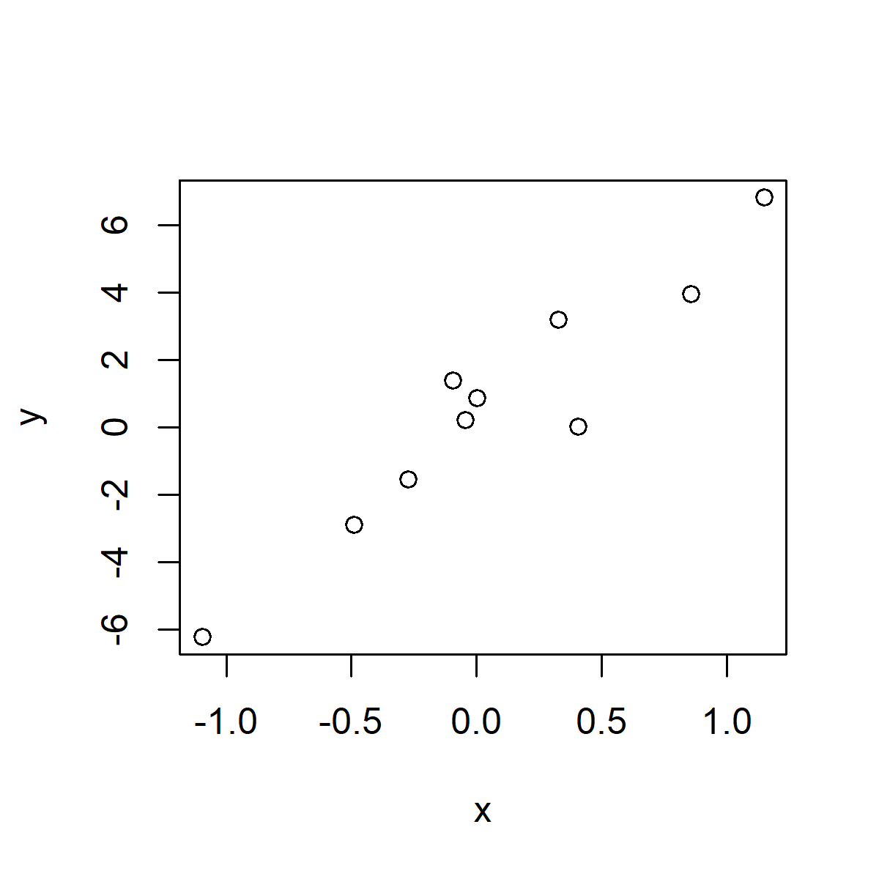
Graph quality
Pixels per inch (PPI)
png(“figure.pdf”, height=4, width=4, units=‘in’, res=300)
Res=100
Res=300

