Slide 1

R Short Course Part 2
Topic 9: Monte Carlo simulation
Sixia Chen, PhD
Department of Biostatistics and Epidemiology
Hudson College of Public Health, OUHSC
April 16, 2021

Slide 2
Outline
Simulations from different distributions
Monte Carlo simulation setups
Monte Carlo simulation examples
  One sample problem
  Two sample problem
  Linear regression
  Logistic regression

Slide 3
Simulation from some distributions
Normal distribution
  rnorm(n, mean = 0, sd = 1)
  Example: rnorm(100, mean=1, sd=2)
Chi-square distribution
  rchisq(n, df, ncp = 0)
  Example: rchisq(100, df=2)
Exponential distribution
  rexp(n, rate = 1)
  Example: rexp(100, 2)

Slide 4
Simulation from some distributions
t distribution
  rt(n, df, ncp)
  Example: rt(10,df=2)
Uniform distribution
  runif(n, min = 0, max = 1)
  Example: runif(10, min=1, max=2)
Gamma distribution
  rgamma(n, shape, rate = 1, scale = 1/rate)
  Example: rgamma(20, shape=1, rate=2)

Slide 5
Simulation from some distributions
Bernoulli distribution
  Install R package ‘Rlab’
  rbern(n,prob)
  Example: rbern(10, 0.5)
Binomial distribution
  rbinom(n, size, prob)
  Example: rbinom(10, 2, prob=0.5)
Poisson distribution
  rpois(n, lambda)
  Example: rpois(20, 1)

Slide 6
Simulation from some distributions
Multivariate normal distribution
  Install R package ‘MASS’
  mvrnorm(n , mu, Sigma)
  Example: mvrnorm(n=10, mu=c(1,2), Sigma=matrix(c(1,0,0,1),2,2))
Simple random samples:
  Without replacement: sample(1:10, 2, replace = FALSE)
  With replacement: sample(1:10, 5, replace = TRUE)

Slide 7
Monte Carlo simulation setups
Population parameter of interest
  Population mean
  Population regression coefficient
  Population percentiles
  Population variance
Statistical model setups
  Generate Monte Carlo samples
  For each sample, provide estimates
Evaluation criteria
  Point estimation: Monte Carlo Bias, Standard error, Variance, Mean Squared Error, relative Bias,

Slide 8
Evaluation Criteria
Point estimation
  Monte Carlo (MC) Bias (Bias)
  MC Standard error (SE)
  MC Mean Squared Error (MSE)
  MC relative Bias (RB)
  MC relative Standard error (RSE)
  MC relative root Mean Squared Error (RRMSE)

Slide 9
Evaluation Criteria
Variance estimation
  MC relative Bias (VRB)
  MC Coverage rate (CR)
  MC Average length (AL)

Slide 10
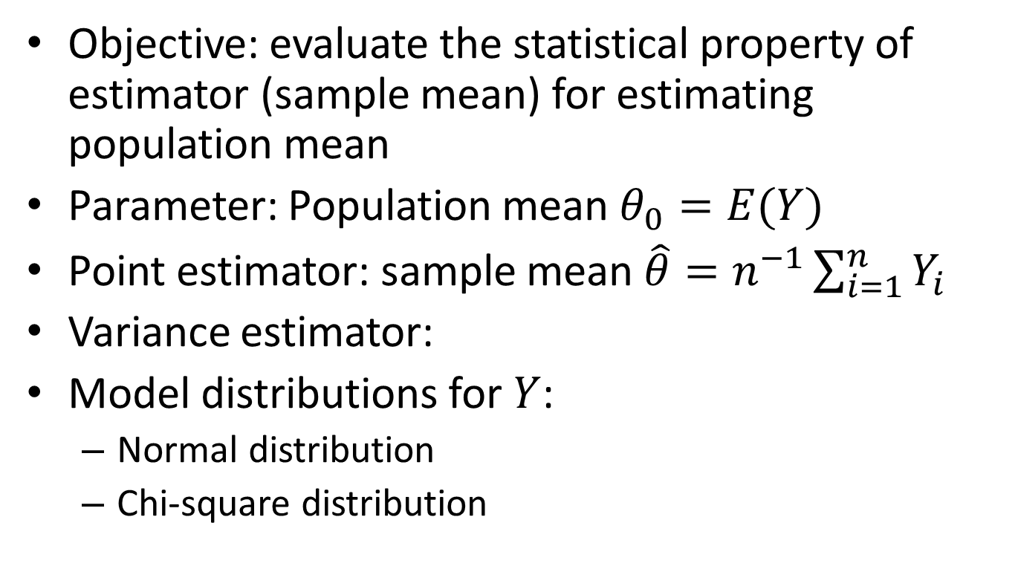
Example 1: One sample problem
Objective: evaluate the statistical property of estimator (sample mean) for estimating population mean
Parameter: Population mean $θ_{0}=E(Y)$
Point estimator: sample mean $\hat{θ}=n^{−1}\sum_{i=1}^{n}{Y_{i}}$
Variance estimator:
Model distributions for $Y$:
  Normal distribution
  Chi-square distribution

Slide 11
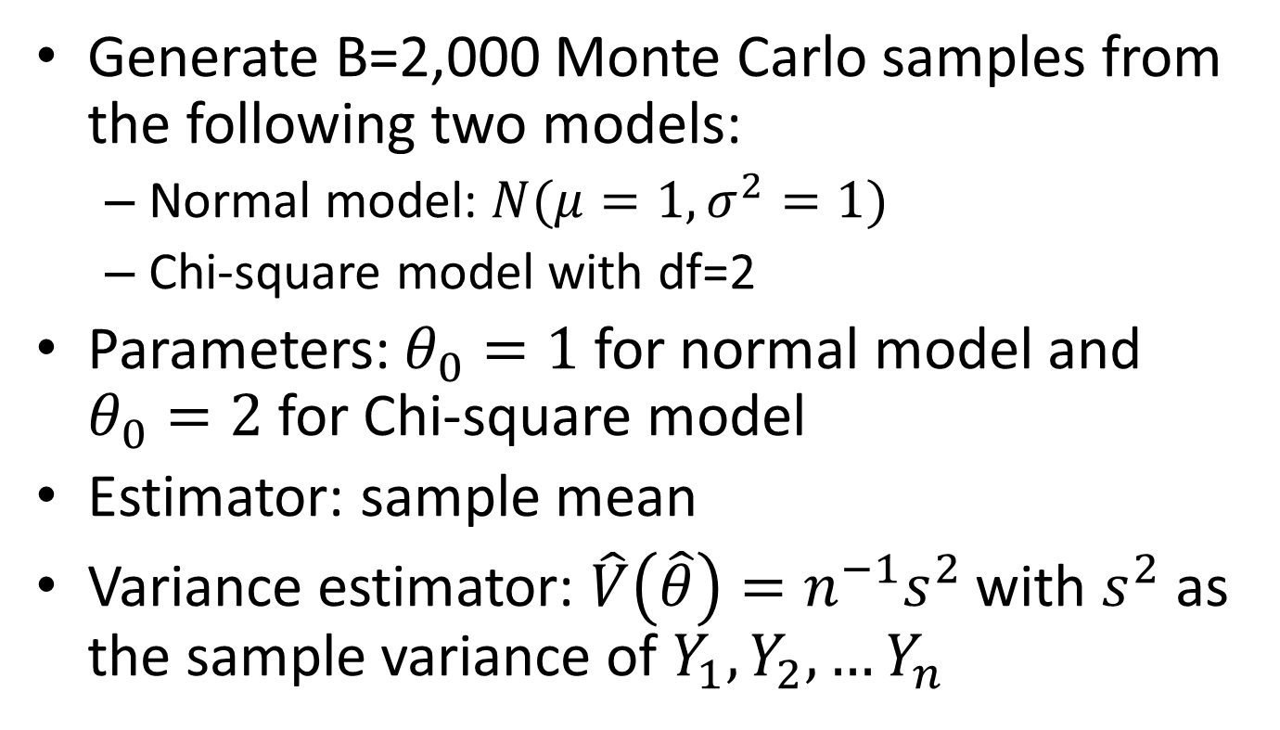
Simulation setups
Generate B=2,000 Monte Carlo samples from the following two models:
  Normal model: $N(μ=1,σ^{2}=1)$
  Chi-square model with df=2
Parameters: $θ_{0}=1$ for normal model and $θ_{0}=2$ for Chi-square model
Estimator: sample mean
Variance estimator: $\hat{V}\left(\hat{θ}\right)=n^{−1}s^{2}$ with $s^{2}$ as the sample variance of $Y_{1}, Y_{2},…Y_{n}$

Slide 12

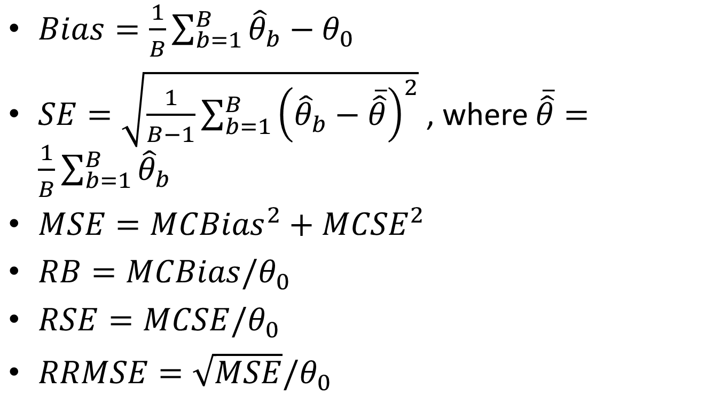
Evaluation Criteria-Point Estimation
$Bias=\frac{1}{B}\sum_{b=1}^{B}{{\hat{θ}}_{b}}−θ_{0}$
$SE=\sqrt{\frac{1}{B−1}\sum_{b=1}^{B}{{\left({\hat{θ}}_{b}−\overline{\hat{θ}}\right)}^{2}}}$, where $\overline{\hat{θ}}=\frac{1}{B}\sum_{b=1}^{B}{{\hat{θ}}_{b}}$
$MSE={MCBias}^{2}+{MCSE}^{2}$
$RB=MCBias/θ_{0}$
$RSE=MCSE/θ_{0}$
$RRMSE=\sqrt{MSE}/θ_{0}$
$$θ_{0}$$

Slide 13
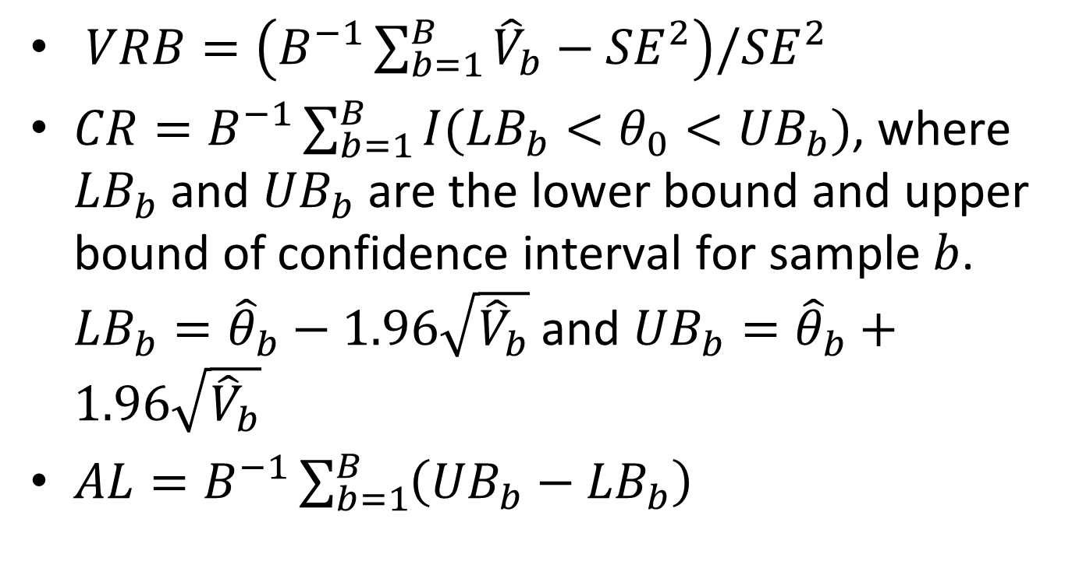
Evaluation Criteria-Variance Estimation
$VRB=\left(B^{−1}\sum_{b=1}^{B}{{\hat{V}}_{b}−{SE}^{2}}\right)/{SE}^{2}$
$CR=B^{−1}\sum_{b=1}^{B}{I({LB}_{b}<θ_{0}<{UB}_{b})}$, where ${LB}_{b}$ and ${UB}_{b}$ are the lower bound and upper bound of confidence interval for sample $b$. ${LB}_{b}={\hat{θ}}_{b}−1.96\sqrt{{\hat{V}}_{b}}$ and ${UB}_{b}={\hat{θ}}_{b}+1.96\sqrt{{\hat{V}}_{b}}$
$AL=B^{−1}\sum_{b=1}^{B}{\left({UB}_{b}−{LB}_{b}\right)}$

Slide 14
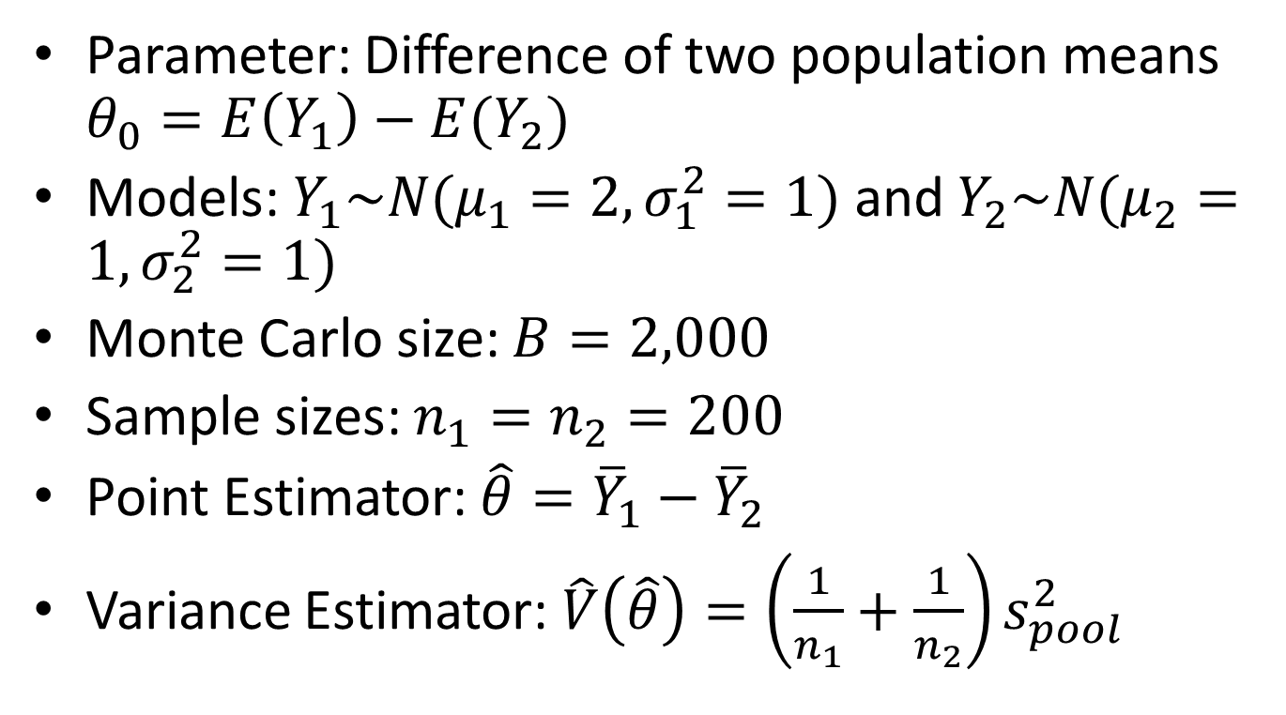
Example 2: Two sample problem
Parameter: Difference of two population means $θ_{0}=E\left(Y_{1}\right)−E(Y_{2})$
Models: $Y_{1}\sim N(μ_{1}=2,σ_{1}^{2}=1)$ and $Y_{2}\sim N(μ_{2}=1,σ_{2}^{2}=1)$
Monte Carlo size: $B=2,000$
Sample sizes: $n_{1}=n_{2}=200$
Point Estimator: $\hat{θ}={\overline{Y}}_{1}−{\overline{Y}}_{2}$
Variance Estimator: $\hat{V}\left(\hat{θ}\right)=\left(\frac{1}{n_{1}}+\frac{1}{n_{2}}\right)s_{pool}^{2}$

Slide 15
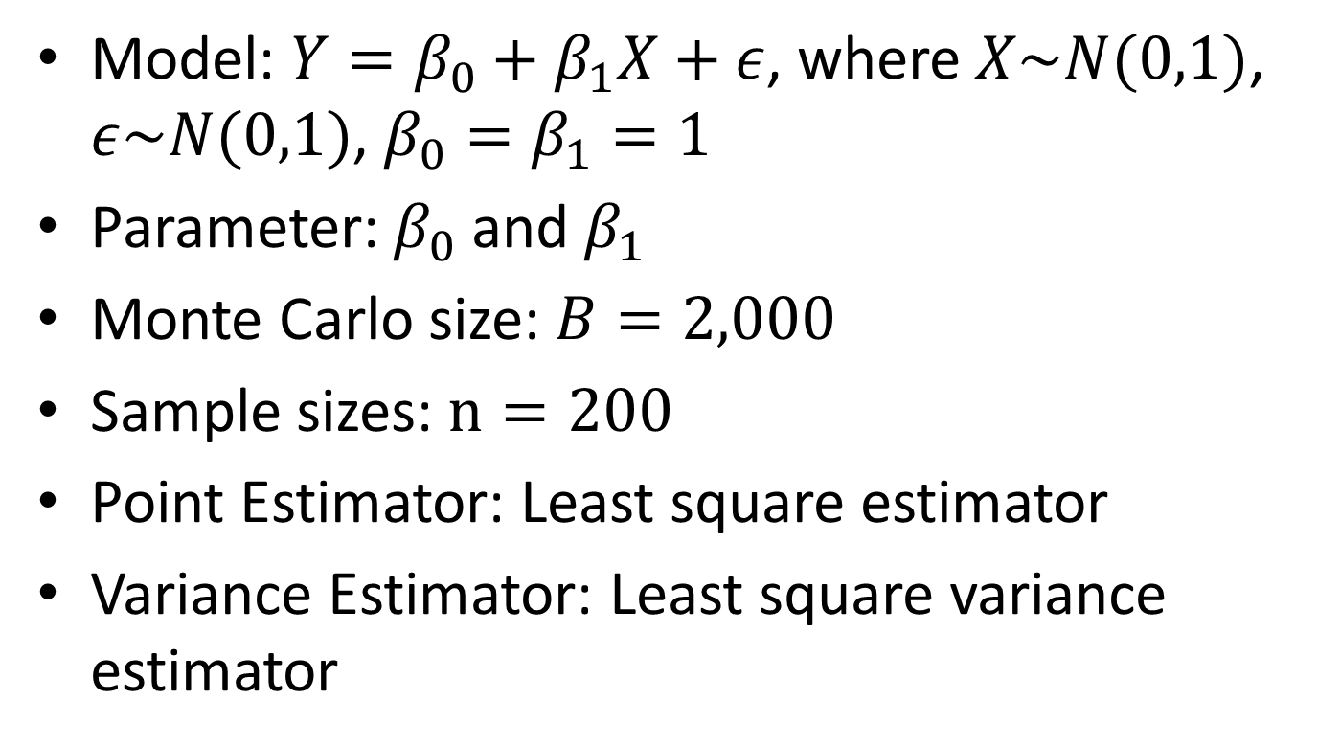
Example 3: Linear regression
Model: $Y=β_{0}+β_{1}X+ε$, where $X\sim N(0,1)$, $ε\sim N(0,1)$, $β_{0}=β_{1}=1$
Parameter: $β_{0}$ and $β_{1}$
Monte Carlo size: $B=2,000$
Sample sizes: $n=200$
Point Estimator: Least square estimator
Variance Estimator: Least square variance estimator

Slide 16
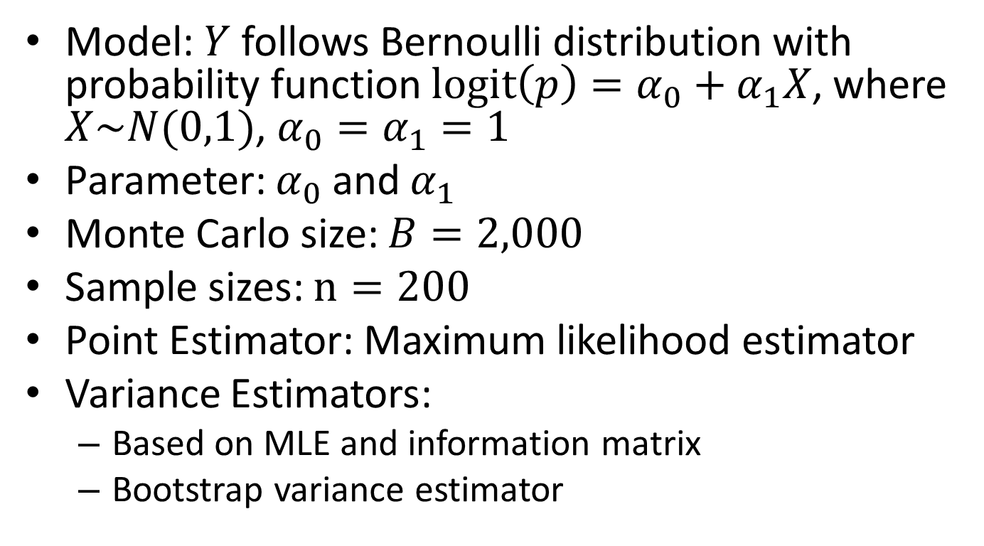
Example 4: Logistic regression
Model: $Y$ follows Bernoulli distribution with probability function $logit\left(p\right)=α_{0}+α_{1}X$, where $X\sim N(0,1)$, $α_{0}=α_{1}=1$
Parameter: $α_{0}$and $α_{1}$
Monte Carlo size: $B=2,000$
Sample sizes: $n=200$
Point Estimator: Maximum likelihood estimator
Variance Estimators:
  Based on MLE and information matrix
  Bootstrap variance estimator

Slide 17
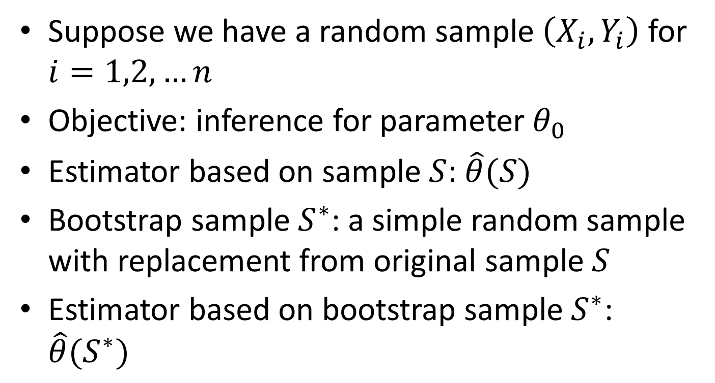
Bootstrap variance estimator
Suppose we have a random sample $\left(X_{i},Y_{i}\right)$ for $i=1,2,…n$
Objective: inference for parameter $θ_{0}$
Estimator based on sample $S$: $\hat{θ}(S)$
Bootstrap sample $S^{∗}$: a simple random sample with replacement from original sample $S$
Estimator based on bootstrap sample $S^{∗}$: $\hat{θ}(S^{∗})$

Slide 18
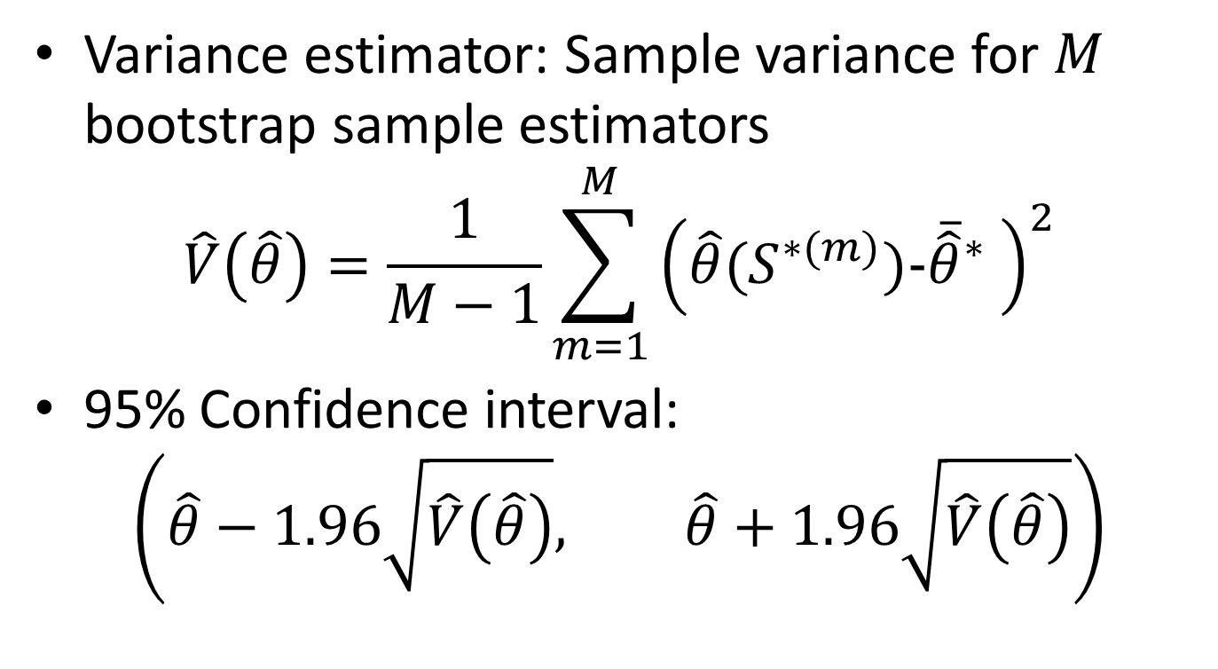
Bootstrap variance estimator
Variance estimator: Sample variance for $M$ bootstrap sample estimators
$$\hat{V}\left(\hat{θ}\right)=\frac{1}{M−1}\sum_{m=1}^{M}{{\left(\hat{θ}(S^{∗(m)})\text{-}{\overline{\hat{θ}}}^{∗} \right)}^{2}}$$
95% Confidence interval:
$$\left(\hat{θ}−1.96\sqrt{\hat{V}\left(\hat{θ}\right)}, \hat{θ}+1.96\sqrt{\hat{V}\left(\hat{θ}\right)}\right)$$

