Slide 1

Multiplicity Adjustment in Design and Analysis of Clinical Trials
Daniel Zhao
Presidential Professor
Associate Dean for Research
Hudson College of Public Health
University of Oklahoma Health Sciences Center
8/13/2021

Slide 2
Outline
Motivate using classical multiplicity adjustment methods (multiple comparison, multiple testing)
Examples of multiplicity problems
Define Familywise Error Rate (FWER)
Why is the controlling of FWER necessary
Weak and strong control of FWER
Closed Testing Principle for controlling FWER
Adjusted p-values
Common multiplicity adjustment procedures

Slide 3
Motivation (1)
Single continuous outcome y, at single time point
Treatment with multiple groups (1, 2, 3).
  Active treatments: 1, 2
  Control: 3
Pairwise comparisons (1 vs 2, 1 vs 3, 2 vs 3)
  Bonferroni Adjustment (nonparametric)
  Tukey Adjustment (parametric)
SAS code (adjusted p-values):
  proc glm; class treatment; model y=treatment;
  lsmeans treatment/adjust=bon pdiff;
  lsmeans treatment/adjust=tukey pdiff;

Slide 4
Motivation (2)
Active vs control (1 vs 3, 2 vs 3)
  Rationale: increase power (smaller p-value) with a smaller number of comparisons
  Bonferroni Adjustment
  Dunnett Adjustment
SAS code:
  lsmeans treatment/adjust=dunnett pdiff=control(‘3’);
SAS outputs adjusted p-values which should be compared to 2-sided .05 level
SAS demo

Slide 5
Examples of multiplicity problems
Multiple treatment comparisons
  Dose-response studies
Multiple primary endpoints
  the efficacy profile of cardiovascular drugs is typically evaluated using multiple outcome variables such as all-cause mortality, nonfatal myocardial infarction, or refractory angina/urgent revascularization
Multiple secondary endpoints.
  progression-free survival and overall survival
Multiple patient populations
  Overall population and Subgroup defined by a signature
Multiple looks
  Group sequential and Adaptive design

Slide 6

Familywise Error Rate (FWER)
Consider $k$ null hypotheses: $H_{1},…, H_{k}$, each is tested using one test statistic and a p-values is calculated.
  Eg, log-rank for $H_{1},$ t-test for $H_{2}$, chi-squared for $H_{3},$ etc.
FWER = $P(reject at least one of H_{1},…, H_{m}|H_{1},…, H_{m} all are true)$, if only the first $m$ hypotheses are true.
A wrong practice without considering FWER control
  Consider a randomized controlled clinical trial comparing drug vs control.
  Two hypothesis testing were performed with two p-values
    Raw Log-rank p-value for overall survival is $p_{1}=.04<.05$. (Survival curves are separated and in favor of drug).
    Raw Two-sample t-test p-value for quality of life is $p_{2}=.03<.05$. (in favor of drug).
  (Wrong) Conclusion: Drug significantly prolongs life and improves quality of life

Slide 7

What happens if FWER is not controlled?
Let’s assume
  the $k$ test statistics for $H_{1},…, H_{k}$ are independent
  each of the hypothesis is tested at .05 level
FWER = $1−P(accept all of H_{1},…, H_{k}|H_{1},…, H_{k} all are true$)
=$1−Π_{i}P(accept H_{i}|H_{i} is true)$ = $1−{0.95}^{k}$
FWER = $33.7\%$ when k$=8$
FWER = $64.2\%$ when k$=20$

Slide 8

Weak and Strong Control of FWER
Consider $k$ null hypotheses: $H_{1},…, H_{k}$
A multiplicity adjustment procedure (MAP) is said to control FWER in the weak sense if it controls the FWER under the global null configuration (intersection of all null hypotheses, $∩_{i}H_{i})$, but not necessarily under all other configurations
An MAP is said to control FWER in the strong sense if it controls the FWER under all possible null configurations
Example of all possible null configurations when $k=3$
  All 3-way intersections: $H_{1}∩H_{2}∩H_{3}$
  All 2-way intersections: $H_{1}∩H_{2}, H_{1}∩H_{3}, H_{2}∩H_{3}$
  All individual null hypotheses: $H_{1}, H_{2},H_{3}$
Strong control implies weak control, and we want MAPs strongly control FWER

Slide 9

Closed Testing Principle (1)
Consider $k$ null hypotheses: $H_{1},…, H_{k}$
We can construct MAPs based on definition of strong control of FWER, which can be hard
Another way is to use Closed Testing Principle
  Test every member (configuration) of the closed family by a $α$-level test
  Reject an individual hypothesis ($H_{1},…, H_{k}$) if
    its corresponding $α$-level test rejects it, and
    every interaction hypothesis includes it is also rejected
  An example (next slide), Reject $H_{2}$ if the following hypotheses are rejected at $α$-level
    $H_{2}$
    $H_{1}∩H_{2},H_{2}∩H_{3},H_{2}∩H_{4},$
    $H_{1}∩H_{2}∩H_{3},H_{1}∩H_{2}∩H_{4},H_{2}∩H_{3}∩H_{4}$
    $H_{1}∩H_{2}∩H_{3}∩H_{4}$

Slide 10
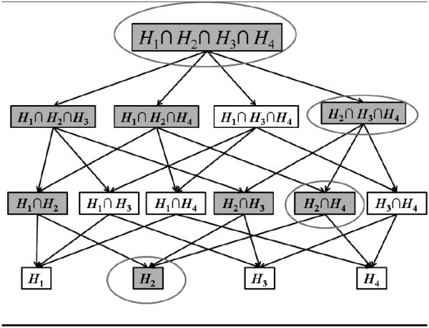
Closed Testing Principle (2)

Slide 11

Adjusted p-values
Example
  two hypotheses $H_{1}$ and $H_{2}$
  FWER controlled at .05 $α$ level
  Bonferroni adjustment with equal split of $α$
  One way is to compute raw p-values $p_{1}$ for $H_{1}$ and $p_{2}$ for $H_{2}$,
  claim significance if either of the p-values is less than .05/2=.025
  Another way is to
    compute adjusted p-values ${\tilde{p}}_{1}=2p_{1}$,${\tilde{p}}_{2}=2p_{2}$,
    still compare ${\tilde{p}}_{1}$ and ${\tilde{p}}_{2}$with .05
In general, adjusted p-value for any hypothesis is the smallest nominal $α$ level at which that hypothesis would be rejected. In other words, it is inverse of the $α$ spending function.

Slide 12

Multiplicity Adjustment Procedures
For illustration, we begin with 4 p-values ($k=4)$ for testing $H_{1}$ t0 $H_{4}$
$p_{1}=0.01, p_{2}= 0.03, p_{3}= 0.20, p_{4}= 0.52$
The 4 p-values may be obtained from running 4 t-tests on four outcome variables comparing drug vs control
Goal is to know whether any of the 4 p-values are significant at FWER .05 level
Many MAPs are developed
  Single Step: Bonferroni, Sidak, Simes
  Stepwise: Holm, Hormel, Hochberg
  Prespecified ordering: fixed sequence, gatekeeping, fallback
  Chain

Slide 13

Bonferroni Procedure
Single-step, nonparametric (works for any joint distribution of p-values), strongly control FWER
Reject $H_{i}$ if $p_{i}<\frac{α}{k}$
Adjust p-values ${\tilde{p}}_{i}=kp_{i}$ if $kp_{i}<1;$ $=1,$ otherwise.
For our example, ${\tilde{p}}_{1}=0.04, {\tilde{p}}_{2}= 0.12, {\tilde{p}}_{3}= 0.80, {\tilde{p}}_{4}=1.00$

Slide 14

Sidak Procedure
Single-step, Semiparametric (if the $k$ test statistics are either independent, or follow a multivariate normal distribution, or follow a multivariate t distribution).
Adjust p-values ${\tilde{p}}_{i}=1−{\left(1−p_{i}\right)}^{k}$
For our example, ${\tilde{p}}_{1}=0.04, {\tilde{p}}_{2}= 0.11, {\tilde{p}}_{3}= 0.59, {\tilde{p}}_{4}=0.95$
Sidak is more powerful than Bonferroni
Both Bonferroni and Sidak are very conservative (produce larger adjusted p-values than other procedures)

Slide 15

Simes Procedure
Single-step, Semiparametric (if the $k$ test statistics are either independent, or follow a multivariate normal distribution with non-negative correlations).
Can only be used to test the global null hypothesis $H_{1}∩H_{2}∩…∩H_{k}$
Simes procedure
  Let $p_{(1)}≤p_{\left(2\right)}≤…≤p_{\left(k\right)}$ be ordered p-values
  Reject global null if $p_{(i)}≤iα/k$ for at least one $i$
Adjusted p-value: $\tilde{p}=k\min{(\frac{p_{(1)}}{1},\frac{p_{(2)}}{2},…,\frac{p_{(k)}}{k})}$

Slide 16

Bonferroni-Holm (Holm) Procedure
Step-down, nonparametric, based on Bonferroni
Let $p_{(1)}≤p_{\left(2\right)}≤…≤p_{\left(k\right)}$ be ordered p-values and $H_{(1)},H_{(2)},…,H_{(k)}$ be the corresponding hypotheses.
Step 1. Compare $p_{(1)}$ with $α/k$. If larger, stop and accept all hypotheses; otherwise, reject $H_{(1)}$ and proceed.
Step 2. Compare $p_{(2)}$ with $α/(k−1)$. If larger, stop and accept $H_{(2)},…,H_{(k)}$; otherwise, reject $H_{(2)}$ and proceed.
…
Step k. Compare $p_{(k)}$ with $α$. If larger, stop and accept $H_{(k)}$; otherwise, reject $H_{(k)}$
Adjusted p-value: ${\tilde{p}}_{(i)}=min⁡(1,\max_{j≤i}{[\left(k−j+1\right)p_{(j)}]}$
SAS output labels this as Stepdown Bonferroni

Slide 17

Simes-Hormel (Hormel) Procedure
Step-up, semiparametric (same assumption as the Simes)
Let $p_{(1)}≤p_{\left(2\right)}≤…≤p_{\left(k\right)}$ be ordered p-values and $H_{(1)},H_{(2)},…,H_{(k)}$ be the corresponding hypotheses.
Step 1. If $p_{(k)}>α$, accept $H_{(k)}$ and move to next step. Otherwise, stop and reject all the hypotheses.
Step $i=2,…,k−1$, If $p_{(k−i+j)}>jα/i$ for all $j=1,…i$, accept $H_{(k−i+1)}$ and move to next step. Otherwise, stop and reject all remaining hypotheses.
Step $k$. If $p_{(j)}>jα/k$ for all $j$, or $p_{(1)}>α/(k−1)$, accept $H_{(1)}$. Otherwise, reject $H_{(1)}$.

Slide 18

Hochberg Procedure
Step-up, semiparametric (same assumption as the Hormel)
Hormel’s procedure is hard to explain to investigators.
Hochberg is a simplified Hormel but uniformly less powerful.
Let $p_{(1)}≤p_{\left(2\right)}≤…≤p_{\left(k\right)}$ be ordered p-values and $H_{(1)},H_{(2)},…,H_{(k)}$ be the corresponding hypotheses.
Step 1. If $p_{(k)}>α$, accept $H_{(k)}$ and move to next step. Otherwise, stop and reject all the hypotheses.
Step $i=2,…,k−1$, If $p_{(k−i+1)}>α/i$, accept $H_{(k−i+1)}$ and move to next step. Otherwise, stop and reject all remaining hypotheses.
Step $k$. Reject $H_{(1)}$ if $p_{(1)}≤α/k$ .

Slide 19
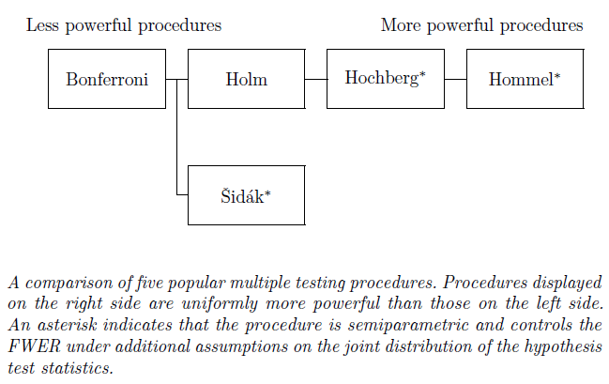
Power Comparison (Dmitrienko)

Slide 20

Fixed-sequence procedure
Suppose that there is a natural ordering among the null hypotheses $H_{1},…,H_{k}$
The order in which the testing is performed is fixed.
This order normally reflects the clinical importance of the multiple analyses.
  Eg, test the primary analysis first, then the most important secondary analysis, etc
Can also be used to test the onset of therapeutic effect of say, Cialis.
Step 1: Reject $H_{1}$ if $p_{1}<.05$ and move to test $H_{2}$. OW, stop and accept all the hypotheses.
Step 2: repeat the process for remaining hypotheses
Adjusted p-values: ${\tilde{p}}_{1}=p_{1}, {\tilde{p}}_{2}=\max\left({\tilde{p}}_{1}, p_{2}\right),$etc
Examples:
  $p_{1}=.06, p_{2}=.02$
  $p_{1}=.04, p_{2}=.02$

Slide 21

Gatekeeping
A slight variation on fixed sequence procedure
Used when there is one test of primary importance ($H_{1})$, and ($k−1)$ other tests of less importance ($H_{2},…H_{k})$.
Step 1: If $p_{1}≥.05$, stop and accept all hypotheses; OW, declare significance for $H_{1}$ and move on to Step 2
Step 2: Test $H_{2},…H_{k}$ at FWER .05 level still.
Benefits:
  No need to adjust the primary test for multiplicity at all
  1 less number of hypotheses for the secondaries
Drawbacks (similar to fixed-sequence):
  If the primary is insignificant, even with $p_{1}=.051,$ then you must give up any significance on ay secondary, even one with $p=.000001$

Slide 22

Fallback Procedure
Similar to fixed sequence and gatekeeping, null hypotheses $H_{1},…,H_{k}$ are ordered.
Allocate the FWER $α=0.05$ to all the null hypotheses using weights $w_{1},…,w_{k}$
The idea is to recycle $α$ if not used by previous testing
Step 1: If $p_{1}<α_{1}=w_{1}α$, reject $H_{1}$; OW, accept $H_{1}$ and move on to next step.
Step 2: Test $H_{2}$ at $α_{2}=w_{2}α$ if $H_{1}$ is accepted, and at $α_{2}=α_{1}+w_{2}α$ if $H_{1}$ is rejected. If $p_{2}<α_{2}$, reject $H_{2}$; OW, accept $H_{2}$and move on to next step.
Repeat until Step $k$
Examples: FWER $α=.05,$ two hypotheses $H_{1}$ and $H_{2}$. $w_{1}=w_{2}=.5$
  $p_{1}=.03, p_{2}=.04$
  $p_{1}=.01, p_{2}=.04$

Slide 23
Chain Procedure
The class of nonparametric procedures known as chain procedures provides an extension of the fixed-sequence and fallback procedures
It pre-assign weights, like fallback procedures.
It supports propagation rules, e.g., after each rejection, the error rate can be transferred simultaneously to several hypotheses.
Example
  A hypertension dose finding clinical trial with Placebo, Low, Medium, and High dose of a study drug.
  Data available from the Phase II trial suggest that the H>M, H>L, but M=L.
  The fixed-sequence and fallback procedures might be suboptimal because there is no clear hierarchical testing order between the L and M doses.
  So, a chain procedure is developed

Slide 24
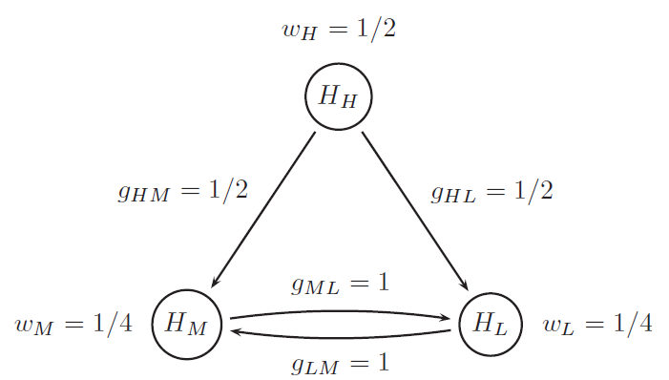

Chain Procedure Example (1)
  Three hypotheses (vs placebo): $H_{H}, H_{M}, H_{L}$
  Initial hypothesis weights: $w_{H}=\frac{1}{2},w_{M}=w_{L}=\frac{1}{4}$. So the initial significance levels for the 3 hypotheses are $\frac{α}{2},\frac{α}{4},\frac{α}{4}$
  Transition parameters $g_{HM}, g_{HL}, g_{ML}, g_{LM}$ determine how $α$ is propagated in case a hypothesis is rejected. The arrows indicate the direction of propagations.
    The error rate released after the rejection of $H_{H}$ is split between $H_{M}$ and $H_{L}$.
    If $H_{M}$ is rejected, all the error rate is transferred to $H_{L}$, vice versa.

Slide 25

Chain Procedure Example (2)
  Assume we observed 3 raw p-values
    $p_{H}=0.017, p_{M}=0.026, p_{L}=0.022$
  Begin with $H_{H}$
    Because $p_{H}<.05/2$, reject $H_{H}$. And its error rate ($.05/2)$ can now be equally split between $H_{M}$ and $H_{L}$
    So, now, the significance level for $H_{M}$ is $.05/4$ (initial assignment) plus $.05/4$ , =.025
    Similarly, the significance level for $H_{L}$ is also .025
  For $H_{M}$,
    Because $p_{M}>.025$, we fail to reject $H_{M}$ (for now) and no further $α$ can be transferred to $H_{L}$
  For $H_{L},$
    Because $p_{L}<.025$, we reject $H_{L}$ and transfer its .025 to $H_{M}$, which now can be tested at $.025+.025=.05$ level (Surprise!)
    Since $p_{M}<.05,$ we reject $H_{M}$ also.
  Conclusion: We rejected all 3 hypotheses while controlling FWER.

