Slide 1
Introduction to CART and Random Forests
Justin D. Dvorak, Ph.D.
March 5th, 2025

Slide 2
Overview
Clinical decision trees
Supervised learning & performance metrics
Classification and regression trees
Validation methods
Random forests

Slide 3
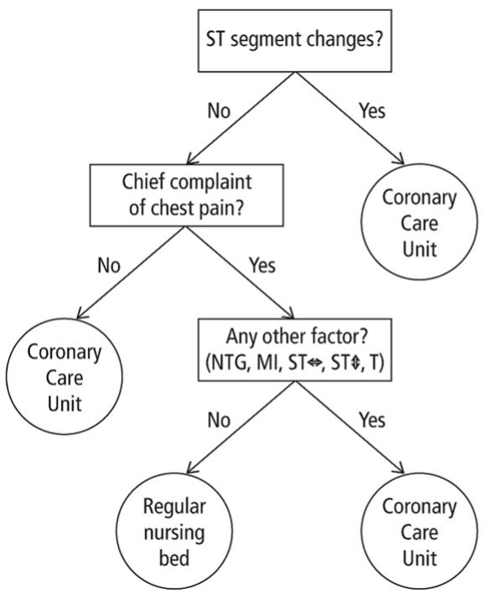
Clinical decision trees
Visual algorithm to support decision-making
Screening
Assignment to risk categories
Differential diagnosis
Testing
Treatment
Tool to identify key decision points among a large number of factors
Example (Green & Mehr,1997)
Decision tree for ER physicians evaluating patients for acute ischemic heart disease

Slide 4
Prediction models
Key unstated assumption of decision trees
Given known information, we can predict unknown information
Example
A physician gathers a patient’s baseline factors (history, signs, symptoms)
These are useful for predicting an outcome (diagnosis, prognosis, treatment)
When is $X$ a useful predictor?
Our prediction is better when we know $X$
Our prediction is worse when we do not know $X$
How do we measure the goodness of …
A prediction (single result)?
A predictor (algorithm)?

Slide 5
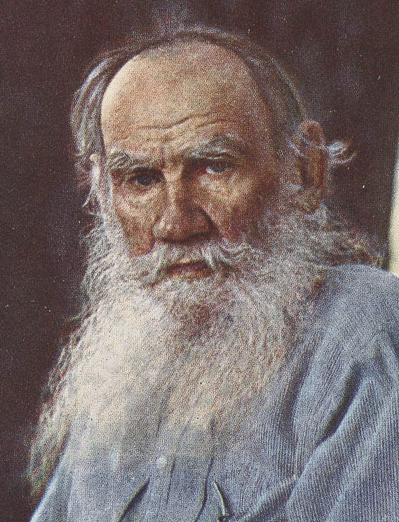
If Leo Tolstoy were a statistician
“All correct predictions are alike; each incorrect prediction is incorrect in its own way.”
Adapted from Anna Karenina (1878)
Incorrectness = error
Direction?
Magnitude?
“Goodness” = minimizing error
Sergei Prokudin-Gorskii (1908)

Slide 6
Error
Difference between predicted value ($\hat{Y}$) and true value ($Y$)
Example: Simple linear regression model
Given a dataset of points $\left(X, Y\right)$
Model equation: $Y=β_{0}+β_{1}X_{1}+ε$
Error $ε$ is known as the “residual”
Regression equation: $\hat{Y}={\hat{β}}_{0}+{\hat{β}}_{1}X_{1}$
In an unbiased predictor, the “mean error” across observations is zero
Examine mean squared error (MSE)
Common “loss function” in AI/ML
See R code Example 1

Slide 7
Error for categorical outcomes
How do we “subtract” two categorical values?
Consider $Y$ as a binary (0/1) variable
Our prediction ($\hat{Y}$) could be an estimated probability of having characteristic $Y$; i.e., $\hat{Y}∈\left(0,1\right)$
Then the error can still be computed as $\hat{Y}−Y$
Example: Logistic regression
See R code Example 2
Can generalize to 3+ categories using indicator variables

Slide 8
Supervised learning
“Supervised”: Outcomes are known
Numeric values
Categories
Binary outcomes (Yes / No)
“Learning”: Determining model parameters
Automated / iterative process
Based on some pre-specified optimization criteria
Minimizing MSE
Minimizing “cost”
Maximizing “benefit”

Slide 9
Common classifier performance metrics
Accuracy
Proportion of patients classified correctly
Sensitivity
Among patients with a characteristic, what proportion are correctly classified as positive?
Specificity
Among patients without a characteristic, what proportion are correctly classified as negative?

Slide 10
Common classifier performance metrics
Positive predictive value (PPV)
Among patients classified as positive, what proportion truly have the characteristic?
Negative predictive value (NPV)
Among patients classified as negative, what proportion truly do not have the characteristic?
Area under the curve (AUC)
Estimation of area under receiver operating characteristic (ROC) curve
Combines model performance across different testing thresholds

Slide 11
Common classifier performance metrics
Dichotomous example: See R code Example 3

Slide 12
Classification & regression trees (CART)
Recursive partitioning of a dataset
Process
Create series of “splits”
Each split partitions the dataset into two or more subsets
Splitting continues recursively until stopping criterion is reached

Slide 13
Tree terminology
A
Trees are directed, acyclic connections of nodes
Directed: Path can be formed from ancestors to descendants
Acyclic: Nodes cannot loop back to themselves
Node = point in the tree
Root: No ancestors
Split: 2+ descendants (internal node)
Leaf: No descendants (terminal node)
B
C
D
E

Slide 14
Classification & regression trees (CART)
Advantages
Can handle many variables
Do not require a prior model specification
Which terms to include?
Interactions?
Can detect non-linear associations
Are directly translatable to clinical workflow
Can generalize to numeric and categorical data

Slide 15
Classification & regression trees (CART)
Disadvantages
Can be susceptible to overfitting
“Memorizing” the training data
Are sensitive to variations in the data
Different sequence of splits
Instability
Less effective than linear regression when modeling truly linear relationships

Slide 16
Classification & regression trees (CART)
Performance can be evaluated with the same metric of MSE
Example: Sepsis death
Based on an example in Fisher & VanBelle (1993)
Original article: Pine et al. (1983)
Outcome: Death
Predictors: Shock, malnutrition, alcoholism, bowel infarction, age
See R code Example 4

Slide 17
Validation methods
Testing a model on the same dataset used to train it yields an overestimate of real-world performance
Idea: Simulate performance on patients with unknown outcome
Some methods
Split into testing vs. training set
Multiple splits (k-fold cross-validation)
Leave-one-out cross-validation (LOOCV)
For each observation, fit model on all others, then predict the withheld outcome
See R code Example 5

Slide 18
Random forests
Heath, Kasif, & Salzberg (1993)
Method
Grow a large number of trees
Classify or predict each observation by each tree
Final prediction is a combination of each tree’s outcome
Categorical: Majority vote
Numeric: Mean / median
Examine “out-of-bag” error (predictions on observations not part of subsampled training sets)
Converges to cross-validation as iterations increase
Bagging introduced by Breiman (2001)

Slide 19
Random forests
Advantages
Addresses overfitting
Improves accuracy
Disadvantages
Difficult to interpret or visualize (e.g., flowchart)
Computational requirements
See R code Example 6

Slide 20
Exercises
Notice that the example script uses repeated code to assess classifier performance. Write a function to create an organized output data frame given a prediction data frame and the variable names for the true and predicted values.
Extend the random forest example to accommodate various methods of cross-validation
Single split
K-fold
LOOCV

Slide 21
References
Breiman L. (2001). Random Forests. Machine Learning, 45(1), 5-32.
Green L, Mehr DR. (1997). What alters physicians’ decisions to admit to the coronary care unit? J Fam Pract, 45(3), 219-226.
Pine RW, Wertz MJ, Lennard ES, Dellinger EP, Carrico CJ, Minshew BH (1983). Determinants of Organ Malfunction Or Death in Patients with Intra-Abdominal Sepsis:– A Discriminant-Analysis. Archives of Surgery, 118, 242-249.
Heath D, Kasif S, Salzberg S. (1993). k-DT: A multi-tree learning method. Proceedings of the Second Intl. Workshop on Multistrategy Learning, 138-149.

