Slide 1
Difference-in-Difference & Event Study Models
Ganisher Davlyatov, PhD
Claudia Rhoades, PhD

Slide 2
Agenda
Introduction (5 minutes)
Why should you care about casual inference? (5 minutes)
Overview of Difference-in-Difference Models (20 minutes)
Overview of Event Study Models (20 minutes)
Demonstration in Stata & R (30 minutes)
Discussion and Q&A (15 minutes)

Slide 3
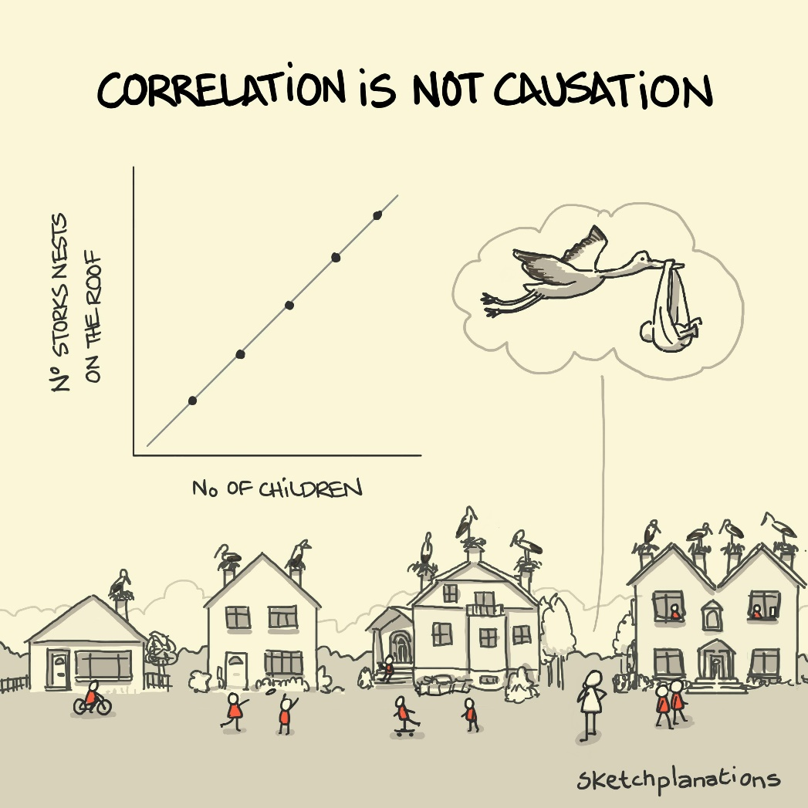
Why should you care about casual inference?
Randomized Clinical Trials (RCT) are ideal, yet often unattainable
  Randomization
  Cost
  Time
There are quasi-experimental methods to help estimate intervention effects in non-experimental settings

Slide 4
Cases
Evaluating the impact of Medicaid expansion on healthcare access by comparing changes in outcomes between expansion and non-expansion states
Assessing the effect of anti-smoking laws on smoking rates by comparing regions with and without the intervention over time
Analyzing the impact of a vaccination mandate on disease incidence by comparing trends in areas with and without the mandate
Etc.

Slide 5
Difference-in-Difference (DiD) Models
Concepts
Goal: Estimate the causal impact of an intervention (like a policy or program) using observational data.
Core Idea: Compare the change in outcomes over time in a group that received the intervention (Treatment Group) to the change in outcomes in a similar group that did not receive the intervention (Control Group).
Setup: Requires data from at least two groups (Treatment, Control) and at least two time periods (Before intervention, After intervention).
Intuition
Controls for time trends
Controls for stable group differences
Estimates the counterfactual
Critical assumption – parallel trends
Notes:
Controls for Time Trends: The change in the Control group captures trends or external factors that would have affected both groups over time anyway (e.g., economic changes, seasonal effects). Subtracting this isolates the change specific to the treatment group beyond the general trend.
Controls for Stable Group Differences: By focusing on changes within groups, DiD automatically accounts for pre-existing differences between the Treatment and Control groups that are constant over time (e.g., if the treatment group always had higher outcomes).
Estimating the Counterfactual: DiD uses the Control group's trend to estimate what would have happened to the Treatment group if they hadn't received the intervention. The DiD estimate is the difference between what actually happened and this estimated counterfactual.
The validity of DiD hinges on the assumption that, in the absence of the intervention, the outcome trend in the Treatment group would have been parallel to the outcome trend in the Control group.

Slide 6
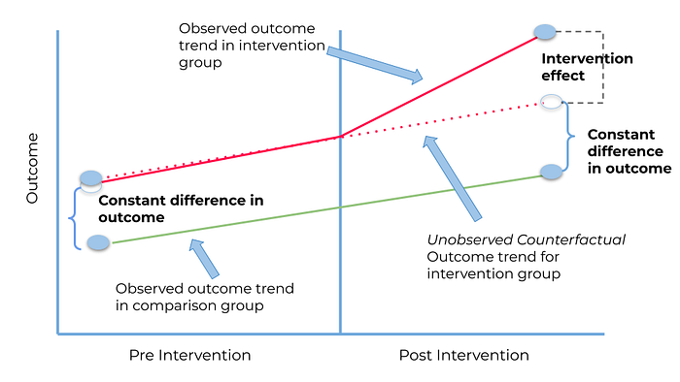
DiD
Notes:
How it Works (The Two Differences):
First Difference (Within-Group Change): Calculate the change in the average outcome from the Before period to the After period for the Treatment group. Do the same for the Control group.
Second Difference (Between-Group Comparison of Changes): Subtract the Control group's change from the Treatment group's change.
This final result is the DiD estimate.

Slide 7
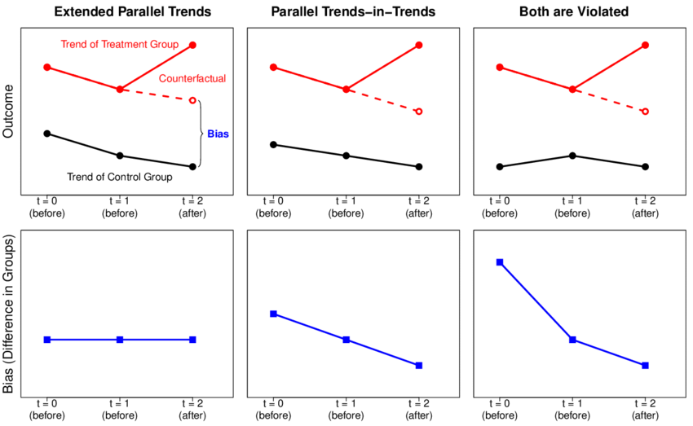
Parallel trends assumption in DiD
For DiD to work, the treatment and control groups should have followed similar trends before the intervention.
Test for parallel trends assumptions

Slide 8
DiD assumptions (cont.)
2. No simultaneous confounding events
- No other changes affect only the treated group during the study period
- Use fixed effects or covariates to account for these events
3. No spillover effects
- Treatment of one group does not influence the control group
- Units must be independent with respect to the intervention
4. Consistent group composition
- The composition of treatment and control groups remains stable over time
- No selective attrition or migration between groups
5. Correct model specification
- Include fixed effects for time and unit
- Properly model standard errors (e.g., cluster at the unit level)

Slide 9
DiD key concepts
8
3
 | Pre | Post | Difference
Treatment | 32 | 40 | 40 – 32 = 8
Control | 25 | 30 | 30 – 25 = 5
Difference |  |  | 8 – 5 = 3
5
DiD estimate = (Treatment_post - Treatment_pre) - (Control_post - Control_pre)

Slide 10
DiD statistical model
D
B₃
Coef. | Calculation | Interpretation
B₀ | A | Baseline average
B₁ | C - A | Time trend in control group
B₂ | B - A | Difference between groups pre-intervention
B₃ | (D–B)-(C-A) | Difference in changes over time
B
C
B₂
A
B₁
DiD equation: Outcome = β₀ + β₁*[Time] + β₂*[Intervention] + β₃*[Time*Intervention] + β₄*[Covariates]+ε

Slide 11
DiD data files
Subject | Outcome | Treatment | Time | Treatment x Time
1 | 50 | 1 (intervention) | 0 (pre) | 0
1 | 65 | 1 | 1 (post) | 1
2 | 36 | 1 | 0 | 0
2 | 42 | 1 | 1 | 1
3 | 55 | 0 (control) | 0 | 0
3 | 68 | 0 | 1 | 0
4 | 36 | 0 | 0 | 0
4 | 45 | 0 | 1 | 0
Treatment: 0 = units that were never treated (e.g., states that never passed a policy of interest); 1 = units that were treated (states that passed a policy of interest)
Time: 0 = time before the event happens; 1 = time when the event happens and after

Slide 12
Using OLS
xtset subject time
 | Pre | Post
Control | 40.33 | 42.67
Treatment | 43 | 51.5
Counterfactual | 43 | 45.34

Slide 13
Stata didregress command
didregress (Outcome_variable control_variables) (Treatment x Time), group(Unit identifier) time(Time_variable)
Use xtdidregress if panel data. Use didregress if repeated cross-sectional data (i.e. surveys over time)

Slide 14
What if you only have two data points?
To check for parallel trends assumption, you need several data points before the event.
To mitigate the issue if you only have pre- and post-intervention data, you can use covariate balancing (e.g., propensity score weighting/matching) where you weight your control group to resemble the treatment group at baseline on observable characteristics and run DiD with those weights.
Alternatively, try Difference-in-Difference-in-Difference (DDD)

Slide 15
What if?
We want to know the what happens to an outcome of interest before, during, and after an event?
The treatment groups are treated at different time periods
Potential solutions:
Staggered DiD
Event Study Models
There are many other methods as well…

Slide 16
What is an Event Study Model?
An event study model is a statistical method used to estimate dynamic causal effects of an intervention (event) at different time points before and after the intervention.
Concepts
Event window: Includes periods before, during, and after the event.
Core Idea: The goal is to estimate how the outcome of interest deviates from what would have happened in the absence of the event.
Lead-lag structure: The leads capture how the outcome evolved before the event. The lags measure the impact after the event.

Slide 17
Event Study Models
Uses:
Policy evaluations
Labor market outcomes
Health interventions
Stock market analysis
Educational reforms
Climate policy
Litigation and regulation
Etc.
E.g., hospital introduces a new protocol to reduce patient readmissions
Event study shows us if readmissions were already trending downward before the policy change, whether there was an immediate drop when the policy kicked in, or if the effects took months to materialize.
Notes:
Controls for Time Trends: The change in the Control group captures trends or external factors that would have affected both groups over time anyway (e.g., economic changes, seasonal effects). Subtracting this isolates the change specific to the treatment group beyond the general trend.
Controls for Stable Group Differences: By focusing on changes within groups, DiD automatically accounts for pre-existing differences between the Treatment and Control groups that are constant over time (e.g., if the treatment group always had higher outcomes).
Estimating the Counterfactual: DiD uses the Control group's trend to estimate what would have happened to the Treatment group if they hadn't received the intervention. The DiD estimate is the difference between what actually happened and this estimated counterfactual.
The validity of DiD hinges on the assumption that, in the absence of the intervention, the outcome trend in the Treatment group would have been parallel to the outcome trend in the Control group.

Slide 18
Event Study Models vs. DiD Models
Similar to DiD, but takes a step further.
Event studies are a generalized extension of “difference-in-differences” designs.
Allow for dynamic leads and lags to the event of interest to be estimated.
DiD estimates the average effect of an intervention over time whereas event studies allow for a more detailed examination of effects across multiple time points.
While DiD assumes a constant treatment effect, Event Study Models allows effect heterogeneity.

Slide 19
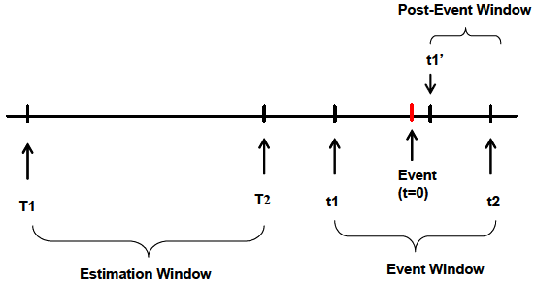
Event Study Models
Notes:
How it Works (The Two Differences):
First Difference (Within-Group Change): Calculate the change in the average outcome from the Before period to the After period for the Treatment group. Do the same for the Control group.
Second Difference (Between-Group Comparison of Changes): Subtract the Control group's change from the Treatment group's change.
This final result is the DiD estimate.

Slide 20
Estimation
$$y_{gt}=α+\sum_{j=2}^{J}{β_{j}{(Lead j)}_{gt}+}\sum_{k=1}^{K}{γ_{k}{(Lag k)}_{gt}+ μ_{g}+λ_{t}}+{X′}_{gt}Γ+ε_{gt}$$
where
$μ_{g}$ = Group fixed effects.
$λ_{t}$ = Time fixed effects.
${X′}_{gt}Γ$ = Time-varying controls.
$ε_{gt}$ = Unobserved error term.

Slide 21
Estimation
$$y_{gt}=α+\sum_{j=2}^{J}{β_{j}{(Lead j)}_{gt}+}\sum_{k=1}^{K}{γ_{k}{(Lag k)}_{gt}+ μ_{g}+λ_{t}}+{X′}_{gt}Γ+ε_{gt}$$
Leads and lags to the event of interest are defined as follows:
$${(Lead J)}_{gt} =(t≤{Event}_{g}−J)$$
${(Lead j)}_{gt} =(t={Event}_{g}−j)$ for $j ∈\{1,…,J−1\}$
${(Lag k)}_{gt} =(t={Event}_{g}+k)$ for $k ∈\{1,…,K−1\}$
$${(Lag K)}_{gt} =(t≤{Event}_{g}+K)$$

Slide 22
Estimation
$J$ and $K$ leads and lags are included.
Final leads and lags “accumulate” leads or lags beyond $J$ and $K$ periods.
Leads and lags are binary variables indicating that the given group was a given number of periods away from the event of interest in the respective time period.
A single lead or lag variable is omitted to capture the baseline difference between groups where the event does and does not occur.
As a standard, this baseline omitted case is the first lead (one period prior to the event), where $j=1$.

Slide 23
Estimation
Event study models are estimated on data that have a panel structure. It is conventional to add two sets of fixed effects.
Groups in which the event never occurs act as pure controls.
These units have 0s in all lead and lag terms and act as the counterfactual on which the estimation of impacts is based.
Unbiased estimation of post-event treatment effects relies fundamentally on the parallel trends assumption.
In the absence of treatment, it is assumed that treated and control groups would have maintained similar differences as in the baseline period.

Slide 24
Estimation
Unit and time fixed effects serve the role of controlling for confounding variables that vary at the group or time level.
Using these two-way fixed effects approach helps to isolate the effect of the event.
The outcome may also be influenced by other underlying factors. Thus, some event studies add other control variables.
It is important to add control variables carefully: can't include anything collinear with time/group FEs.
In the panel data used by event studies, units may have an event (basic model), or more than one event.

Slide 25
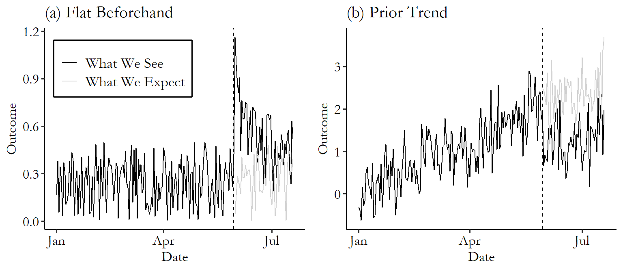
Estimation

Slide 26
Estimation
Estimation of event specification provides two key pieces of information not observable in DiD single coefficient models.
The full set of event leads allows for the inspection of parallel trends in the pre-treatment period.
The lags allow for inspection of the temporal nature of treatment effects, noting any dynamics in the appearance of effects (i.e. increasing or decreasing effects over time, or whether the effects are transitory or permanent).

Slide 27
Assumptions in Event Study Models
1. Parallel Trends (Before the Event)
- Treated and control groups follow similar trends pre-event.
- Lead coefficients are flat and statistically insignificant.
2. No Anticipation (Unless modeled)
- No changes in behavior before the intervention.
- Anticipatory effects modeled if present.
3. No Confounding Events at the Same Time
- No overlapping policies or shocks during the event window.
- Use time-varying controls or fixed effects to isolate impact.

Slide 28
Assumptions in Event Study Models
4. Correct Model Specification
- Time is coded relative to the event (e.g., -3, -2, -1, 0, +1…).
- Reference period clearly chosen (typically t = -1).
5. SUTVA (No Interference or Spillovers)
- Treatment is well-defined and uniform across units.
- No spillover effects between treated and control units.
6. Sufficient Data Across Event Time
- Enough observations in each time bin (leads and lags).
- Precision acceptable in long-term estimates.

Slide 29
Inference
A standard concern where outcomes are followed over time is related to potential serial-correlation in the outcome variable over time.
It is fundamental to account for this within-cluster correlation when conducting inference.
The standard solution is to allow for within-cluster auto-correlation by using a cluster-robust variance-covariance estimator (CRVE) to estimate standard errors and Cis on regression parameters.
However, standard CRVE are only asymptotically valid, where the asymptotic behavior depends on the number of clusters or groups.

Slide 30
Graphical summary of the results
Visual: Timeline showing pre- and post-event periods relative to treatment.
One of its most appealing features is that it creates a built-in graphical summary of the results.

Slide 31
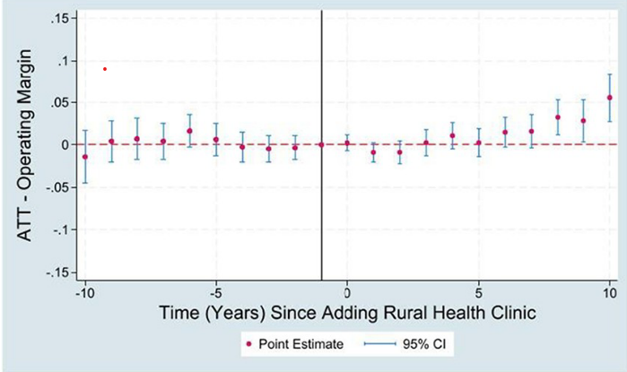
Graphical summary of the results
Notes:
Added Service Line Average Treatment Effects on Rural Hospitals’ Operating Margins

Slide 32
Event Study Models Summary
✅ Event studies are a generalization of DiD.
✅ Key tool for understanding dynamic policy effects.
✅ Must check assumptions (esp. pre-trends).
✅ Powerful with staggered treatment designs.

Slide 33
Q&A
When should we use event studies in our work?
Any projects that could benefit from this?

